Slide 2
Department of Applied Social Studies (DAPPSS)
The Department of Applied Social Studies (DAPPSS) was established in 1981 and is the longest established provider of professional education and training in community work and youth work in the country.
Our mission is:
"To promote human rights, social justice and equality, nationally and internationally, through excellence and innovation in education, research and public engagement that contribute to the development of the social professions and applied social sciences"

Slide 3
Overview of Degree programme

Slide 4
BSocSc Community and Youth Work
Three-year full-time Degree.
Four-year part-time Degree.
A dual-endorsed, professionally recognised qualification. (AIEB/NSETS)
Full days on campus Tuesday to Thursday
Other days reserved for organisation visits, research, group work and study.

Slide 5
Programme
Underpinned by equality and human rights focus.
Focused on engaging you as an active participant in your own learning.
Small, experiential group learning and use of creative methods are a central part of the programme.
Lecturers and staff are active participants in the wider community and youth sectors through research, being board members, external examiners and activists!
Comparative study visits – e.g. Belfast and Inis Oírr.

Slide 6
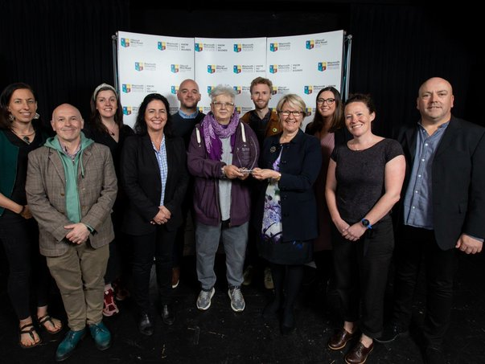
Maynooth University
Team Teaching Award – CYW Team
Summer 2023

Slide 7
Flavour of Modules
An integrated and progressive programme:
Community Work Principles and Processes.
Youth Work Principles and Processes.
Youth & Community Arts.
Group Work.
Equality Studies.
Sociology.
Comparative & International Studies.

Slide 8
Fieldwork Practice Placement
14-week full-time fieldwork practice placement in each year.
Supervised block fieldwork placements are integral to the programme.
Placements in community work and in youth work settings.
Organised by the Department, network of suitably qualified supervisors all over Ireland and internationally.
Opportunity to travel for fieldwork practice placement.

Slide 9
Progression & Career Prospects
Employment
Professional employment in Youth Work and Community Work and related areas
Sound foundation for positions which require social awareness, analytical skills, ability to plan and organise etc.
‘Equality practitioners’
DAPPSS CYW students are highly thought of!
Academic
Masters in Social Science – Rights and Social Policy
Masters in Social Science – Social Work
Professional Doctorate in Social Science
- structured doctoral programme

Slide 10
Employment Examples
Youth worker with Youth Work Ireland or Foróige in the midlands.
Community worker in a Local Development Company in Kildare/South Dublin/Longford etc.
Migrant support worker in a local or national organisation.
Youth diversion worker in an inner-city project.
Men’s health worker in a national Traveller organisation.
Youth worker in a national LGBT organisation.
Working in the areas of gender equality, mental health, adventure sports, disability advocacy, developing life skills – and more!
Always working in solidarity with those affected by human rights denial, poverty and inequality.

Slide 11
Choose this degree if you are interested in:
Professional education and training that engages you as an active participant.
Working in solidarity with those affected by human rights denial, poverty and inequality.
Community work - facilitating the active participation of communities in addressing issues that affect them collectively e.g. Travellers, migrants, areas of disadvantage etc.
Youth work – ‘non-formal education’, supporting young people to reach their potential and develop their understanding of societal issues e.g. LGBT issues, sexual health, social justice.

Slide 12
Part-time in-service degree

Slide 13
Part-time in-service Degree
Four-year Degree.
‘In-service’ means those already working as a Community Worker or Youth Worker and with employer support to participate.
Applications open until the summer via www.pac.ie Course code MUB11.
Not eligible for SUSI currently.
Two external seven-week fieldwork placements and two internal practice projects.

Slide 14
We welcome applications from a variety of backgrounds.
We believe that those who experience community work or youth work in their lives should be the ones who work in the sector.
We actively work to increase diversity within our programmes.

Slide 15
Overview of recruitment process

Slide 16
Application Process: full-time
Restricted Entry programme – don’t use CAO points.
Strict closing date on CAO of 1st February 2024. Course code MH116.
Stages:
Personal Statement
Two written references from work or voluntary experience
Written test on campus
Individual & group interview
All eligible candidates must satisfactorily complete a Garda Vetting process.
50% places are reserved for mature applicants.

Slide 17
Matriculation
Offers are made subject to matriculation & based on selection process:
Leaving Certificate:
6 subjects. 2 H5 and 4 O6 or H7
Must include English, Irish & 3rd language
QQI Level 5 (Five Distinctions)
Mature Students –
23 years on 1st January 2024 for full-time applicants
21 years on 1st January 2024 for part-time applicants

Slide 18
Key messages

Slide 19
Key messages
We want to make sure you are a good fit for us and also we are a good fit for you!
There are lots of supports available in Maynooth University – Disability Office, Writing Centre, Access office, Student Budgeting Service. We have worked with students from many backgrounds, but…
1. This is a Level 8 academic Degree
2. This is a professional qualification.
Are you ready for both?

Slide 20
Key messages
It doesn’t matter if someone else thinks this is the course for you!
You need to show us. Prepare for your interview.
Prepare:
Look up the MU website, see what modules are covered
Talk to people who have done the programme
Look up key websites (see further info slide):
Know what you are applying for and ‘why’.

Slide 21
Key messages
It’s ok if this is the start of your journey to being a Community Worker or Youth Worker.
You might have plenty of experience in a paid or volunteer capacity. You might not.
We also look at a person’s potential. What do you feel passionate about? What changes would you like to see in society or the world?

Slide 22
Thank you!
Today was a short introduction to community work and youth work:
What they are.
Why they are important.
The importance of social justice, not just in college but in all of our lives.
A life-changing and transformative programme that gives many skills to make you employment ready.

Slide 23
Questions and Answers

Slide 24
Further enquiries/information
E: cywrecruitment@mu.ie
MH116 BCYW Full-time: https://bit.ly/3Oa2OJX
MH802 BCYW Part-time: https://bit.ly/3Ol3NXz
Community Work Ireland: www.cwi.ie
National Youth Council of Ireland: www.youth.ie
Undergrad fees 2023-2024: https://bit.ly/4biIGPx

Slide 25
Further enquiries/information
E: cywrecruitment@mu.ie
MH116 BCYW Full-time: https://www.maynoothuniversity.ie/study-maynooth/undergraduate-studies/courses/bachelor-social-science-community-and-youth-work-full-time

