Slide 1
Pre-departure orientation 2020

Slide 2
welcome
This presentation will cover all the main things you need to be aware of before your year abroad.
Please make sure to read it fully.
Please read through it again and familiarize yourself with everything.

Slide 3
WHAT TO THINK ABOUT BEFORE LEAVing
Health
Academics
Culture shocks
Expectations
Tips

Slide 4
Health – while abroad
If you take any medication, be sure to speak with your home doctor and make arrangements to have supplies of any prescription medication you may need while abroad.
Ask your host university about health services on campus or if a specialist is needed, recommended local doctors.
Download the European Health Insurance card app.
Remember to try keep to your usual routine, looking after yourself both physically and mentally while abroad is important for your overall health.
Remember that MU staff are still a support to you while abroad!

Slide 5
Safety before you go
You must register with
the Department of
Foreign Affairs…



To record your
contact details
■

Slide 6
It will allow them to contact you, and provide assistance, if necessary and possible, in case of…
Natural disaster
Civil unrest
Or if you have a family emergency while you are overseas.
Therefore, the nearest Irish Embassy or Consulate to where you reside is aware of your whereabouts
and can include you in their contingency planning in the event of a crisis or an emergency situation.
https://www.dfa.ie/travel/citizens-registration/

Slide 7
If you are A non-eu citizen
It is your responsibility to adhere to your host country’s visa and residency requirements

Slide 8
Personal safety and responsibilities
Personal Safety | Responsibilities
Be aware of local cultural norms = other cultures may have different definitions of what is appropriate Don't go out alone at night and observe cultural norms related to alcohol Follow the same precautions as you would at home Should any incidents occur, don't hesitate to seek help and contact the relevant supports (your home and host university are points of contact while abroad!) | While abroad you are subject to the local laws and regulations of the host country and university If you are arrested abroad you have the right to request to speak to an Irish Consular Officer You are still subject to the judicial policies of Maynooth University

Slide 9
COVID - 19
Make sure to keep up to date with the situation in your host country.
Make sure you adhere to any and all local laws, which may change frequently.
Make sure to find out what measures have been taken by your host university and follow them to ensure safety of both yourself and others.
Check the website of Ministry of Foreign Affairs in your host country for updates.
Remember the Irish Embassy is a good point of contact if you’re unsure about travelling restrictions, laws, etc.
In other words, be a responsible citizen! ☺

Slide 10
Document and financial safety
Make 2 copies of valuable documents & keep 1 copy with you and store the other in a safe place (separate from the originals)
Remember to notify your bank that you are going away to prevent them blocking your card when they notice foreign withdrawals from your account
If you lose your bank card(s), get in touch with your bank as soon as you can to have them disabled. Make a note of the emergency number your bank provided.
DO NOT KEEP ALL YOUR MONEY IN THE SAME PLACE

Slide 11
Helpful links
AND APPS…
EHIC
Aroundme
Yelp
World Customs
Google Maps
Itranslate
Oovoo
XE Currency
Lonely Planet
Department of Foreign Affairs - dfa.ie
→ The list of embassies and consulates in other countries)
European Youth Portal - europa.eu/youth/en
Numbeo - numbeo.com/cost-of-living/
Online Linguistic Support - https://erasmusplusols.eu/

Slide 12
Registration & fees
You must complete online registration and pay the relevant fee due to Maynooth University while you are studying abroad
Failure to do so will result in a late penalty fine
Current Fees & Grant details are available at maynoothuniversity.ie/students-fees-grants
If you fail to register with Maynooth University, you will be considered to be a deferred student and your credits earned abroad will not count towards your degree.

Slide 13
Registering your year abroad
After registering you will then receive a confirmation email. If you do not receive the email, you have not completed the registration process!
If you get logged out during the process, you will need to contact Records Office as you won't be able to proceed with the online registration again. The registration has to be done in one go!
You will receive an email to your MU account in August giving you the details of how and when you should register
! Failure to register by the deadline will result in a €100 fine !
1
2
3

Slide 14
Repeat exams
Repeats
It depends on when your host university academic year begins, there may be time for you to take repeats for you year in MU.
The repeat exam results will be published on 11th September 2020.
Appeals
There is no time to appeal the result of a repeat examination.

Slide 15
Academic differences
Educational structures differ by institution. Assessment, class culture and teaching style may not be what you are accustomed to.
Complete your course work by the deadlines:
It is important to maintain your academic performance even while you are abroad.
Be aware that it is common for attendance to be taken for classes abroad. Your attendance may likely make up part of your grade!
Reach out to professors and fellow students if you are having difficulty with a class.

Slide 16
Transcript of records
Make sure you properly register for your courses abroad.
Keep certificates for any extra courses that you attend and send them to intl.outgoing@mu.ie
Be sure to find out the method by which your transcript(s) will be issued to you.
You will receive your official Transcript of Records from Maynooth University in late October 2021.

Slide 17
Students receiving SUSI, Back to Education, County Council/VEC or other grants
You are entitled to receive your grant while abroad.
You may need a letter from the International Office to confirm that the year abroad is a compulsory part of your 4-year International degree.
To apply for a SUSI letter, please click on the link below: → SUSI letter form
IMPORTANT: Please bear in mind that if you are not successful in your year abroad, you will NOT qualify for a grant in your final year at Maynooth University.

Slide 18
It is compulsory to register for 30 ECTS per semester so make sure you are meeting this minimum.
→ Contact your International Coordinator with any ACADEMIC issues. Remember the resources you have at Maynooth are still available to you abroad. List of all international coordinators may be found below: International Coordinators
→ If anything unexpected occurs that will affect your academic performance, inform your International Coordinator as well as the International Office.
If you make ANY changes to your Learning Agreement,
they must be approved by your International Coordinator!

Slide 19
ERASMUS GRANT
All of our Erasmus students are entitled to receive the Erasmus grant BUT you must spend at least 3 months abroad to qualify for the Erasmus grant (mobility allowance). This means, that if you return home early (in less than 3 months), you will not be able to receive any allowance.
There is NO NEED TO APPLY for the Erasmus grant.
International Office must receive relevant paperwork from students before the grant can be paid out. This will be communicated to you clearly via email.
The grant is NOT processed individually for each student. The grants can only be processed when ALL paperwork is in for ALL students.
Please note the grant instalments are not paid out in equal amounts. The first instalment of the grant is the biggest, the second instalment is smaller, and the third instalment is the remainder of your grant. * Students going abroad for one semester only will receive two grant payments.
The amount of your grant is calculated using the dates on your Certificate of Attendance.

Slide 20
Erasmus documents
Learning Agreement
Credit Agreement
Grant Agreement
Risk Assessment Form
Certificate of Attendance (Arrival part)
Grant Receipt x 2
Updated Learning Agreement (if relevant)
Certificate of Attendance (Departure part)
Grant Receipt x 1
EU Survey
Transcript of Records
BEFORE LEAVING
WHILE ABROAD
AFTER ERASMUS

Slide 21
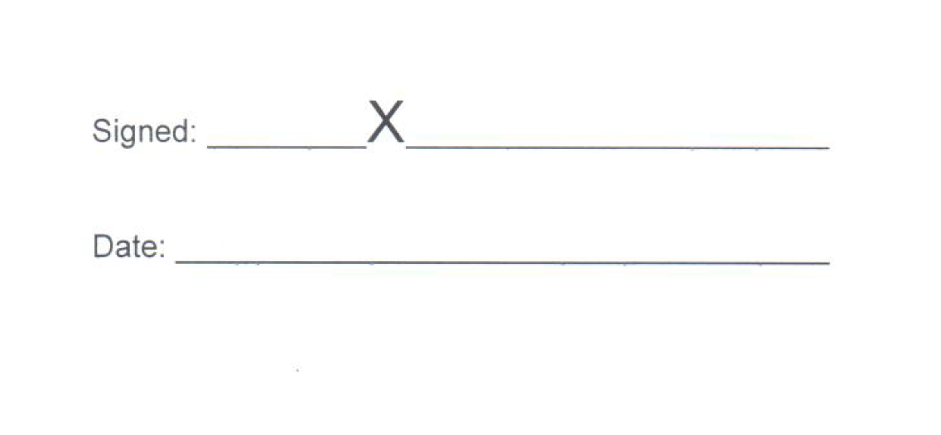
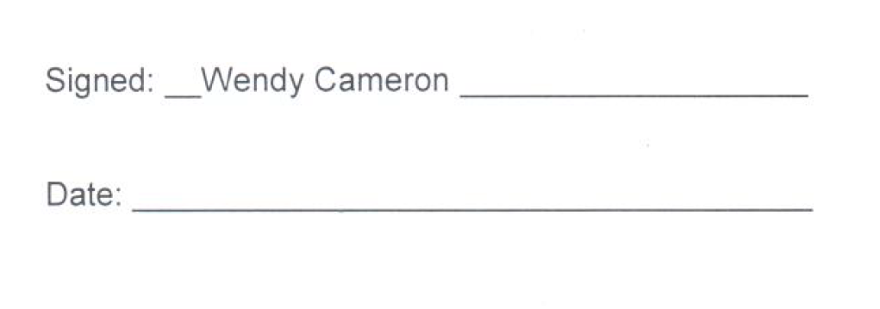
About the grant receipt…
There will be 3 payments:
- Early December 2020
- May 2021
- August 2021
Wendy will issue you with a Grant Receipt after a payment has been made to you.
You will need to sign the Grant Receipt and email it back to Wendy (wendy.cameron@mu.ie)
You can sign it using an electronic signature, but NO TYPED SIGNATURES will be accepted.
Remember, you can only be paid if ALL your paperwork is in order and received within deadlines.

Slide 22
Living situations
It is the student’s responsibility to source accommodation options at the host university.
Make sure to get a WRITTEN CONTRACT for all rental agreements (ask for receipts of payments and keep track of everything.
Yes, it will be different than your current situation but we are sure you will land on your feet!
It is obviously better to live with local and other international students to meet the maximum of people and create contacts all over the world.
Don’t forget that the respect is universal ☺

Slide 23
expectations
Be proud of who you are
Don’t be ashamed of your accent!
Don’t hesitate
to ask
Be realistic in your expectations of your year abroad because
not everything will go smoothly all the time.
Remember it's ok to say NO!

Slide 24
CULTURAL ADJUSTMENT BE PREPARED FOR MORAL UPS AND DOWNS
HONEYMOON
CULTURE
SHOCK
SURFACE
ADJUSTMENT
UNRESOLVED
CONFLICTS
FEELING
AT
HOME
DEPARTURE
CONCERNS

Slide 25
A key TO your future
Link your experience to your degree
Shadow a professional in your chosen field
Look into internships offered through your host university

Slide 26
Hints and tips
PACK LIGHT!
You need less than you think.
Pack clothes that can mix and match.
Leave room for souvenirs.
KNOW BEFORE YOU GO!
Check luggage restrictions with your airline.
BE PREPARED!
Have enough in your carry-on to last a day or two in case of lost luggage.
SAVE YOUR MONEY
Don’t travel every weekend, live like a local, watch the exchanges rates. Don’t keep all of your money in one place.

Slide 27
Budget now
What extra expenses do you anticipate?
Do you have an emergency fund?
Plan for your entire time abroad, including extra money for unexpected expenses.
Plan out a budget for your yourself and stick to it!
Inform yourself in advance of the cost of living in your host country:
How much will a monthly travel pass be?
How much should you expect to pay for rent?
Have you factored in the cost of books, etc.?

Slide 28
Stay in touch
Check your MUMAIL regularly!
Link your MUmail to your personal email so that you don’t miss any important information/deadlines.
Email us at intl.outgoing@mu.ie if you have any questions or concerns.
Follow us on Instagram! Use #muabroad and tag us @maynoothuni_goingabroad
W

Slide 29
ENJOY YOUR EXPERIENCE ☺

