Slide 1
Subject & Module Choice in Second year for Arts Students
Programme Advisory Team

Slide 2
Overview of Session
2nd Year Flexible Pathways
Subject & Module Choice in Year 2
Electives
Opportunities to enhance your degree
Marks & Standards
Where to find more information

Slide 3
Flexible Pathways within Arts
You will decide the structure of your degree (based on your subjects and results from first year).
We let you decide if you would prefer to
specialise in one subject with a little of another - Major
with Minor
just specialise in one if you meet the criteria – Single Major
or two subjects - Double Major

Slide 4
Second Year Pathways within Arts
Single Major – 60 credits of one subject
Subject 1 – 60 credits
Double Major – 30 credits in two subjects
Subject 1 – 30 credits
Subject 2 – 30 credits
Major with minor – 40 credits in one subject; 20 credits in the other
Subject 1 – 40 credits
Subject 2 - 20 credits

Slide 5
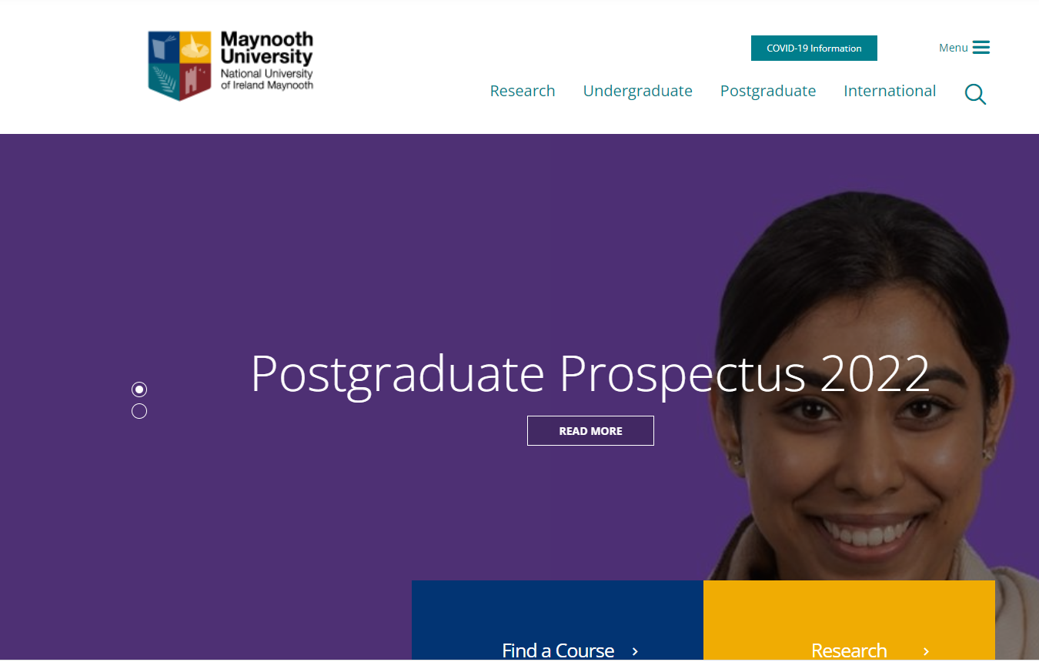
Coursefinder
Choose the For Current Student option from the drop down menu

Slide 6
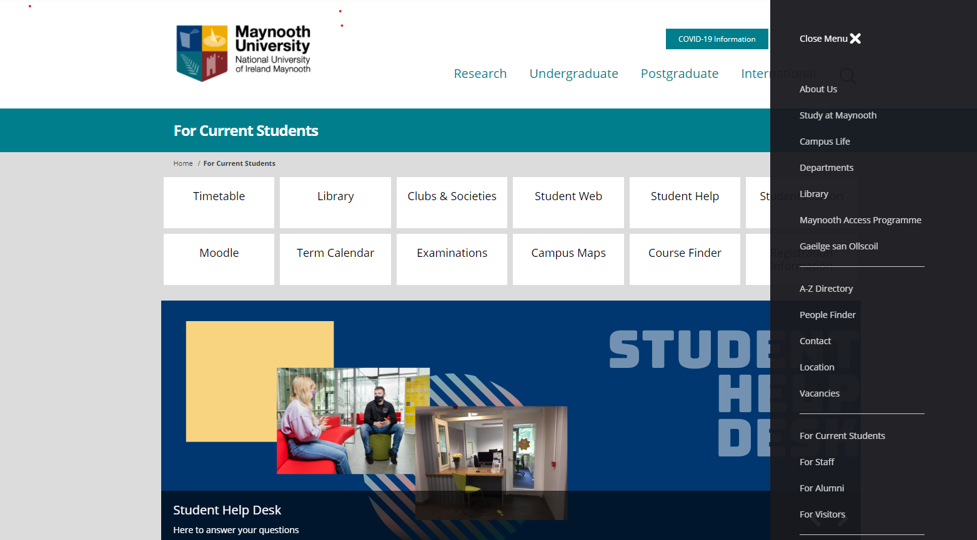
CourseFinder

Slide 7
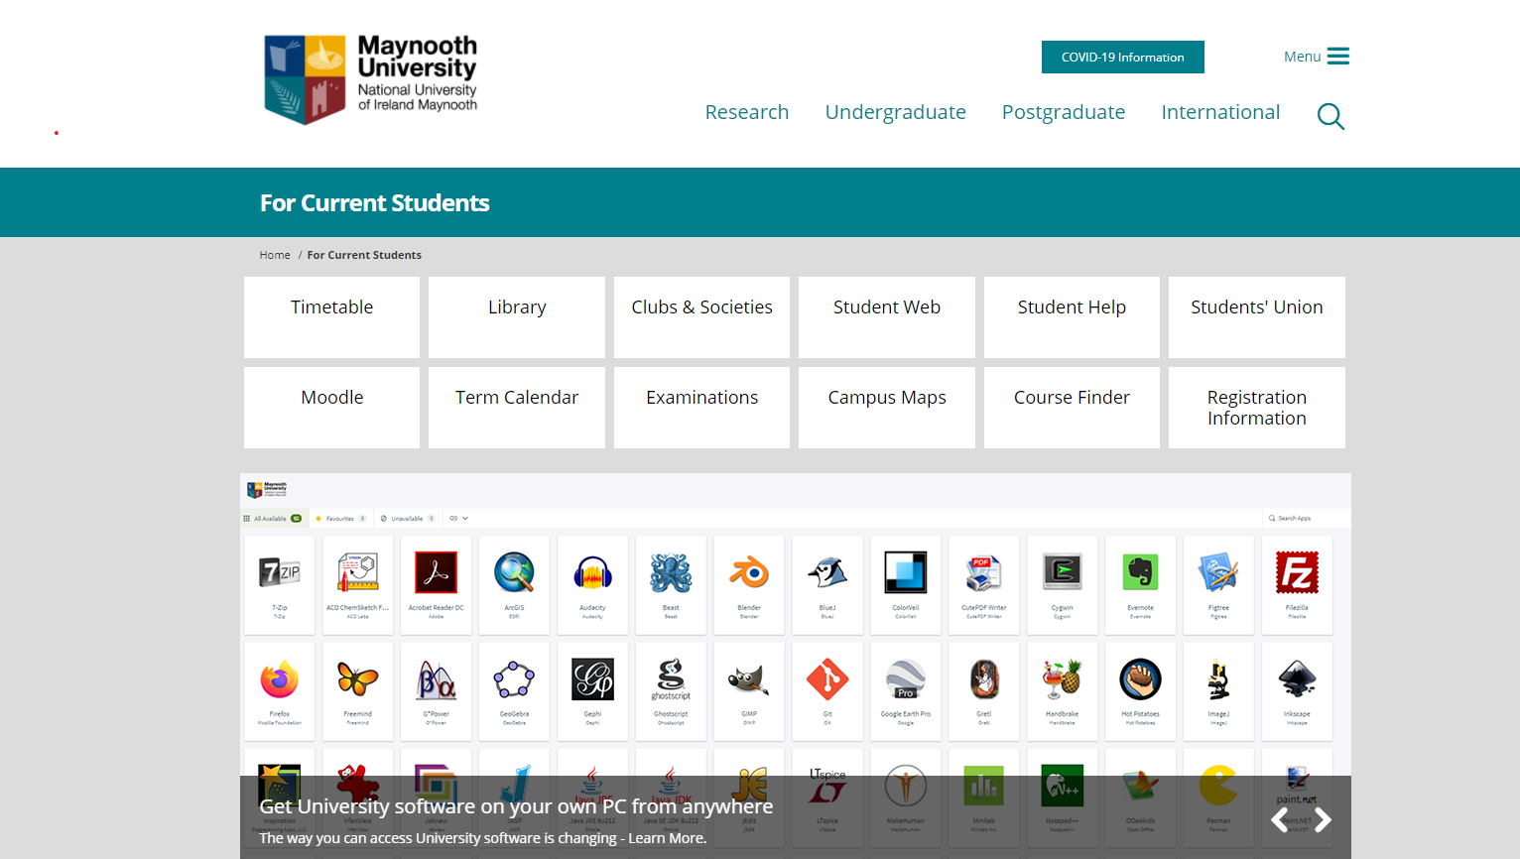
For Current Students

Slide 8
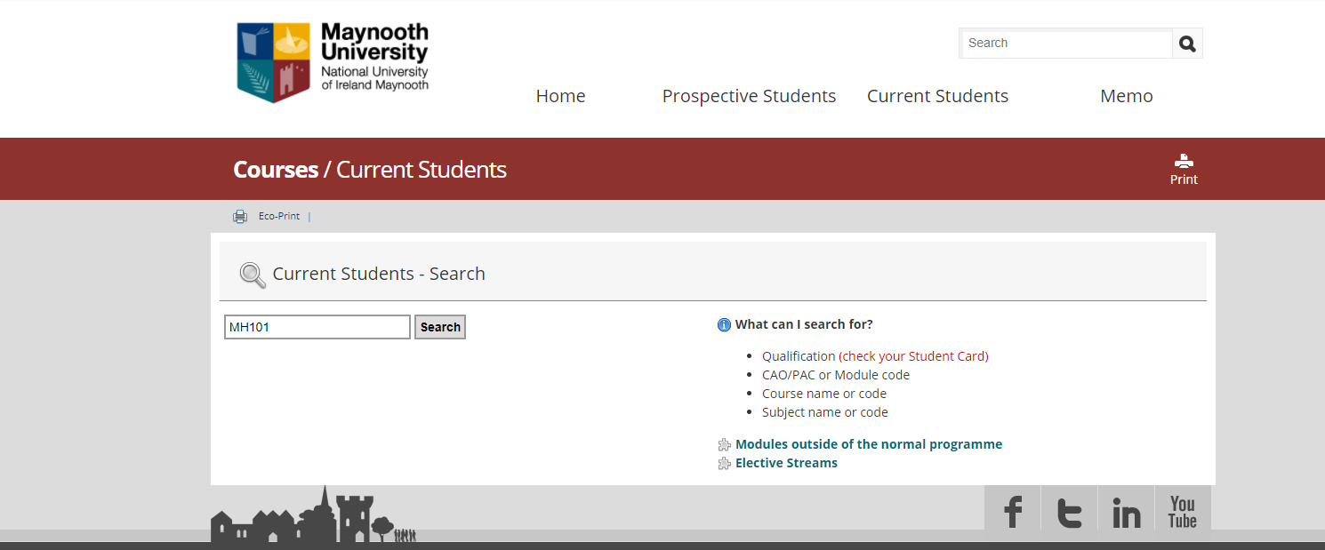
CourseFinder
For information on your pathways, subjects and modules in every year of study
Search by course code or module code

Slide 9
MH101 in Coursefinder

Slide 10
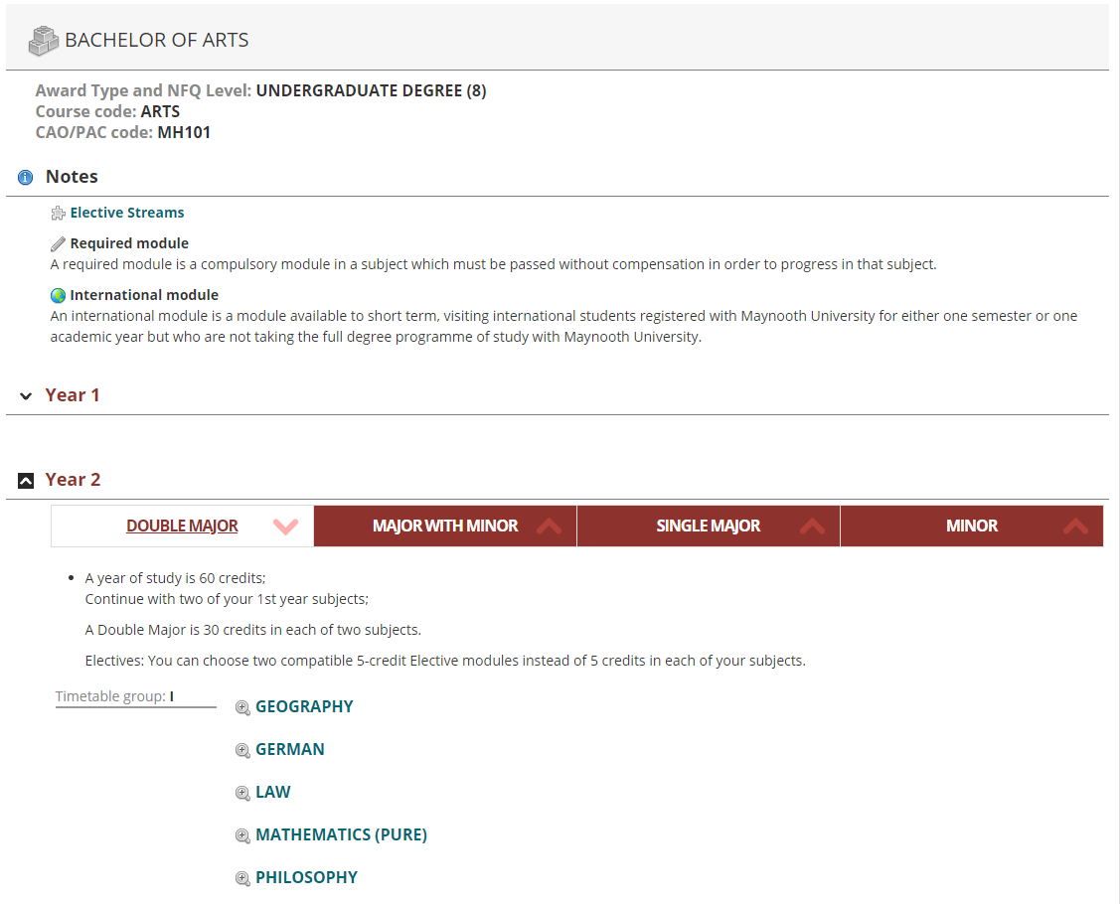
MH101 in CourseFinder

Slide 11
What is an Elective?
Electives allow you to expand your university education by providing the opportunity to study an area outside your chosen degree programme.
An Elective is worth 10 credits : 2 x five credit modules - one five credit module in each semester .

Slide 12
Why take an Elective?
Develop new skills that will compliment your chosen programme (e.g. a language, entrepreneurship, or science communication)
Broaden your perspective: study across disciplines, learn
how to think differently & appreciate different viewpoints
Introduction to the diverse fields of research as well as the excellent lecturing staff throughout the University
To start a new language or keep up a current one
Intrigued by the topic
Programme Advisory Office, Office of the Dean of Teaching & Learning

Slide 13
How an Elective works – MH101
Double Major
Subject 1 25 credits | Elective 10 credits | Subject 2 25 credits
Major with Minor
Subject 1 35 credits | Elective 10 credits | Subject 2 15 credits
Single Major
Subject 1
50 credits
Elective
10 credits

Slide 14
Ts & Cs apply
Registration for all modules are subject to usual timetable viability and requirements in your main subjects
Electives are not available on every programme
Programme Advisory Office, Office of the Dean of Teaching & Learning

Slide 15
Electives on offer this year
Many students have the opportunity to take an Elective in Year 2
Some of the Electives this year include:
Accounting in Society
Beginners Chinese & German (NEW!)
Continuing French/Spanish/German/Gaeilge/Chinese
Film and Screen Studies
Gender and Sexuality in Society and Culture
Good and Evil
Engaging with civil society
Skills for Success (exceptions apply)
You should check Course Finder in mid July when it is updated for the academic year 22/23

Slide 16
Exception to the Rule… Skills for Success
Professional Development and Employability Skills module
5 credits in either semester one or semester two
Practice and develop a range of employability skills: teamwork, communication, leadership, creative problem solving, self awareness and more
Continuous Assessment: Simulated Recruitment Process with job application, interview and E-portfolio
Programme Advisory Office, Office of the Dean of Teaching and Learning

Slide 17
Transfer from Arts
into 2nd year of another programme

Slide 18
Specific Transfer Criteria
Subject | Year 2 Option | Progression Requirement
Business | Progress into Year 2 of MH404 Bachelor of Business Studies | Pass double Business (30 credits) or single Business subject (15 credits) + Economics + Accounting *Pass is 40% or more in each module
English | Single major | Average mark of ≥50+ in English in first year.
Geography | Single major | Average mark of ≥40+ in Geography in first year.
History | Single major | Average mark of ≥50% in History in first year.
Law | LLB Single major; ( this is a 4 year degree) BCL Major [Law, 40 credits & Arts subject, 20 credits] | Students who successfully pass 15 credits of Law in 1st year have following transfer options: -LLB Single major -BCL Major
 | BCL Double Major | Must have passed 30 credits of Law to choose this option
 | BCL Law & Accounting | BCL Law & Accounting must have 60% or more in Accounting (30 credits ) and have passed 30 credits of Law
 | BCL Law & Business | BCL Law & Business (must have passed 30 credits of Law and 30 credits of Business)
 | BCL Law & Criminology | BCL Law & Criminology (must have passed 30 credits of Law and a pass in Criminology)

Slide 19
Specific Transfer Criteria (continued)
Subject | Year 2 Option | Progression Requirement
Accounting (Must have passed 30 credits of Accounting to transfer to these degrees) | MH403: Accounting & Finance MH407: Business & Accounting MH502: Law & Accounting | MH403: 60% in Accounting and 40% in Economics MH407: 60% in Accounting and 40% in Business (15 credits of Business) MH502: 60% in Accounting and 40% in Law (30 credits in each subject) *All of the above require AC160
Economics / Finance Other options available also see page 17 of the MH101 Guide for First Year Students | MH401 Finance MH401 International Finance & Economics | 50% in Economics/Finance & pass in Accounting (either the 15 or 30 credits of Accounting) 50% in Economics/Finance & pass in Maths
There is no transfer option from Arts to 2nd year of the following programmes:
BA or BSc Psychology
Primary School Teaching
Programme Advisory Office, Office of the Dean of Teaching & Learning

Slide 20
22.5 credits does not make a Double
The difference between a double subject and 22.5 credits in a subject
Subject Credits | Semester 1 | Semester 2 | Total
Double subject | 15 credits | 15 credits | 30 credits
Single subject & additional module in 2nd semester | 7.5 credits | 7.5 + 7.5 credits | 22.5 credits
In general, students who register for 22.5 credits in a subject have the same progression options as a student who studies 15 credits of the subject.
Programme Advisory, Office of the Dean of Teaching & Learning

Slide 21
Marks & Standards
All years after first year contribute to your final degree result.
Three year degree
Year 2 | 30%
Year 3 | 70%
Four year degree
Year 2 | 10%
Year 3 | 20%
Year 4 | 70%

Slide 22
Any questions about 2nd year
Subject & Module Choice?
Programme Advisory Office, Office of the Dean of Teaching & Learning

Slide 23
Programme Advisory Office Contact Details
HOW TO CONTACT US:
Email: programme.choices@mu.ie
Webpage and query form:
www.maynoothuniversity.ie/programme-advisory-office

