Slide 1

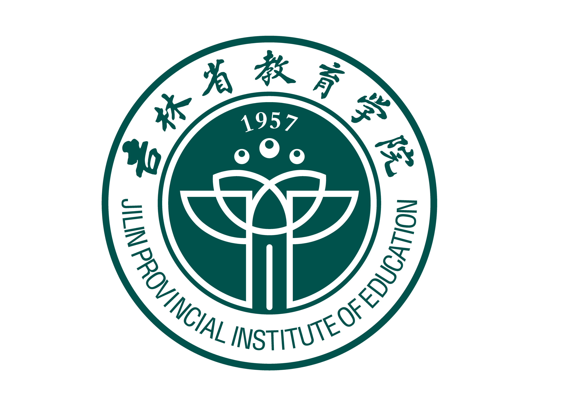
Teaching and Research:
New Concepts and Practices in Basic Education of China
Zhang Yan Pro. Dr. / TR
Jilin Provincial Institute of Education China

Slide 2
1
Portrait of the teaching
and research system
2
Design of teaching
and research system
Content
3
Professional standards for
teaching researchers
4
Practical work of
teaching researchers

Slide 3
1
PART ONE
Portrait of the teaching
and research system

Slide 4

什么是中国的教研制度？
What is the teaching and research system? In short, this is an invention of contemporary China’s education system. It aims at the development of basic education （ primary and secondary education） in China. It aims to implement the country’s basic education policy through the establishment of specialized teaching and research institutions and the work of full-time teaching and research staff, serve the education and teaching of schools in various places, and guide the professional development of subject teachers. , and at the same time investigate the development demands of grassroots schools and teachers to provide reliable basis for formulating education and teaching policies for primary and secondary schools.

Slide 5
谁是中国的教研员？
The development of teaching and research work relies on a specialized professional group, that is, the teaching and research staff team. They are teaching researchers who work in teaching and research organizations at all levels and in various places in China and are specifically responsible for carrying out teaching and research work. They undertake the functions of research, guidance, service, and management. They are the teaching researchers who are closest to the actual education and teaching practices of primary and secondary schools and best understand the actual conditions of primary and secondary schools.

Slide 6
中国的教研制度有什么用？
Many teaching researchers are former front-line teachers. Because their professional teaching level is outstanding, they have the ability to organize educational activities, and can demonstrate and guide the teachers around them to improve their teaching level, they were selected to the position of teaching researcher based on their personal wishes. Therefore, they are also known as "teachers of teachers". In China, teaching researchers are particularly popular with front-line teachers and are recognized and respected by their peers in education.
In short, although teaching and research institutions are independent of the school, they are closely related to the development of the school. Although teaching researchers do not work in schools and are not ordinary teachers, they are caring and guides for teachers' professional development.
6

Slide 7
2
PART TWO
Design of teaching
and research system

Slide 8
中国教研制度的基本结构
China's teaching and research system was born when the People's Republic of China was founded, developed rapidly after the reform and opening up, experienced transformation and improvement at the end of the 20th century, and became more mature and effective in the new century. This system complies with the basic national conditions of China, which has a large educational population, and effectively connects the country and local areas, inside and outside schools, teaching and research, experts and teachers, theory and practice, and serves as a grassroots promoter and local hub for China's basic education. Its basic structure can be described as "5-4-3".
8

Slide 9
5：中国教研机构分五级
"5" refers to the five-level teaching and research institution.
national institution
provincial institutions
municipal institutions
country institutions
school institurions
The administrative relationship between these five levels of institutions is top-down. The higher-level teaching and research institutions provide guidance to the lower-level teaching and research institutions, and the lower levels implement the tasks and arrangements of the upper levels and feed back information at the grassroots level. Therefore, it can also be said that the upper and lower levels are connected and the five levels are linked to form a harmonious teaching and research community.
9

Slide 10
国家和省级的教研机构
The first-level teaching and research institutions are located in the country. The Basic Education Curriculum and Textbook Development Center of the Ministry of Education is responsible for guiding teaching and research work across the country. In the future, a special "National Teaching Research Center" will be established to more effectively lead the national teaching and research work.
The second level is provincial teaching and research organizations. Each province in China has its own teaching and research institutions, which are responsible for implementing the national education and teaching policies, creating a training platform for teachers in the province to learn, research, and exchange, and providing support for their professional development.
10

Slide 11
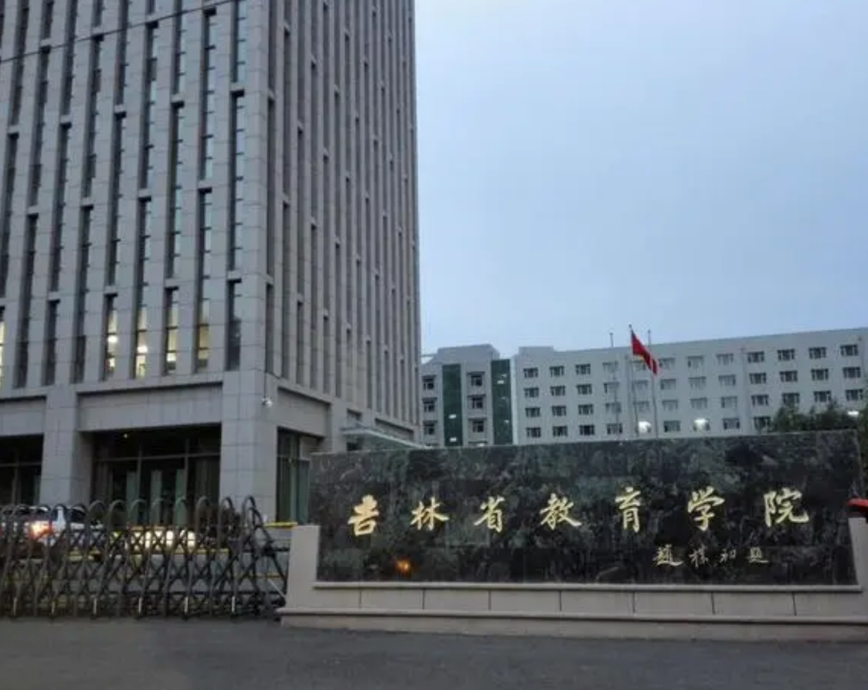
如：吉林省教育学院
My own unit, Jilin Provincial Institute of Education, is the teaching and research organization of Jilin Province and is responsible for providing guidance and services for the professional growth and improvement of principals and teachers of primary and secondary schools in Jilin Province. I was a history teaching researcher in Jilin Province and was responsible for providing guidance and services to improve the history teaching skills of history teachers across the province. Some people jokingly call us “subject governors”.
11

Slide 12
市级和县级的教研机构
The third and fourth levels are municipal and county-level teaching and research units. They are located in key cities and counties with radiating power and are responsible for guiding subject teachers in urban areas, counties and surrounding rural areas. Municipal and county-level teaching researchers have closer ties with grassroots teachers, especially teachers in marginalized areas. The majority of grassroots teachers often obtain national and provincial education system reform information and subject teaching cutting-edge information through city and county-level teaching and research staff, ensuring that they are not isolated or closed, and that they keep pace with the times and advance with their peers in business.
12

Slide 13
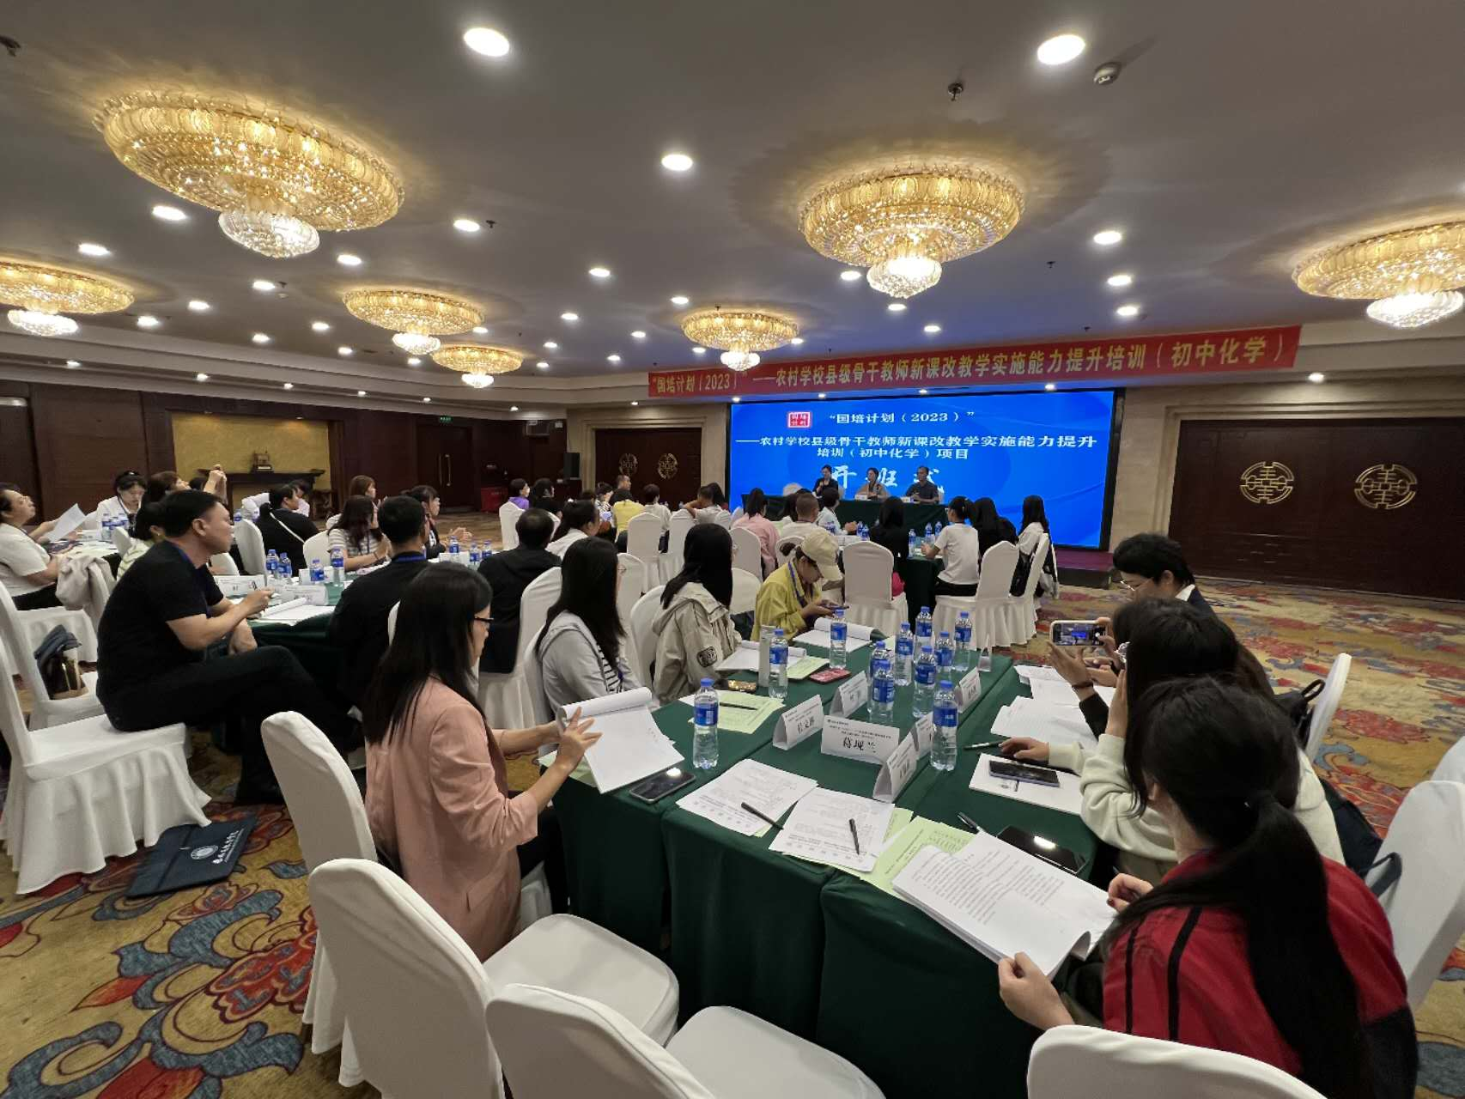
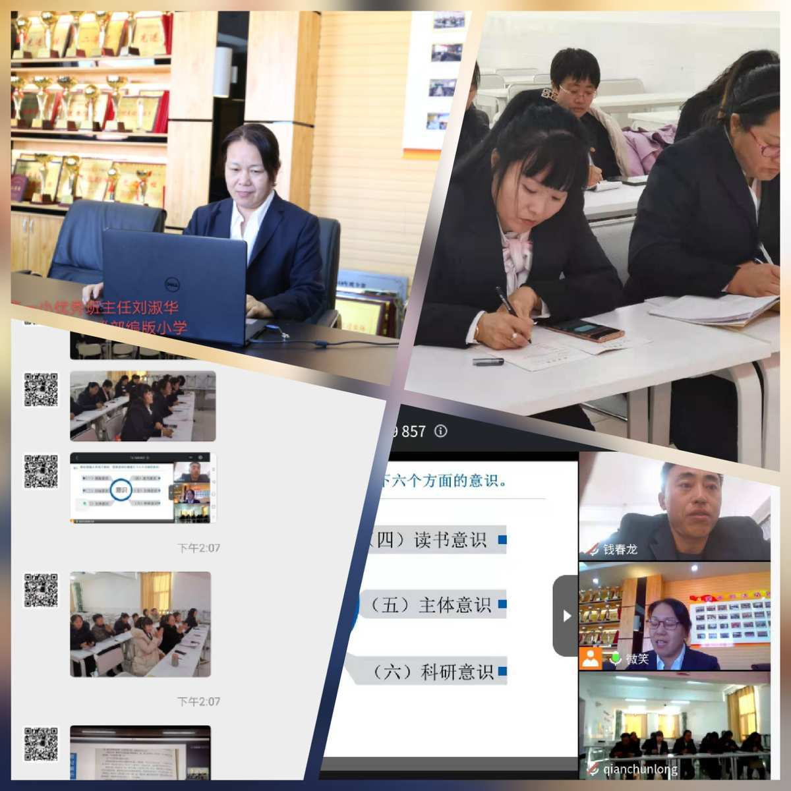
一线教师到各级教研机构参加培训
training meetings online
The teachers from local schools attended various training meetings
13

Slide 14
设在学校的教研组
The fifth level is the school-level group，that is equivalent to the nerve endings of the community. Whether the teaching and research effect is good or not depends entirely on the actual operation effect of this level. They often use a certain subject in the school as a unit to organize teachers to conduct professional seminars, classroom observations, collective lesson preparation, or exchange and learn with subject teaching and research groups from other schools, or select representatives to attend short-term training courses organized by provincial and national teaching and research institutions. All employees remain "professionally charged" at all times.
14

Slide 15

教研：教师职业发展的“充电器”
Chinese primary and secondary school teachers are lucky. From the beginning of their employment to the farewell podium, teaching and research organizations have always been with them. Charging at any time and permanently recharging can ensure that primary teachers always have full power and continue to work.
15

Slide 16
4：教研员的四个服务
serving government
serving students
Serving schools
serving teachers
"4" refers to the core tasks of "four services" for teaching and research staff. According to China’s national policy requirements, teaching and research personnel should undertake four core tasks.
16

Slide 17
教研员的四个服务：具体内容
Serve school education and teaching, lead the reform of curriculum and teaching, and improve the quality of education and teaching;
Serve the professional growth of teachers, guide teachers to improve teaching methods, and improve their ability to teach and educate people;
Serve the all-round development of students, and conduct in-depth research on student learning and growth patterns, improve students' comprehensive quality;
Serve education management decision-making, strengthen basic education theory, policy and practical research, and improve the scientific level of education decision-making.
17

Slide 18
教研员对教师专业发展的作用：重要职责
I will focus on the important role of teaching researchers in teachers’ professional development. Before becoming teachers, normal school students receive systematic teacher education at universities, but it is not enough. After becoming teachers, novice teachers need to quickly adapt to the reality of school teaching, transform theoretical learning into practice, and should continue to absorb cutting-edge results and pioneering experiences in education and teaching research.
This requires an “always open university” that allows students to acquire knowledge, skills and literacy after attending college, and “teachers who will accompany them throughout their lives.” So, the teaching and research staff came in handy. Teaching researchers summarize and refine their accumulated large amounts of rich and successful teaching experience to form various operational plans. In activities organized by teaching researchers at all levels, they share, communicate, and negotiate with teachers, so that grassroots teachers can continue to develop. Continuously acquire new knowledge and constantly forge ahead.
18

Slide 19
3：三级教研员队伍
"3" refers to the third-level teaching and research staff team.
The main body of teaching and research work is teaching and research personnel. China has established a three-level team—provincial, municipal and county levels respectively.
5.37%
60000
70000
67.29%
19

Slide 20
三级教研员的数量
As of 2023, there will be a total of 7,200 teaching and research institutions in 31 provinces across the country, including about 60,000 full-time teaching and research staff and about 70,000 part-time teaching and research staff, totaling 130,000. Provincial-level teaching and research staff account for approximately 5.37%, municipal-level teaching and research staff account for approximately 24.62%, and county-level teaching and research staff account for approximately 67.29%. The third-level teaching and research staff cooperate with each other and work together to ensure that various national education policies and subject development information can be spread to all regions and types of primary and secondary schools across the country in a timely manner.
20

Slide 21
3
PART THREE
Professional standards for teaching researchers

Slide 22
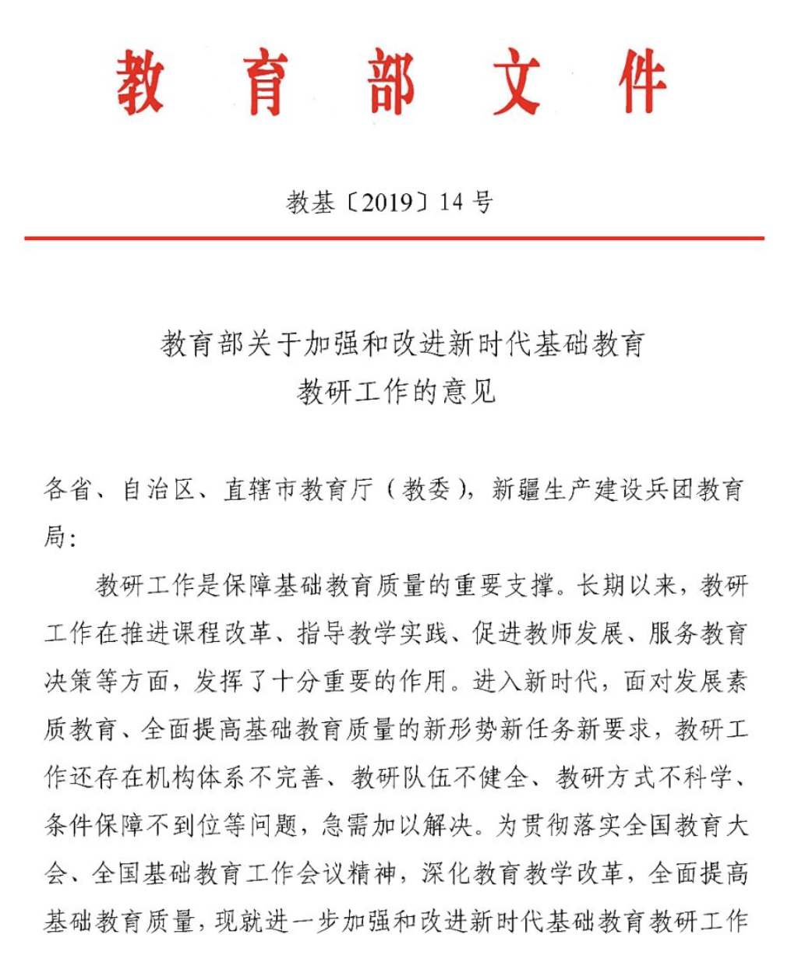
教研员的准入条件
In China, becoming a teaching researcher is very honorable, but it also requires greater responsibilities than ordinary teachers. In 2019, the "Opinions on Strengthening and Improving Teaching and Research Work in Basic Education in the New Era" issued by the Ministry of Education of China clarified the professional standards for teaching and research personnel.
22

Slide 23
成为教研员的5项基本条件
To become a teaching researcher, should meet the 5 basic requirements:
Excellent political quality.
Have a strong sense of professionalism and responsibility.
The educational concept is scientific.
Strong teaching and research capabilities. Have a solid foundation in educational theory and rich teaching experience. In principle, they should have more than 6 years of teaching experience, have intermediate professional and technical titles as teachers or above, and have achieved excellent results in education and teaching.
Proper professional ethics.
23

Slide 24
4
PART FOUR
Practical work of
teaching researchers

Slide 25
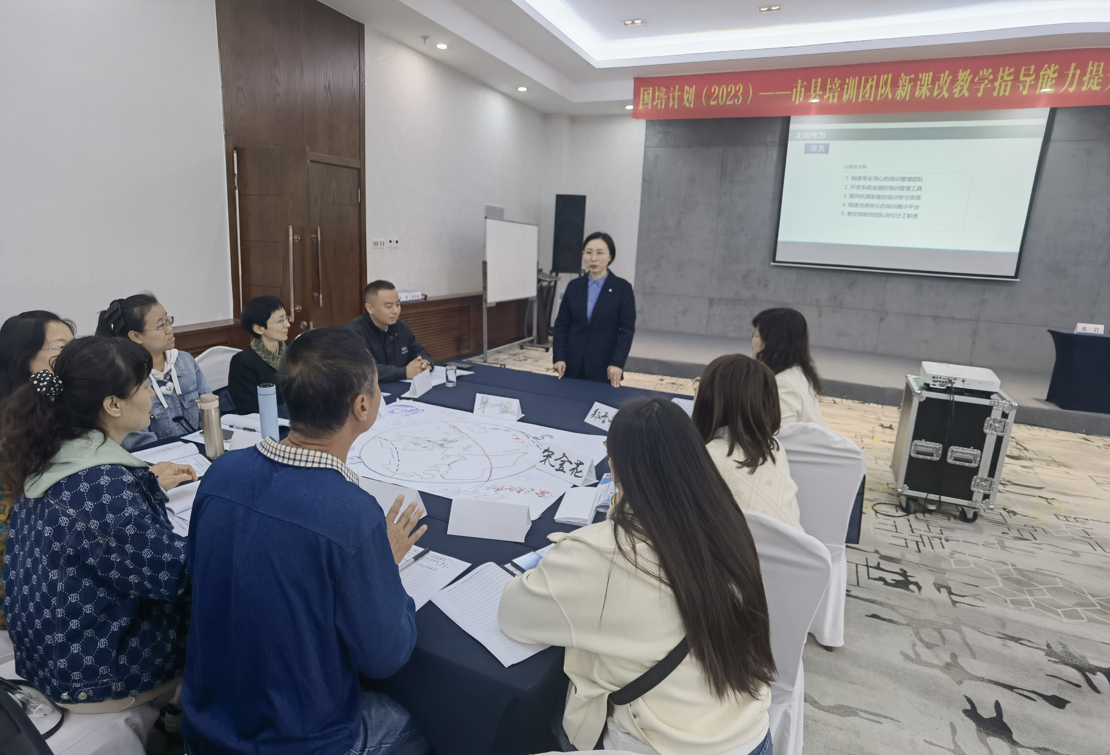
教研员的3项日常工作
Teaching researchers are the backbone of subject teaching guidance and promotion. Their daily work is very intense, but to sum up, it can be summarized by three key words:
Research
Guidance
Service.
25

Slide 26
教研员的专业研究
Professional research on all elements of education and teaching
The major difference between teaching researchers and ordinary teachers is that they focus more on education and teaching research. Teaching researchers are first and foremost researchers of education and teaching. At present, they focus on comprehensively improving students' core competencies, linking them with the reality of subject education, focusing on researching the issues faced in the development of subject education, actively promoting curriculum reform, and strengthening curriculum construction. Teaching researchers also go deep into schools to carry out teaching investigations, teaching diagnosis and experience summaries, promptly discover problems, conduct discussions and propose countermeasures. In addition, they also lead teachers to actively explore, study teaching rules, summarize practical experience, and set typical examples under the guidance of certain theories. In addition, they also organize backbone forces to carry out special research and research on key issues to form valuable educational research results.
26

Slide 27
教研员带动学校教师进行合作研究
In practice, teaching and research staff can continuously innovate working mechanisms and working methods, unite and lead teachers to explore and invent a series of teaching and research activities such as project research, demonstration observation, lesson study, teaching forum, action research and other forms of teaching and research activities, forming a regional teaching and research Effective teaching and research models such as continuous teaching and research, online teaching and research, school-based teaching and research, theme teaching and research, and project teaching and research have accumulated vivid and rich practical teaching and research experience.
These experiences are not only the transformation of research results, but also provide new materials for further research, raise new questions, and achieve the close integration and two-way promotion of teaching and research.
27

Slide 28
教研员指导学校教师的课堂教学
2. Regular guidance for subject teachers’ teaching
Teaching researchers are also responsible for guiding teachers’ teaching work, including teaching design, teaching methods, teaching methods, etc. They can accurately understand teachers' teaching needs, provide targeted guidance and training according to different needs, and help teachers improve their teaching standards. Teaching researchers will also organize and guide teachers to study new curriculum standards and new textbooks, and demonstrate excellent teaching methods and means to teachers through open classes, special lectures, etc. At the same time, they also pay attention to the guidance of experts, inviting well-known experts and scholars at the municipal and even national levels to approach teachers and classrooms, participate in lectures and evaluate classes, and provide suggestions and directions for school-based teaching and research work.
28

Slide 29
教研员在中国课程改革中的作用
Times are developing and education is changing. The ten-year cycle of curriculum reform has become a common practice in education reform in countries around the world. China, like many countries in the world, has experienced eight basic education curriculum reforms in the past 75 years.
Every time the curriculum is reformed, teaching researchers in teaching and research institutions are responsible for the important work of researching and guiding the implementation of the curriculum, playing a "bridge" role for the smooth implementation of the curriculum. It can be said that giving full play to the supporting role of teaching and research has become the secret weapon of my country’s previous curriculum reforms. Teaching researchers are regarded as the transformers of national and local curriculum and teaching policies, the promoters of curriculum reform, the organizers of regional teaching research, the guides of school teaching reforms, and the promoters of teachers' professional development.
29

Slide 30
教研员助力国家基础教育质量提升
3. Synchronous services to improve the quality of basic education
Teaching researchers are not front-line teachers, but teachers of teachers. They must understand teaching, be able to give demonstration classes, and guide teaching; teaching researchers are not theoretical researchers in universities, but they must be able to do research, be able to help teachers solve problems, and must have experience in discovery.
Refining the wisdom of educational practical experience; teaching researchers are not administrative managers, but they have the responsibility of making suggestions to the educational administrative department, and are often given a certain administrative color. As special teachers, teaching researchers serve basic education with their professional knowledge, professional abilities and professional spirit through their own efforts and dedication, and have made positive contributions to improving the quality of education and teaching.
30

Slide 31
THE END

