Slide 1
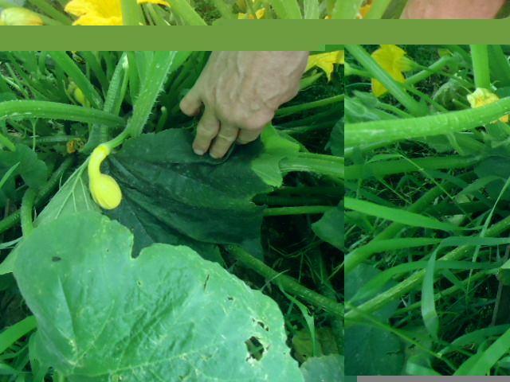
Social, historical, ecological, political and aesthetic readings of the landscape
All welcome. Light lunch provided so please let us know in advance if you are attending at sociology.department@nuim.ie. | A seminar series organised by the urban-suburban studies cluster of the Dept of Sociology in co-operation with Maynooth University’s Sustaining Communities Research Cluster and the Crops, Plants and Bio Economy Research Cluster. | Seminars take place in the Resource Room Auxilia Building 12-2pm
Emmet Fox | Society, Power and Climate Change: A Social Critique of Public Climate Change Receptivity in Ireland (2008–2014) | Wed April 22 2015
Clodagh O Malley Gannon | Ways of Knowing & Their Impact on Nature-Society Interaction within Production | Wed April 29 2015
Patrick Bresnihan | The Bio-financialization of Water and the Making of Third Nature | Wed Sept 22 2015
Eamonn Slater | Marx on the colonialisation of Irish soil: a class analysis of the metabolic rift | Wed Sept 29 2015
Patricia C. Kettle | It's all about organic, but it's not: A sociological analysis of allotment gardening in Dublin | Wed Oct 14 2015
Mary P. Corcoran | Home is where the art is: painting suburbia in Tallaght West** (seminar takes place in the library as part of the ‘House Portraits exhibition ) | Wed Oct 21 2015
Michael Byrne | The state and the financialization of the city | Wed Nov 18, 2015
Trish Morgan | Going Green Digitally? Environmental crisis and the evolving role of media | Wed Nov 25 2015
Eoin Flaherty | Studying social-ecological systems: beyond the qualitative-quantitative divide | Wed Dec 9 2015
Mary C. Benson | Allotment Gardens: A re-imaging and re-imagining of suburban landscapes. | Wed Dec 16 2015

Slide 2
Social, historical, ecological, political and aesthetic readings of the landscape
Dept of Sociology and Dept of Geography
in co-operation with Maynooth University’s Sustaining Communities Research Cluster and the Crops, Plants and Bio Economy Research Cluster
Presents
Dr. Emmet Fox
Society, Power and Climate Change: A Social Critique of Public Climate Change Receptivity in Ireland
(2008–2014).
Wed, April 22, 2015 Resource room, Auxilia, 12-2pm
Light lunch provided. Please email sociology.department@nuim.ie
if you are attending

