Slide 1
MAP Student
Advisory Service
Welcome Week 24/25

Slide 2
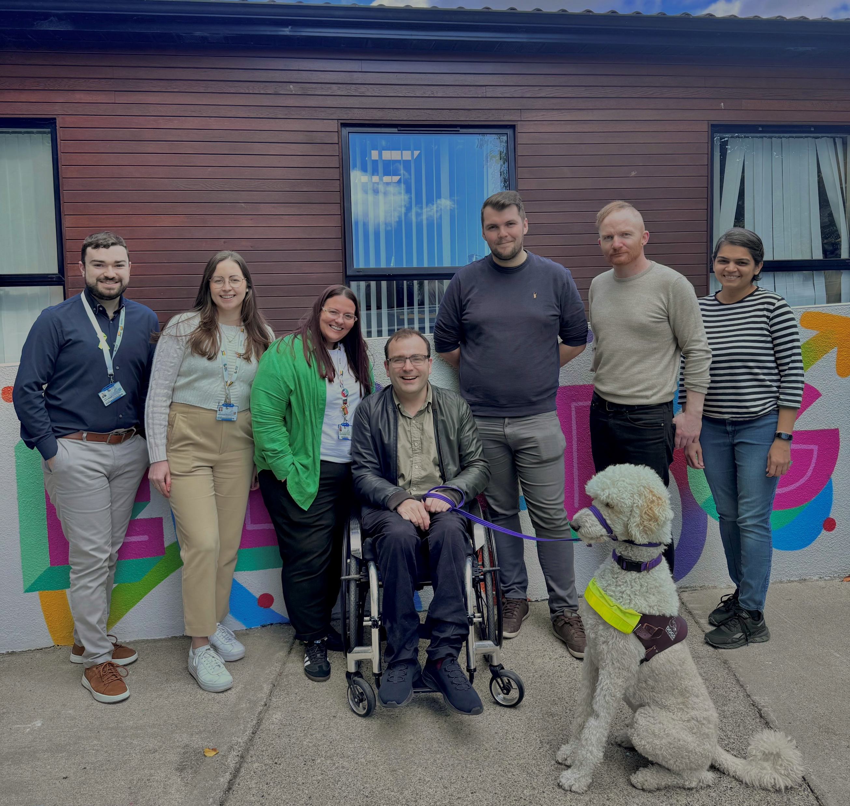
Who We
Are

Slide 3
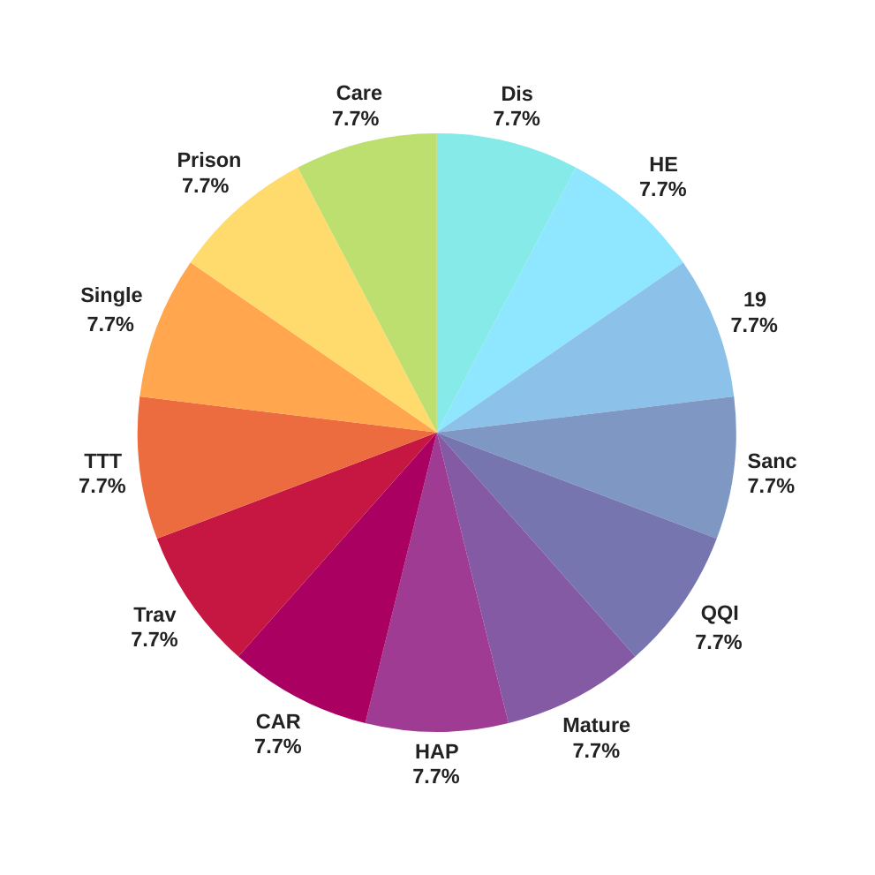
WHO WE SUPPORT​
Care Of The State
Disability
Prison Experience
HEAR/DARE
Single Parent
1916
TTT
Sanctuary Scholars
Traveller & Roma
QQI
CARER
Homeless HAP/HAP
Mature

Slide 4
MAP SUPPORTS
Financial
Academic
Personal
Social

Slide 5
CONNECT WITH MAP
Online MAP supports Application Form
1
Supports coordinated by MAP Student Advisor
2

Slide 6
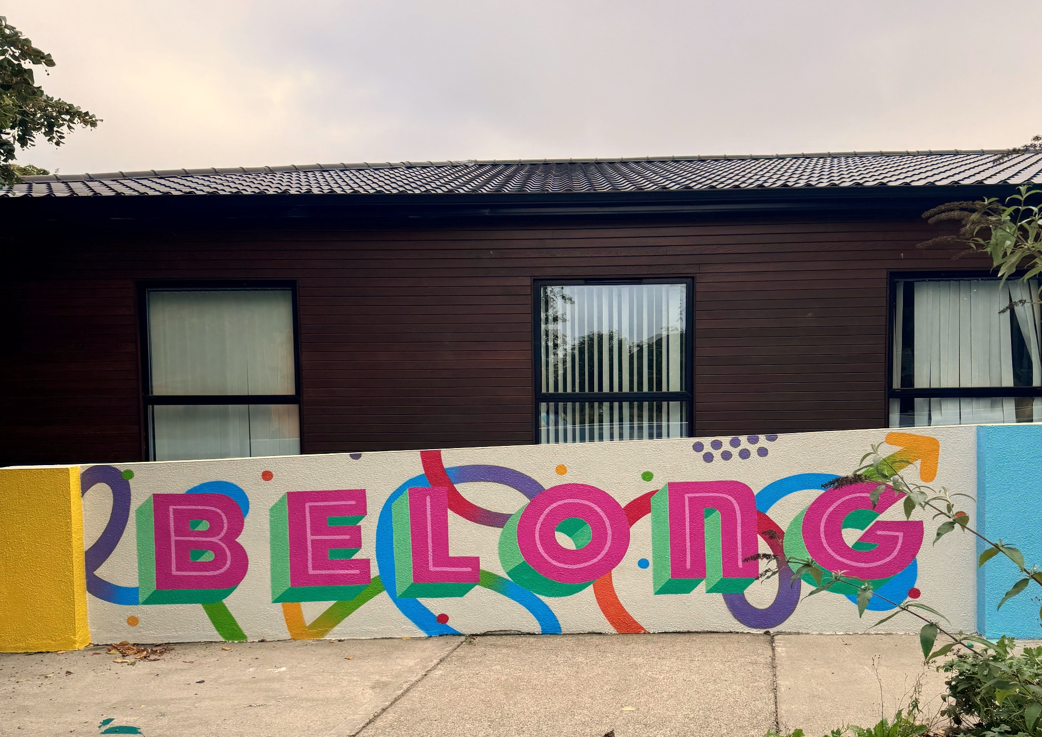
MAP DROP-IN HOURS
12PM - 2PM
Every Week Day!

Slide 7
ACADEMIC
Workshop examples:
Positive Thinking Workshop
Exam Mastery Workshop
The Daily Hustle Workshop
Academic supports include Study Skills Workshops and the Milo platform
mu.ie/milo
Notes:
SBA Services include:
-1-1 meetings
-Drop in Clinic
- SUSI Grant queries
-Financial supports - Emergency/Crisis Fund
-Sign posting to Social Welfare supports and other internal/external services

Slide 8
ACADEMIC
MAP Student Advisors signpost students or make referrals
to the following services
MAP
Academic
Advisors
Computer
Science
Centre
Writing
Centre
Maths
Support
Centre
Academic
Advisory

Slide 9
SOCIAL
MAP runs an extended orientation for first years that helps students build social connections and settle into college
MAP MY WAY SESSIONS
Intro to Milo
Thursday 3 October
Mental Health Supports
Wednesday 9 October
Money Matters
Thursday 7 November

Slide 10
Join A Club & Society
MU Life, Clubs & Societies

Slide 11
Diversity Workshops
Lunch Time Workshops:
E
Q
U
A
L
I
T
Y
!
!
!
Afrobeats Dancing
MSU
Beady Pockets
TSI Building -MAP Zone
Drumming
Outside John Hume
Building

Slide 12
PERSONAL
MAP Student Advisors signpost students or make referrals
to the following services
Student
Counselling
Service
Mental
Health
Nurse
Healthy Campus
Student
Health
Centre
Chaplaincy

Slide 13
Contact Us
map.advisory@mu.ie
Email Us if you have any queries
Follow us on instagram for updates

