Slide 1
ANA MARIA SANCHEZ RODRIGUEZ
Scaling Disability people’s organizations-
-Lao PDR as a case study
Home Host Organization: Maynooth University-
Mentor: Malcolm MacLachlan
Main Partner Organization: Humanity and Inclusion-
Mentor: Aude Brus
October, 2019
CAROLINE: Collaborative Research Fellowships for a Responsive and Innovative Europe
Marie Skłodowska-Curie Actions COFUND Grant Agreement no. 713279

Slide 2
Outline
Overall Research and this paper
Study location and methodology
Inclusive scaling and directions for DPOs
Case Study-Lao PDR
References

Slide 3
1) Overall Research
Successful community social innovations relevant to persons with disabilities that remain in the periphery
How can the gap between community social innovations and national-level policies be bridged in order to scale the most effective and inclusive initiatives?
Problem
Research Question

Slide 4
Research Questions
What is scaling of social community innovations for Disability people´s organizations (DPOs)?
How is scaling happening for DPOs?
What are the different scaling directions taken by DPOs?
Notes:
1 question, simple and concrete
2 stage process that in slide 13 with previous acknowledgement of a project design stage and INGOs or other intermediary organizations.
3 taken the four examples how did I observe they scaled if the did?

Slide 5
2) Study Location and methodology
Lao PDR as a case study
Ethnography and multi-case qualitative study
Pilot studies: March and November 2018
Long term stay : April to September 2019
Data collection: In-depth interviews, focus groups and participant observations
Data analysis: pattern matching

Slide 6
Definitions
Disability People´s Organizations (DPOs) established by and for people with disabilities with the idea that these are composed of and governed by a majority of people with disabilities at the membership and leadership level (People with Disabilities Australia, 2015 in Young, Reeve, & Grills, 2016).
Scaling: influencing, repeating, adapting and ensuring social change for vulnerable populations, in particular for persons with disabilities.
Social inclusive innovation: “the development and implementation of new ideas which aspire to create opportunities that enhance social and economic wellbeing for disenfranchised members of society” (George et al 2012, p.663) promoted through organizations whose primary purposes are social (Mulgan, 2006, p. 146)

Slide 7
3) Inclusive Scaling
Scaling Inclusion and non-discrimination of vulnerable populations
Identify inclusive social innovation
Plan- scaling in, out, up and down
Adapt-integrating and changing for improvement
Learn-adopting participatory tools
Implementation-strategy choice
Notes:
Adding implementation

Slide 8
Scaling dimensions
Scaling Dimension | Description | Strategies | Goal
Scaling In/Organizational | Adjusting the structure, functions or skills within an organisation; to allow it to take on the particular work required to implement the good practices it is trying to promote; recognising that change ‘outside’ often requires change “inside” the organisation too. | Capacity building | Ensure the organisation is capable of delivering the scale of good practices required.
Scaling Out/Replication | Repeating the organization model or approach, across organizations working at similar levels within the systems. | Diffusion, communicating, learning and adapting | Broaden the range or scope of good practices geographically.
Scaling Down/Allocation | Ensuring that changes in laws, policies or norms, have the necessary means to implement the envisaged good practices ‘on the ground’. | Devolve and empower | Effective resourcing to achieve implementation
Scaling Up/Structural | Influencing social structures; such as laws, policies, institutions, and norms; to allow good practices to be more extensively adopted. | Advocacy, networking, partnerships, negotiation, | Achieve changes in laws, policies, institutions or norms.

Slide 9
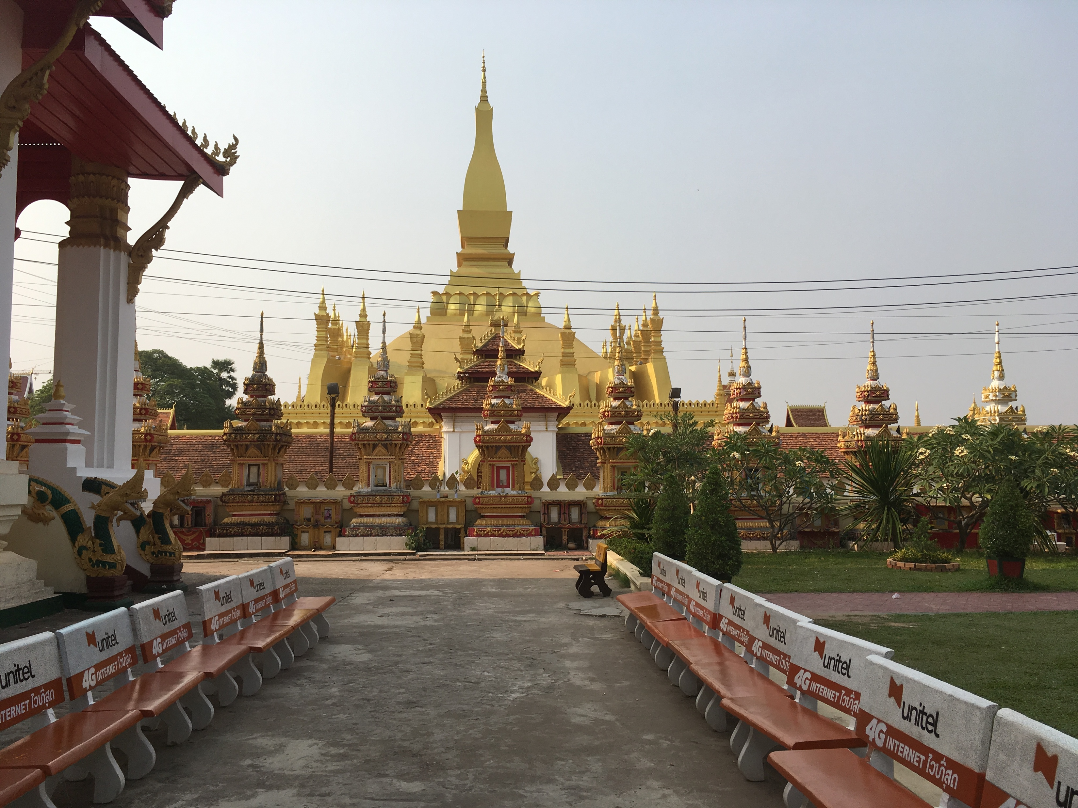
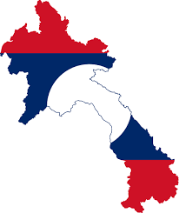
4) CASE STUDY-LAO PDR
Notes:
Apologize for the lack of context of my overall study and bringing this example rapidly to illustrate the conveying of HRBA and CDS GS

Slide 10
Data collection in Lao PDR-Pilot studies (2018)
Sector | Number of people interviewed
DPO | 21
University | 2
Government | 6
INGO and Intergovernmental Organizations | 15
NPA | 2
Experts | 2
TOTAL | 48
Participant observations | 9

Slide 11
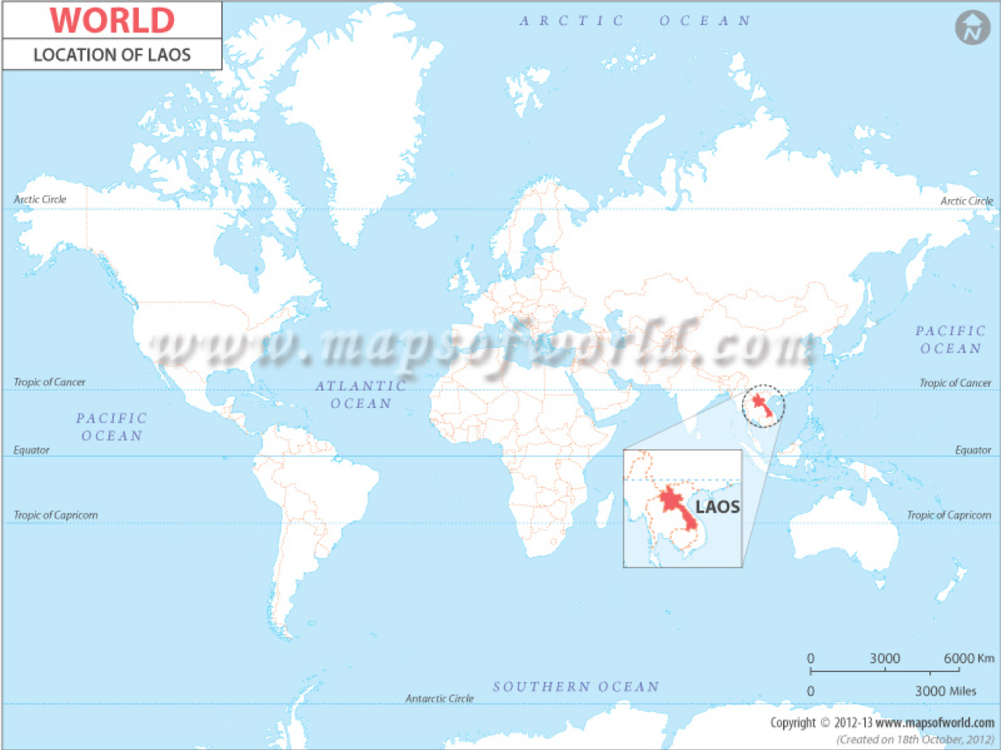
6.5 million people (2018)
Disability prevalence 2.8 (2015)
One-party State
Lao language
Buddhist
49 ethnic groups

Slide 12
Disability People’s Organizations (DPOs) in Lao PDR
Acronym | Name of Organization | Yr. registered | Members- beneficiaries
AFA | Association for Autism | 15/03/2012 | 88
AFD | Association for the Deaf | 09/07/2013 | 2914
LDPA | Lao Disabled People’s Association | 13/09/2011 | 13393
LBA | Lao Blind Association | 16/08/2012 | 75
LDWDC | Lao Disabled Women’s Development Centre | 05/04/2001 | 945
QLA | Quality of Life Association | ND | ND
SDDPA | Saysetha District for Disabled People Association | 29/06/2014 | 687
IDU | Intellectual Disability Unit | ND | 135
VDBA | Vocational Development for Blind Association | ND | ND
Source: Third Disability Forum, DPOs presentation, March, 2018

Slide 13
DPOs-scaling process
1.- Practise (qualified is innovative in a given context)
2.- Decision to scale? Yes or no
5.- Managing scaling
6.-External evaluation
3. Yes we scale! scale is not a planned process
4. Trial – test strategies
Notes:
Problem understanding practice ad good, our inability to understand the context we work with, the criteria that we use and the lack of measurements and evidence.
Scaling is not necessarily based on funding and not an strategic decision
The trial stage uses different strategies is similar to the trial and test
No follow up but the obligation to report back it is implicit and comes with the funding
Managing scaling to its best
External evaluation less input from the organization

Slide 14
DPOs- Inclusive social innovations
CRITERIA
Ideas:
Target people with disabilities
Are novel
Are Cross-sectoral
Are Effective
NPAs
Have the authorship of the practice
Are registered
Have more than five years of work
EXAMPLES
Inclusive Learning Centre (LBA)
Communication technologies (AFA)
Taxi Service (LDPA)
Disability Inclusive Committees (QLA)
Notes:
Inclusive Learning Centre (LBA)-evidence of scale
Communication technologies (AFA)- evidence of scale but stagnation
Taxi Service (LDPA) – trouble scaling after funding ended and increase of tariff
Disability Inclusive Committees (QLA) – reach a plateau, the committees are only working in Xieng Khouang provincial level.

Slide 15
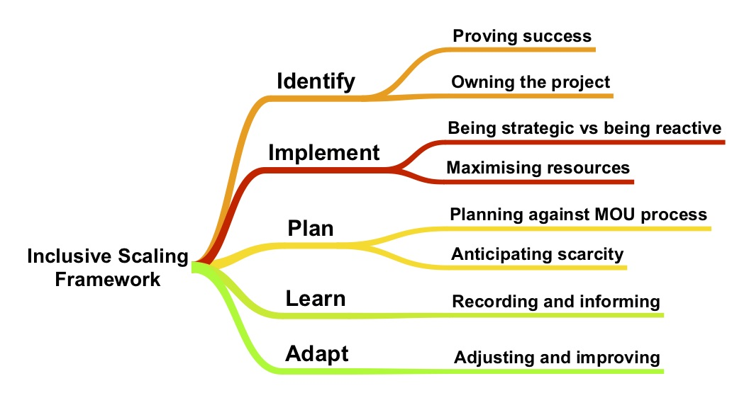
The DPOs’ puzzled process of scaling in Lao PDR
Notes:
Tools to show success outreach, how much is good?, example. Making it Work
Whose idea/ the donor, the INGO, the DPO, the communities. Almost all projects are planned and designed at the INGO and donor’s level

Slide 16
Preliminary Findings (Pilots)…
Stakeholders have multiple understandings on what is needed to implement a project and to perform well – INGOs devolution to DPOs and other NPAs
Project-gap between the initial planning and what can be effectively delivered by the DPOs-larger donors-higher expectations.
Social inclusive innovations from DPOs are simple, concrete, have limited impact and are tied to government restrictions and donor support
DPOs have a vision of what and how to scale and implement different strategies, but without formal planning
Scaling of DPOs inclusive innovations is happening –different directions and levels- depending on the DPO resources and networks

Slide 17
To discuss
DPOs’ puzzled process of scaling in Lao PDR-
Prior explanation on the stage process where INGOs and government get involved to provide the funds
AFA- scaling organizational models as good practices or occasional projects

Slide 18
5) References
  Balboa, C. M. (2019). Introduction: NGO Authority, Effectiveness, and the Paradox of Scale. In The Paradox of Scale. https://doi.org/10.7551/mitpress/11254.003.0002
  Bezzina, L. (2019). Disabled people ’ s organisations and the disability movement : Perspectives from Burkina Faso, 1–10.
  Buchner, D. (2012). Stories without endings: A study of illness and disability narratives in rural Laos. Dissertation Abstracts International: Section B: The Sciences and Engineering.
  Burns, D., Worsley, S., Burns, D., & Worsley, S. (2015). Implications for development. In Navigating Complexity in International Development. https://doi.org/10.3362/9781780448510.009
  Fixsen, A. A. M. (2009). Defining Scaling Up Across Disciplines : An Annotated Bibliography. Complexity, (December), 1–34. Retrieved from http://www.fpg.unc.edu/~nirn/resources/other/ScalingUp_Annotated_Definition.pdf
  George, G., Mcgahan, A. M., & Prabhu, J. (2012). Innovation for Inclusive Growth: Towards a Theoretical Framework and a Research Agenda. Journal of Management Studies, 49(4), 661–683. https://doi.org/10.1111/j.1467-6486.2012.01048.x
  Hall, A., & Clark, N. (n.d.). What Do Complex Adaptive Systems Look Like And What Are The Implications For Innovation Policy? https://doi.org/10.1002/jid.1690
  International Innovation Alliance (IDIA). Scaling Innovation June 2017, Retrieved from: https://www.idiainnovation.org/idia-insights
  Lao Statistics Bureau. (2016). The 4th Population and Housing Census (PHC) 2015. Lao Statistics Bureau, 280pp. Retrieved from http://www.lsb.gov.la/PDF/PHC-ENG-FNAL-WEB.pdf
  Linn, J. F., & Hartmann, A. (2008). Scaling up through aid - the real challenge. Global Views, Brookings Global Economy and Development, the Brookings Institution.
  Löve, L., Traustadóttir, R., & Rice, J. G. (2018). Achieving Disability Equality: Empowering Disabled People to Take the Lead. Social Inclusion, 6(1), 1. https://doi.org/10.17645/si.v6i1.1180

Slide 19
Questions?
THANK YOU !

