Slide 1
Maynooth University Student Services
maynoothuniversity.ie/student-services

Slide 2
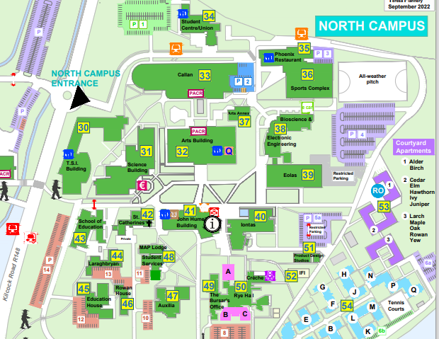
Locations
Student Services Centre
Student Health Centre
Counselling Service
Student Support Officer
Student Advisory
Student Budgeting Advisor
Student Support Hub
maynoothstudentpad.ie
Arts Building
Healthy Campus
Student Helpdesk
TSI Building
Student Helpdesk
Crèche
Rye Hall

Slide 3
One-stop-shop for all your questions. Two on campus and one virtual desk.
Doctor, nurse and mental health nurse advisor led-clinics, open to all students during office hours.
Creating an environment and culture that enhances the health and wellbeing of the campus community.
Purpose build childcare facility catering for children from 1 year to school going age.
Provides one-to-one support, wellbeing workshops, self help resources.
Student Advisory services including Budgeting, practical guidance and support and off-campus accommodation information.
Student Helpdesk
Counselling
Student Support Division
Student Health Centre
Student Helpdesk
Student Support Division
Student Health Centre
Healthy Campus
Crèche
Healthy Campus
Crèche
Counselling

Slide 4
Speak Out
Reporting Tool
Speak Out is an online anonymous reporting tool available to staff and students to disclose incidents of bullying, cyberbullying, harassment, discrimination, hate crime, coercive behaviour/control, stalking, assault, sexual harassment, sexual assault, and rape.
It is important to remember that as the Speak Out reporting tool is completely anonymous, there is no way of identifying or contacting any member of the university community who uses the tool.

Slide 5
How to reach us
Appointments (in person & virtual)
Drop in clinics
Info sessions
Workshops
Visit:
maynoothuniversity.ie/student-services
Email:
student.services@mu.ie
Phone:
01 708 4729
Live Chat:
mu.ie/studenthelp

