Slide 1


Slide 2






Equality, Diversity & Inclusion (EDI)
in
Maynooth University
2024
Sam Blanckensee (They/He)
Equality Officer

Slide 3

Our MU Community
c.16,000 students
- gender balanced, 55%F:45%M*
- from over 100 countries
- c.1,000 international students
- increasing ethnic diversity
- 12% students from disadvantaged areas
c.1,300 staff
  - gender balanced, 58%F:42%M*
  - 45 nationalities
  - c.8% of staff have a disability**
Our diversity is our strength
Equality, diversity and inclusion is a key enabler in the MU Strategic Plan 2023-2028
*Not including non-binary, <1%
** From EDI Staff Survey, 2022
Notes:
The size of our MU student and staff community is about the same as the population of Maynooth town 17,259 (census 2022), so we have a big impact on the culture and feel of the area.
Both our student and staff cohorts (15,774, 2022/23) are gender balanced (min 40% of women & men)
*We also have non-binary students and staff, although %s are not shown here as they are less than 1% in each cohort.
We are proud of our increasing diverse scholarly community in MU. Students from over 100 countries.
Increasing ethnic diversity e.g. in the 1st year Equal Access Survey which is voluntary, our students reporting African/Any other Black background has increased from 3.6% in 2018/19 to 7.4% in 2022/23.
We are leaders in widening participation with 12% of our student body from the most disadvantaged areas (by postcode) and 15% are from the most affluent backgrounds (HEA 2020/21 data).
We see this diversity as our strength, as we come together to study and research ‘to imagine and create better futures for all’ and EDI is a key enabler in the MU Strategic Plan 2023-2026.
Student data, 2022/23
- HEA Deprivation Index Scores 2020/21
Total students: 16,113 (includes MIEC 1,175 but slide numbers don’t include them) and
1,300 staff.
Staff data, 2022/23
**from EDI staff survey, 2022

Slide 4


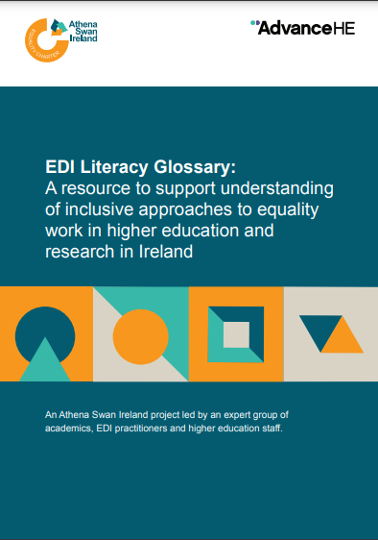

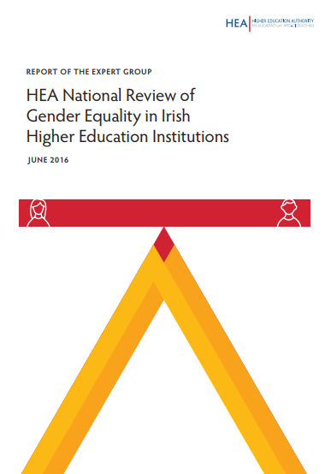

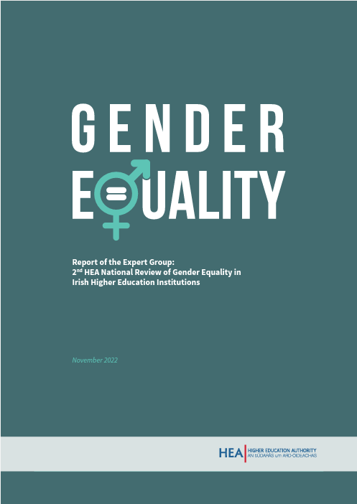

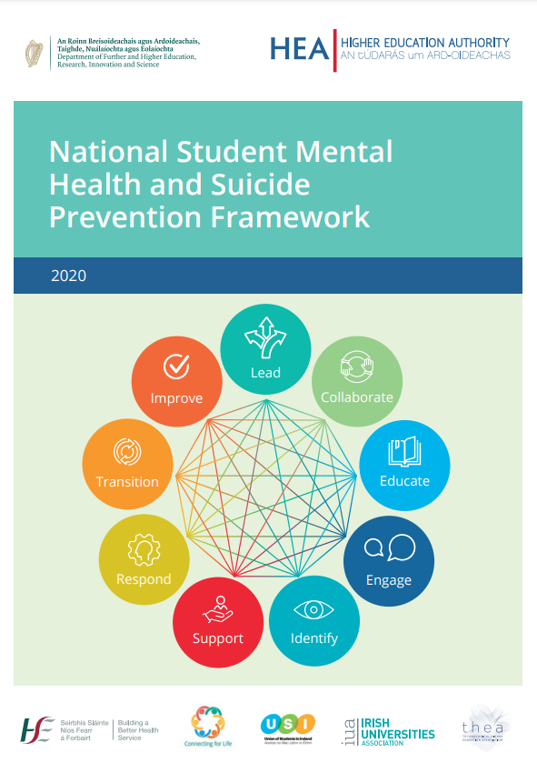

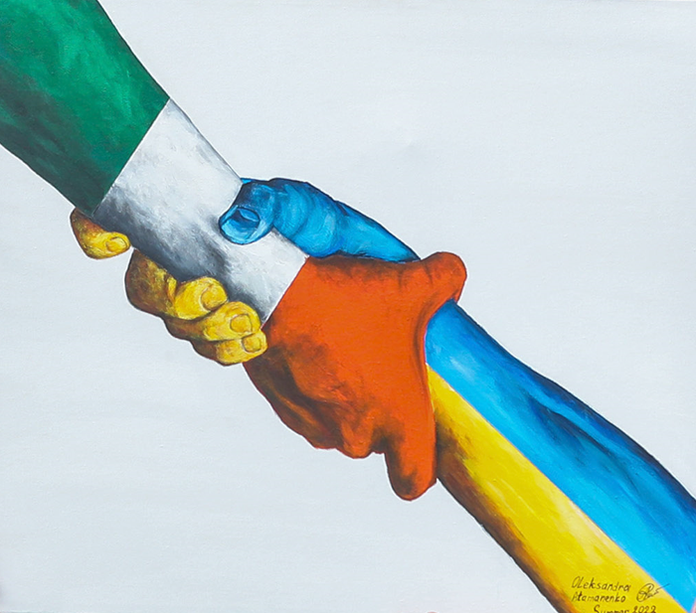
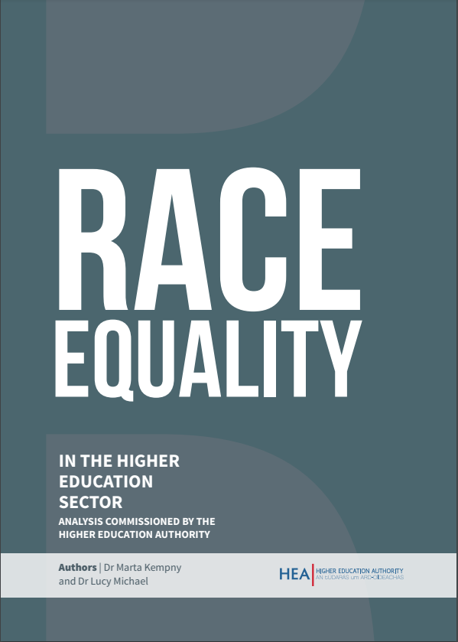

Equality, Diversity and Inclusion (EDI) is everyone’s responsibility
Access & Widening Participation
Gender Equality
Intersectionality
Excellence in Exile Refugees, Asylum Seekers & Migrants
EDI
LGBTQIA+
EDI
Race Equality
Disability
Other New Areas:
- Neurodiversity
Age Friendly
Belonging & Wellbeing
Notes:
What do we mean by EDI? We’ve taken a unique approach in MU, we’ve brought staff EDI, and student access/widening participation together, so we just talk about people. Our EDI portfolio relates to all of our community and the areas that it covers has exponentially expanded over recent years in Ireland…
MU is a national leader in widening participation and we’re ranked in the top 100 institutions globally (#84) for our work on SDG 10 - Reducing Inequalities (2024). We’re a trusted destination for many groups traditionally the furthest from higher education.
‘Talent is equally disturbed across gender, race and class, but opportunity and access are not’. So, we are effectively a first-mover on identifying new talent from groups currently under-represented in higher education.
We’ve also been recognized by the European Commission as a Gender Equality Champion, one of the first four universities in Europe to be awarded this status. For example, we’ve shifted the % of our professors who are female from just 28% in 2018 to 37% now. Our approach has been to focus on ‘fixing our organization and culture’ rather than the historical ‘fix the women approach’.
We’re taking the learnings from this work, to develop further our Race Equality, Disability and Intersectionality focus.
We have national reporting requirements and frameworks to adhere to, EDI is highly structured and monitored in Ireland. Core grant funding and research funding is linked to our progress.
I work closely with all my colleagues across the university to achieve change, and in particular with Student Services & HR on ‘Belonging & Wellbeing’ through the Healthy Campus Charter, Consent Framework and the Mental Health Framework.
This portfolio could sit anywhere in the University, as it spans Students, Staff, Research, International Education, Governance, Finance etc. It is not important where it sits, but rather that someone in the University has responsibility for bringing it all together and coordinating it so that a strategic holistic approach is taken. In MU, that responsibility rests with me as VPED, but it is everyone’s responsibility to implement in their day job.
We use our community as a living lab, where data and research informs our policy and practice, which then feeds back into new data and research. We’ll be launching a new National Centre of Inclusive Higher Education later this year, providing a place to gather all this expertise together.
But I’d like to turn now to how all of this can be used to support Excellence in Exile….
4

Slide 5
Discrimination in Ireland
Under the Equal Status Acts 2000-2018 it is illegal to discriminate in the provision of good and services, accommodation and education under 10 grounds:
Gender
Age
Race and Ethnicity
Sexual Orientation
Religion
Disability
Civil Status
  whether or not you are married
Family Status
  whether or not you have children
Membership of the Traveller Community
  Irish Travellers are an indigenous nomadic ethnic group who face considerable levels of discrimination.
Housing Assistance
  only applies in relation to accommodation

Slide 6

Notes:
Our work has been recognised at European level withy MU was announced as the inaugural winner of the 2022 EU Award for Gender Equality Champions prize in the inaugural EU Award for (Academic) Gender Equality Champions.
Commissioner for Innovation, Research, Culture, Education and Youth, Mariya Gabriel presented the award to MU recognising progress achieved in advancing gender equality for staff and students in academic and research organisations.
MU has achieved this through a focus on changing our organisation and culture rather than the historical ‘fix the women’ approach. Our approach is holistic in focusing on both staff and students and encompasses gender equality, addressing gender-based violence, and consideration of the sex/gender dimension in research content. In addition to this, we have initiatives on LGBTQIA+, race equality, disability, refugees, asylum seekers and migrants.
We have a dedicated Vice President for Equality & Diversity, working with our Institutional Gender Equality Steering Group which includes membership from across the University at all levels and roles, and students.
We have specific targets in relation to gender equality:
Min 40% women on key decision-making panels including GA, AC, UE and committees
The proportion of female Professor As will increase from 33% in December 2021, to 37% in 2024, and 40% in 2026.
Recruitment application, shortlisting, appointment and success rates by gender and Faculty with 3-year average targets set for these to be gender balanced (min 40%F).
Promotion application, success rates by gender and Faculty to be gender balanced (min 40%F).
Target of 60 female academics and 40 ATP staff to have been mentored by 2026. Increase participants on Early Career Academic Mentoring Scheme and run sponsorship pilot
Gender Pay Gap decreasing year on year from 9.99%
Our President is a great ambassador for our work, hosting International Women’s Day events with the 6 first female presidents last year in Ireland, and in Brussels this year bringing the female rectors in ARQUS together, to highlight need to empower women and sharing our learnings with other HEIs.
Aiming for 3 new facilities for new mothers/parents, currently have 2 and adding 1 more.
There is a decrease in the number of female academics reporting in the EDI Survey that gender had negatively impacted on their promotion prospects (down to 20% by 2026).
Staff survey targets for % agreeing that they are supported for career development, workload allocation,

Slide 7
Gender Equality
Ireland has made considerable progress in gender equality in recent years
MU has an Athena Swan Bronze Award for a commitment to gender equality
Students can get involved in this work at department level and around specific dates e.g. International Women’s Day.
MU Women in STEM society
MU Gender Equality Action Plan
National Women’s Council
Online module on Ending Sexual Violence and Harassment

Slide 8
LGBTQIA+
Useful Contacts
Acronym stands for Lesbian, Gay, Bisexual, Transgender, Queer, Intersex, Asexual and others
Ireland has a thriving LGBTQIA+ community and there are community venues in most large cities and towns
MU has a number of gender neutral bathrooms throughout the campus
Many MU staff wear Progress Pride lanyards to show their support of the LGBTQIA+ community and commitment to learning
MU Pride Society
LGBT Ireland
Transgender Equality Network Ireland
Belong To - LGBTQ+ Youth Ireland

Slide 9
Race Equality
Higher Education Institutions in Ireland are currently increasing the focus on work on race equality and anti-racism
MU will be developing its Race Equality Action Plan in 2024/25
‘Let’s Talk About Race’ module is available to all staff and students on Moodle
MU Societies:
Africa
Filipino
Korean
Indian
Japanese Culture
Irish Network Against Racism
Pavee Point Traveller and Roma Centre

Slide 10
Religion
Maynooth has a number of options for Christian services, with Catholic mass held on the South Campus daily
Dublin has three synagogues that Jewish students can attend
There are a number of mosques and Islamic centres throughout Ireland that Muslim students might wish to attend
MU has a number of religious student societies including Catholic, Christian Union, Gospel Choir, Islamic, St Catherine’s and The Purpose Movement who run a variety of events and organise prayer on campus
Students who wish to pray or have a place for quiet reflection can avail of the prayer room in the Arts Building. Prayer mats are also available there. A space for wudu is available beside the nearby toilets.
Notes:
Although Ireland is known as a Catholic country, census figures show a reduction in those who identify as Catholics and an increase in people who have no religion or another religion

Slide 11
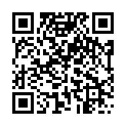
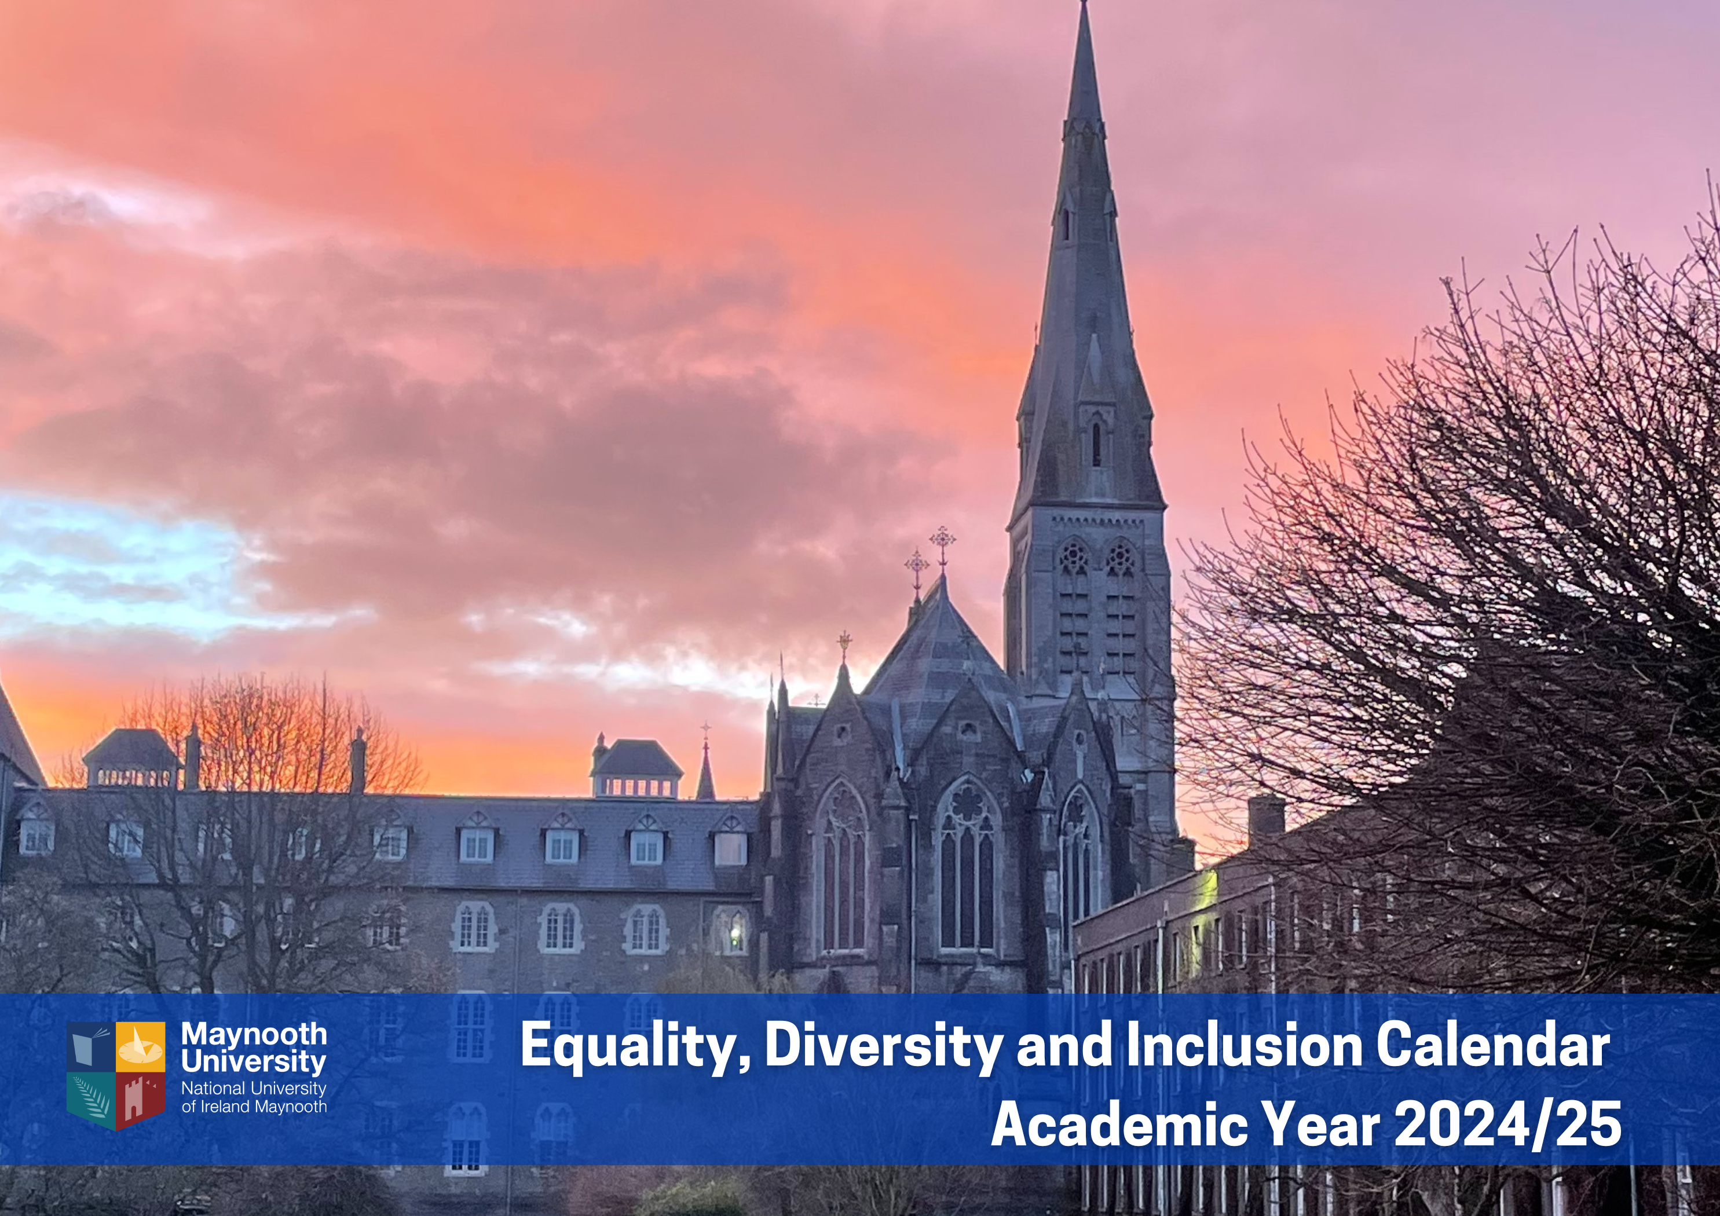
Key Dates
October
Black History Month
19 Nov. 2024
International Men’s Day
3 Dec. 2024
International Day of Persons with Disabilities
1 Mar. 2025
Ramadan starts
3–7 Mar. 2025
Social Justice Week
8 Mar. 2025
International Women’s Day
31 Mar. 2025
Transgender Day of Visibility
Notes:
Click picture for link

Slide 12
MU Support Links
If you require support, please contact one of our services below:
For Students: Student Services 01 708 4729
www.maynoothuniversity.ie/student-services
  Student Health Centre 01 708 3878
  Counselling Service 01 708 3554
For Staff: Inspire Workplace Services (counselling, legal and budgeting supports) www.maynoothuniversity.ie/human-resources/staff-development/employee-assistance-programme
For Everybody:
Text about it – Free text ‘MU’ to 50808
Campus Security 01 708 3929
Maynooth Garda Station (Police) 01 629 2380
Dublin Rape Crisis Centre 24-hour national helpline: 1800 77 8888
Niteline – Student Support Line 1800 793 793
‘Speak Out’ https://mu.speakout.ie/ is an online anonymous reporting tool available for students and staff, to disclose incidents of bullying, cyberbullying, harassment, discrimination, hate crime, coercive behaviour/control, stalking, assault, sexual harassment, sexual assault, and rape. The tool will help you to find information and contact details on relevant Maynooth supports and specialist external supports. Should you wish to make a formal report, guidance on formal reporting procedures is signposted.
Notes:
Presenter: Gemma

Slide 13




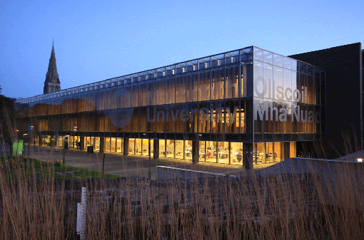







Dr Gemma Irvine (she/her)
Vice-President for Equality & Diversity
vicepresident.equality@mu.ie
Equality, Diversity and Inclusion Office
equality@mu.ie
Maynooth University Access Programme
access.office@mu.ie
maynoothuniversity.ie/edi
@maynoothuniversityedi8121
maynoothuniversity.ie/athena-swan
@EqualityMU
facebook.com/EqualityMU
@maynoothuni_edi
@MU_AthenaSwan

