Slide 1
ERASMUS STUDENT NETWORK
MAYNOOTH
ERASMUS STUDENT NETWORK MAYNOOTH
MEET THE C O M M I T T E E

Slide 2
ERASMUS STUDENT NETWORK MAYNOOTH
ERASMUS STUDENT NETWORK
MAYNOOTH
MEET THE C O M M I T T E E
President: Amina Traboue
Vice-President: Robert Melia
Secretary: Charli Middleton
Treasurer: Beraca Antonio
Education Officer: Luke Fetherson
PRO: Alanna Ní hUrnaigh
PRO: Liam Kennedy
ESNCard Manager: Dylan Mc Clave
Buddy System Coordinator: Yasar Berke Peker
Events Team:
Aaron O Donovan Helena Apetroaei
Conor Bermingham Oisín Cumiskey
Allen Ibba Oille Smith

Slide 3
ERASMUS STUDENT NETWORK
MAYNOOTH
President: Amina Traboue
Vice-President: Robert Melia
Secretary: Charli Middleton
Treasurer: Beraca Antonio
Education Officer: Luke Fetherson
PRO: Alanna Ní hUrnaigh
PRO: Liam Kennedy
ESNCard Manager: Dylan Mc Clave
Buddy System Coordinator: Yasar Berke Peker
MEET THE C O M M I T T E E
Events Team:
Aaron O Donovan Helena Apetroaei
Conor Bermingham Oisín Cumiskey
Allen Ibba Oille Smith

Slide 4
SO… WHAT IS ESN?
ERASMUS STUDENT NETWORK
MAYNOOTH
Non- profit organisation International Student Network
Helps students get a cultural experience in the host country
Provides opportunities for the students to gain cultural understanding and self-development
Lead by students for students
So you could be on this amazing committee!!

Slide 5
E V E N T S
ERASMUS STUDENT NETWORK
MAYNOOTH
Overnight trips
Belfast and the Giant Cassway
Galway and the Cliffs of Moher
Cork City
Weekly running club
Culture/ Movie Nights
Parties/ discos nights
And much more :)
ESN Card
Ryanair discounts
Flixbus/ Flixtrain
Tomorrowland discount
The Economist
Discounts to trips ESN Ireland holds
Meet like-minded people
For committee members: → EGM
International meetings paid in full

Slide 6
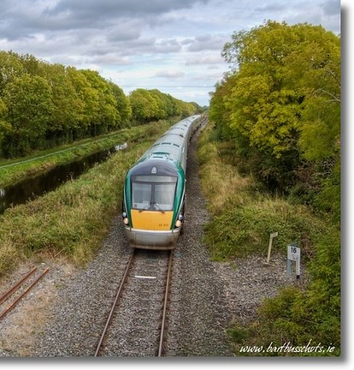
WHY SHOULD YOU JOIN?
ERASMUS STUDENT NETWORK
MAYNOOTH
ESN Card
Ryanair discounts
Flixbus/ Flixtrain
Tomorrowland discount
The Economist
Discounts to trips ESN Ireland holds
Meet like-minded people
For committee members: → EGM
International meetings paid in full

Slide 7
Where to eat?
ERASMUS STUDENT NETWORK
MAYNOOTH
M A Y N O O T H
Orient
Royal City
O’Briens
Student Union Bar
D U B L I N
Kakilang
Sano Pizza
Elphant and Castle
Dash Burger
ESN Card
Ryanair discounts
Flixbus/ Flixtrain
Tomorrowland discount
The Economist
Discounts to trips ESN Ireland holds
Meet like-minded people
For committee members: → EGM
International meetings paid in full

Slide 8
HOW TO JOIN
Where to eat?
ERASMUS STUDENT NETWORK
MAYNOOTH
ANY QUESTION

Slide 9
ANY QUESTION
THANK YOU FOR YOUR ATTENTION!

Slide 10
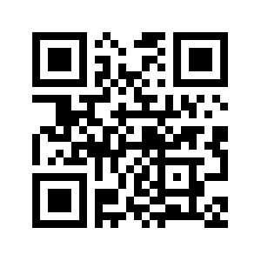
THANK YOU FOR YOUR ATTENTION!
Scan me!!

