Slide 1
Welcome International Students!
International Office, Maynooth University

Slide 2
Céad Míle Fáilte! One Hundred Thousand Welcomes!
We are delighted that you have chosen Maynooth University for your studies!
There are around 250 Erasmus and Study Abroad students starting at MU this semester.
Please attend all relevant orientation talks. They are for your benefit and will help you adjust to life at Maynooth.

Slide 3
Getting Online – Your MU Account
YOU NEED:
MU STUDENT NUMBER
MU PASSWORD
Your unique MU student number (username), email (mumail) and password were emailed to you by the Student Records & Registration Office.
Your student number and password will provide you with access to Email (Outlook), Microsoft 365, Moodle and Campus WIFI.
If you have any access/technical issues email servicedesk@mu.ie or visit the IT Services Reception.

Slide 4
Registering with the University
Registration with the University: Please make an appointment with the Office of Student Records and Registration to complete your MU registration and receive your MU Student ID card. It is best to schedule a suitable time that does not clash with the orientation activities provided. Please book via this link, selecting the Registration Verification option. The Office of Student Records and Registration located on our South Campus
Erasmus & Study Abroad students MUST attend in-person registration.
You will receive your MU Student card at the in-person registration
This is not connected to changing modules (you do that through the online form), this is to complete registration as a student at MU.

Slide 5
Your Personal Details
Please always ensure that your details are accurate and up to date on your registration, particularly emergency contact details.
To update details log into ‘Student Web’ found on the For Current Students webpage.
Examples of Irish addresses:
ELM 9A, COURTYARD APARTMENTS, MAYNOOTH UNIVERSITY, MAYNOOTH, CO. KILDARE, W23 F3F1, Ireland.
7 STRAFFAN GREEN, STRAFFAN WOOD, MAYNOOTH, CO. KILDARE, W23 Y2W9, Ireland.
STUDY ADDRESS
HOME ADDRESS
EMERGENCY CONTACT

Slide 6
Student web is on the “For Current Students” section of MU website: https://www.maynoothuniversity.ie/current-students

Slide 7
Modules
MODULE = CLASS
As a visiting student you can take modules across all Departments at MU.
It is your responsibility to ensure you take the necessary or required modules and credits that will be approved by your home university.
We recommend that you take no more than 35 ECTS per semester.
CHANGING MODULES:
Identify Department International Coordinator
Email & Request Approval (Incl. student no. & transcript etc.)
Complete the CHANGE MODULE form on the Student Records Office webpage
Student Records will register you for new approved module
To remove a module from your registration, email: registration.docs@mu.ie

Slide 8
Understanding the Timetable
How to access your personalized timetable? Go to the 'For Current Students' section of MU website.
Allow time for your registration and timetable to update if you are making changes to your modules.
Allow 2-3 days for changes to be reflected on your Moodle.
The Timetabling Office will speak to you today to explain everything.

Slide 9
Changing Modules
Amendments can be made up to the 14th February 2025
https://www.maynoothuniversity.ie/records

Slide 10
Theology Modules
Reminder for students who registered with St. Patrick's Pontifical University to take theology and philosophy modules - you are required to attend in person on Thursday 6th February between 2:30pm and 4:30pm for registration verification. This takes place in the Theology Office, South Campus
You must bring your MU Student Card and Valid Passport with you.
If you are unable to make this session, please email registry@spcm.ie

Slide 11
Semester 2 Dates
Bank (public) Holiday: Monday 3 February (St. Bridget’s Day) – no lectures
Start of classes: 4 February
Bank Holiday: Monday 17 March (St. Patrick’s Day) – no lectures
Study Week (no classes): 18 – 21 March
Good Friday: 18 April – no lectures
Easter break: 21-25 April
Lectures resume: 28 April
Bank holiday: Monday 5 May – no lectures
Last week of lectures for 2nd semester: 6-9 May
Study Period: 12-15 May

Slide 12
Semester 2 Examinations
Semester 2 exams will run from 16 May to 3 June approximately
The Exams Office will release the timetable in April.
Updates here (includes guide to exam venues): Examination Timetable Information | Maynooth University
If you require exam accommodations or learning support, register with the MU Access Office (access.office@mu.ie) as soon as possible.
Exam regulations https://www.maynoothuniversity.ie/exams/examination-timetable-information

Slide 13
What Next?
11.00 am | Break
11.30 am | Timetabling office | Information and advice on understanding your timetable - All students should attend to hear about essential information
12.00 noon | Campus Tours | All students should attend; we will assemble in the Iontas Foyer
2 pm | Irish Cultural Heritage at MU | Students who are interested or have signed up for ICH modules or the certificate should attend. All students welcome!
3 pm | Living in Ireland – dealing with culture shock and cultural differences | All students should attend this workshop
3.30 – 5pm | Drop in questions and answers, Venue: TSI Building Café | Optional: Come along if you have a question for one of our international office team members.
5 pm | Scavenger Hunt | Social event – come along to learn about campus and win prizes!
7.30 pm | St. Bridget’s Festival fire display Luxe Theatre Landscape LUXe | Landscape Theatre and Processional Spectacle | Optional event - Luxe Landscape Theatre will lead a grand fiery processional event through the main street of Maynooth on Thursday January 30th. Gathering at 7.15pm – procession leaves at 7.30pm. Dress for the weather. Photography and filming will be in progress. No tickets are required for this event.

Slide 14
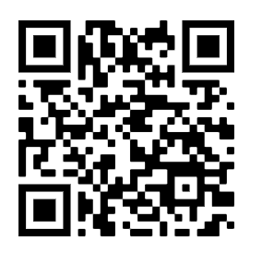
What Next?
Quick sign-up for Scavenger Hunt
Win MU Hoodies!

Slide 15
Friday schedule
Time | Event
9.30 am | Immigration talk for non-EU citizens | Mandatory attendance is required for all non-EU/non-EEA citizens
10.00 am | Student Services | All students should attend to hear about essential student services
10.30 am | Healthy Campus/Consent | All students should attend to hear about essential student services
11.00 am | Break
11.30 am | Staying safe in Ireland and on campus | Talk by on-campus Garda (Police officer) Damien Travers. All students should attend for important safety information
12.00 noon | Meet our students- Maynooth Students Union, clubs and societies | All students should attend to about student life from one of our students
1 pm | Welcome lunch - foyer of Iontas building | Please join us for a welcome lunch!
2 pm | US Embassy | All US citizens should attend for essential information.

Slide 16
Other activites to note
Library tours – Library tours will be available during the first weeks of the semester; please check the Library website and social media accounts for details.
Our Pop-Up Reuse Centre: Call in for free items donated by previous students. Items include Linens, towels and duvets; Crockery – mugs, cutlery, plates, etc; Pots & pans, kitchen utensils, etc; Decorations; Stationery; Bathroom ware and Clothes. The Centre is on the ground floor of Cedar Block, in the Courtyard Apartments, North Campus. It will be open during your orientation week from Monday-Tuesday 10-12 pm and Wednesday-Thursday 3 to 5 pm.
Tours of Dublin: Guided tours of Dublin are available on Saturday 1st and Sunday 2nd February – please sign up here if you are interested: https://fareharbor.com/embeds/book/dublintourguide/items/406766/?full-items=yes

Slide 17
Clubs and Societies
The Clubs & Societies Fairs Day
will be taking place from
10 am to 3 pm on Tuesday 11 February
in the Upper Foyer of the TSI Building.

Slide 18
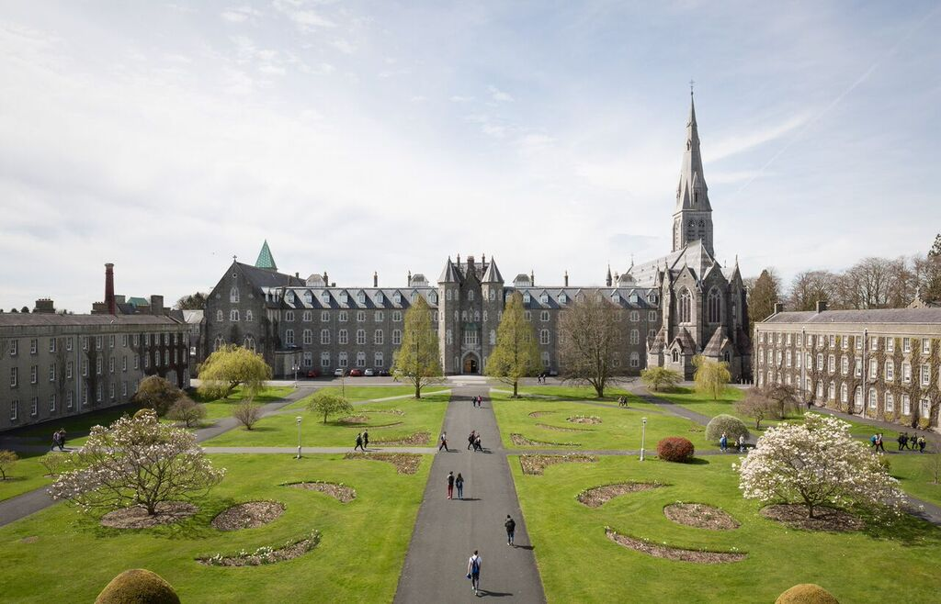
The International Office
We are one of your main points of contact while at Maynooth University!
We look after Erasmus & Study Abroad (incoming & outgoing), full degree UG & PG, Summer Schools, and more!
Blend of on campus and work from home for staff so please understand our working hours vary.
FIND US ON SOCIAL MEDIA:

Slide 19
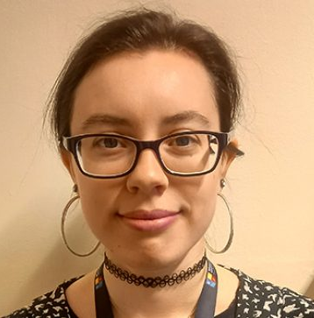
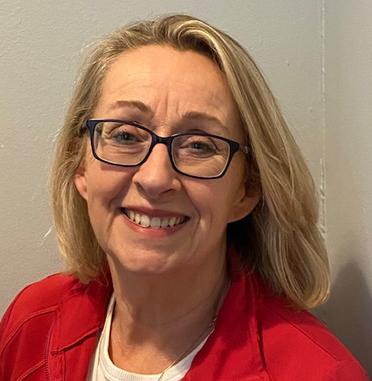
Contacting the International Office
Front Office
Lauren Matthews – starting next week
international.office@mu.ie
Erasmus+ & Non-EU Exchange
Emma Ward
incoming.exchange@mu.ie
Study Abroad
Denise Coyne
studyabroad@mu.ie

Slide 20
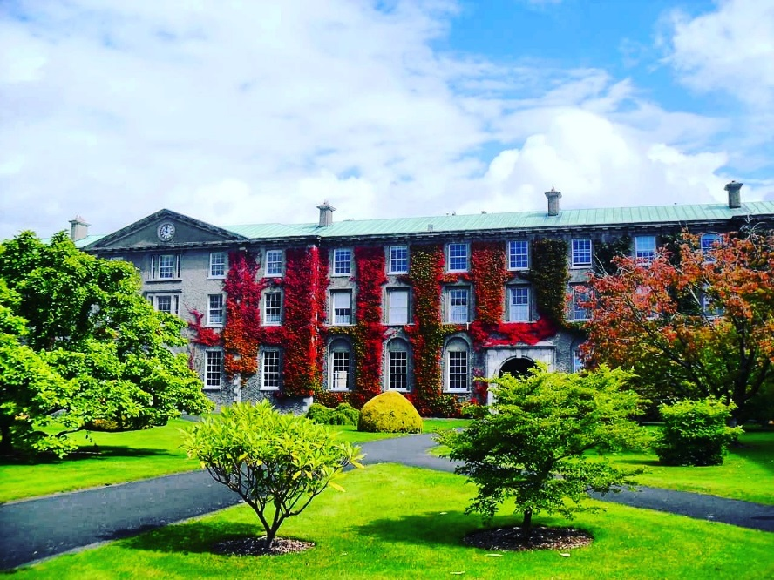
Contacting the International Office
Where?
Front Office, Top floor, Humanity House, South Campus
When? Monday to Friday: 10am – 12:30pm 2pm – 4:30pm
First week – drop in when suits
How?
Drop-in during these office hours or you can email us
In the second semester we plan have a drop-in centre on the North campus – details to be announced.

Slide 21
Student Helpdesks North Campus
Located in the TSI building and the Arts Block
for all questions
Help me, I’m lost!!
I can’t understand anything!!

Slide 22
Discounted travel - Leap Cards
Apply directly to leapcard.ie to have their card processed, this is now known as the Young Adult card.
Further information can be found at Leap Card https://www.leapcard.ie/

Slide 23
Letters
Letters for immigration registration—you can ask the Records Office for a letter proving registration - Letter Request | Maynooth University
If you need a letter with your Irish address on it, please email the Student Records Office directly specifying what you need to have included in the letter (i.e. your full Irish address) records.applications@mu.ie
If you require proof of payment of fees, please contact the Fees & Grants Office or check you Fee Account for a receipt.
If you need a bank letter – the quickest way to open an account is online with AIB, for any other bank you need to request a letter from the International Office (letters may take up to 5 working days)

Slide 24
Emergencies
Emergency Services: 999 or 112 – Gardaí (Police), Ambulance, Fire Services, Coastguard
Campus Security 24/7: 00353 1708 3929 or 00353 1708 3333 (Emergency)
Medical Contacts:
Doctor on campus: 003531708 3878
KDOC Appointments: 1890 599 362
Call ambulance 112 or 999
Nearest Hospital: Connolly Blanchardstown
Call campus security to notify them of an ambulance arriving on campus. If you need to attend A&E - the wait times can be 8+ hours. Be prepared.
If you need help, please ask!

Slide 25
Thank You for Listening!
We wish you the best of luck as you begin your studies at Maynooth University

