Slide 1
Welcome International Students
International Office, Maynooth University

Slide 2
Céad Míle Fáilte! One Hundred Thousand Welcomes!
We are delighted that you have chosen Maynooth University for your studies!
There are approximately 480 Erasmus and Study Abroad students starting at MU this semester. There will also be hundreds of returning students and other international students to meet and interact with during the semester.
Please attend and listen to ALL orientation talks. They are for YOUR benefit and will help you adjust to life at Maynooth.

Slide 3
MU Orientation Schedule
 | Monday, 16th | Tuesday, 17th | Wednesday, 18th | Thursday, 19th | Friday, 20th | Saturday, 21st
9:00
10:00 |  |  | Information Sessions | Information Sessions
11:00 | Dublin Walking Tours | Scavenger Hunt |  |  | Dublin Walking Tours | Dublin Walking Tours
12:00
13:00 |  |  | Break | Break
14:00 |  |  |  | Information Sessions
15:00 |  |  |  |  | Dublin Walking Tours
16:00 |  |  | Campus Tours
17:00 |  | Registration Verification & Library Tours | Welcome Event in Pugin Hall | Registration Verification & Library Tours / Céilí
18:00

Slide 4
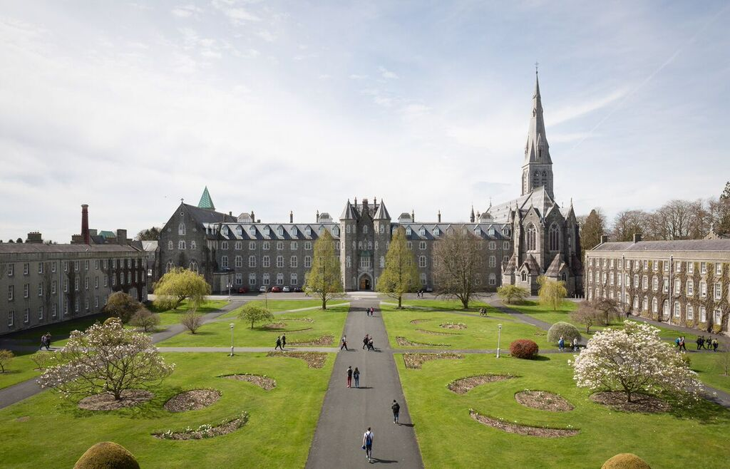
The International Office
We are one of your main points of contact while at Maynooth University!
We are an office of 21 staff members. We look after Erasmus & Study Abroad (incoming & outgoing), full degree UG & PG, Summer Schools, and more!
Blend of on campus and work from home for staff so please understand our working hours vary.
FIND US ON SOCIAL MEDIA:

Slide 5
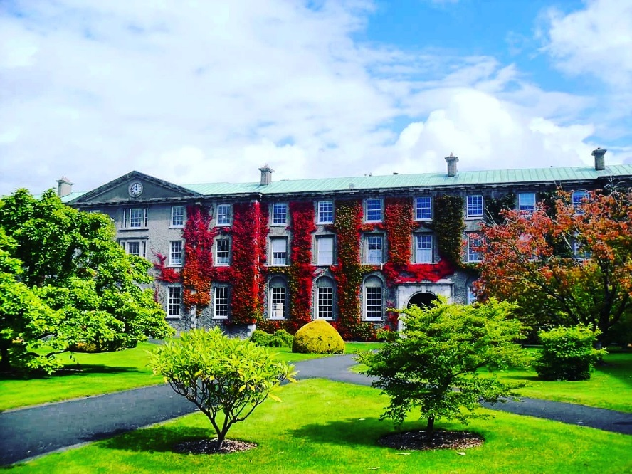
Contacting the International Office
Where?
Front Office, Top floor, Humanity House, South Campus
When? Monday to Friday: 10am – 12:30pm 2pm – 4:30pm
How?
Drop-in during these office hours or you can email us.

Slide 6
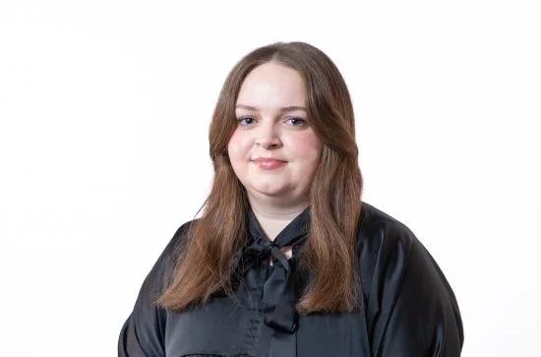
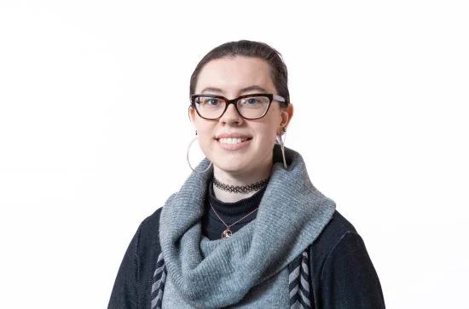
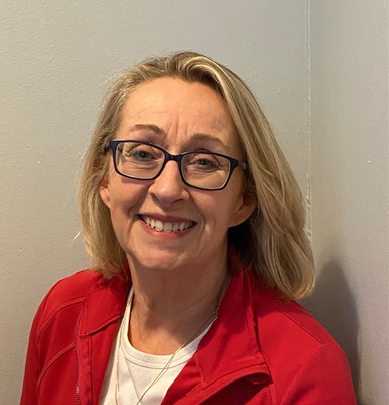
Contacting the International Office
Front Office
Megan Walsh
international.office@mu.ie
Erasmus+ & Non-EU Exchange
Emma Ward
incoming.exchange@mu.ie
Study Abroad
Denise Coyne
studyabroad@mu.ie

Slide 7
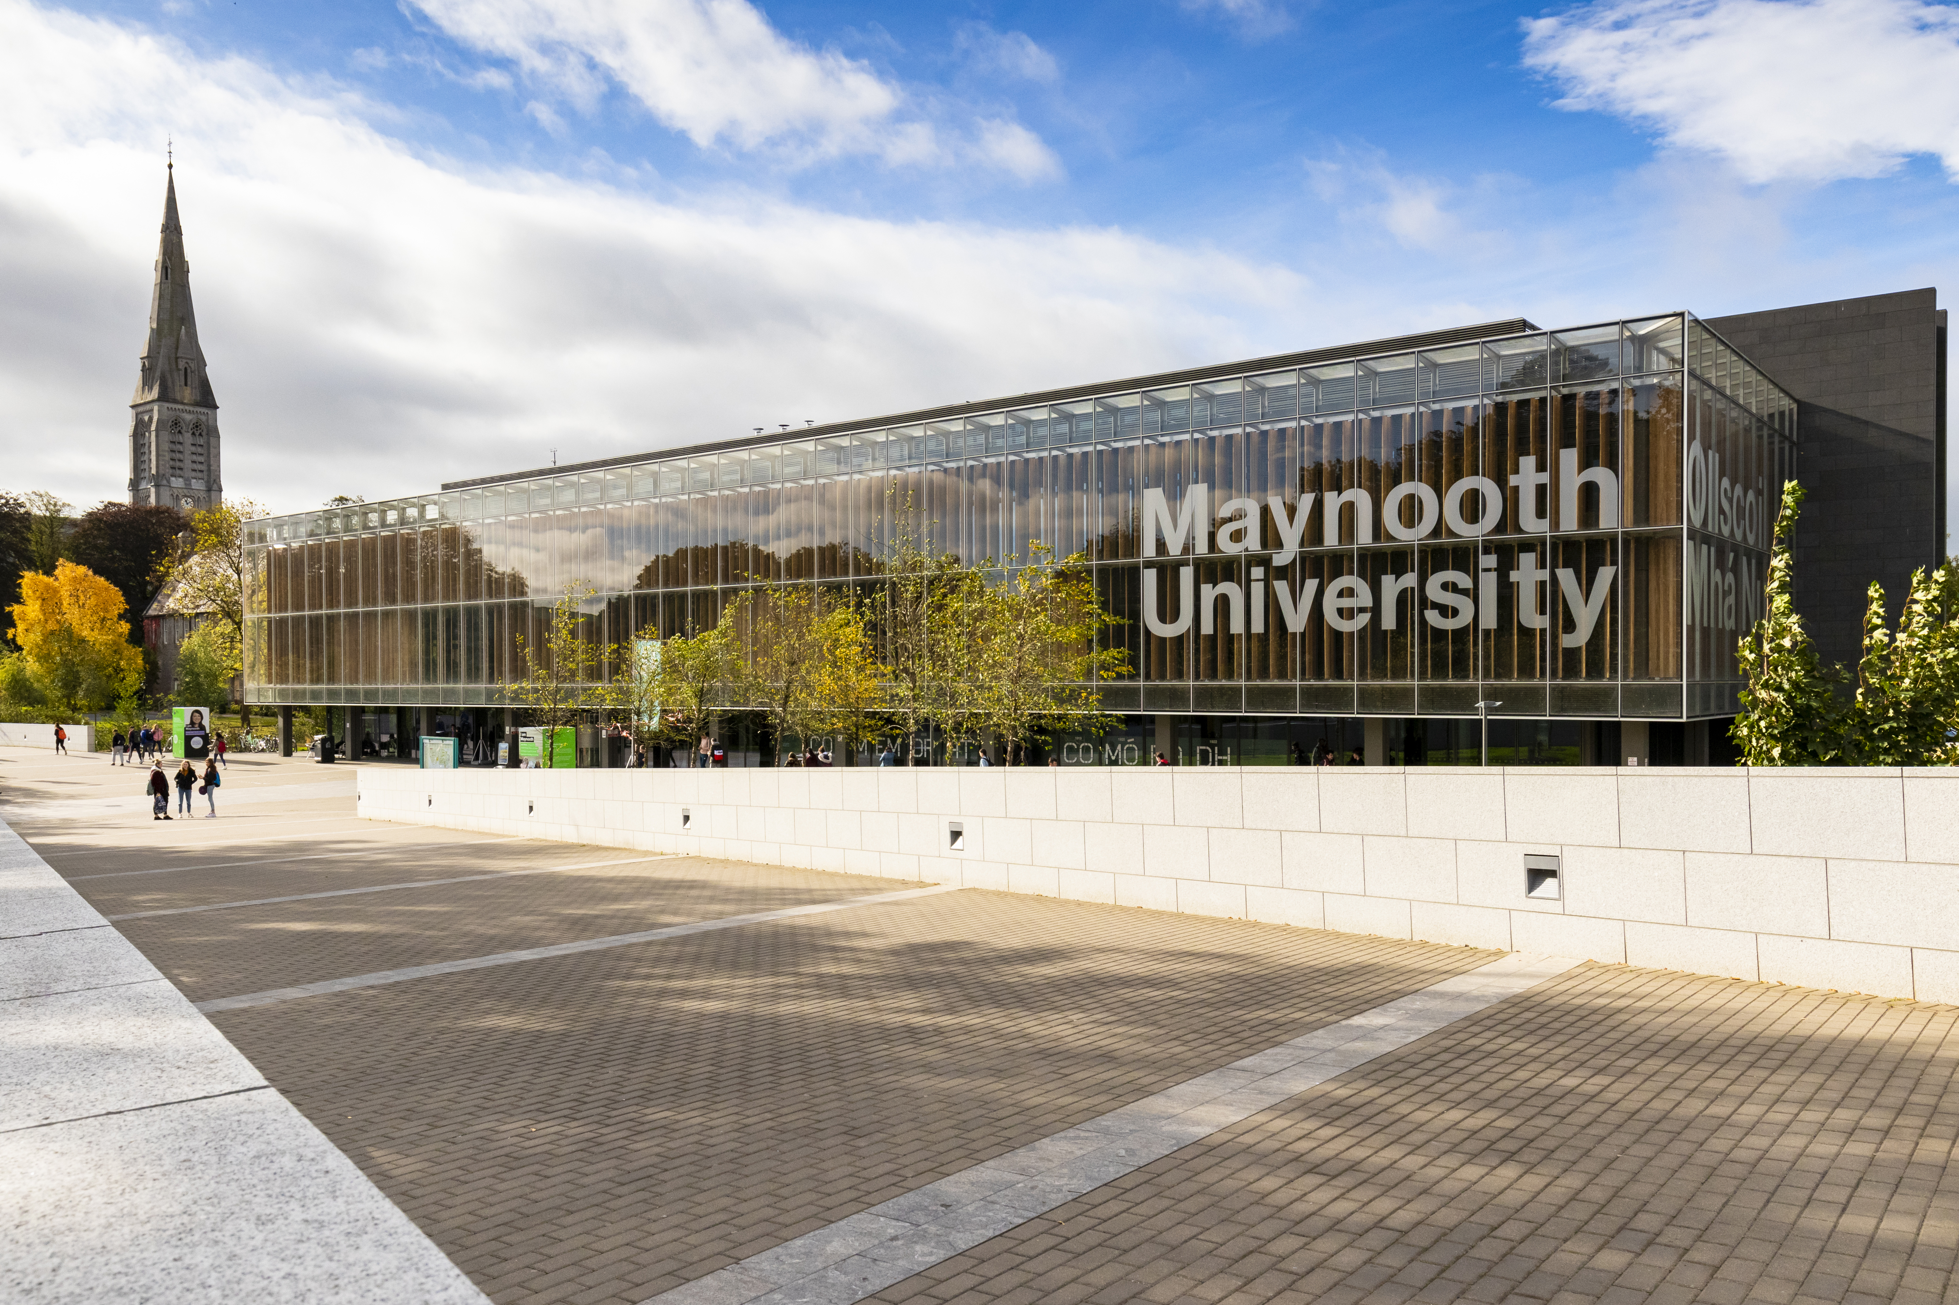
Pre-Arrival Guide
Maynooth Pre- Arrival Guide For International Students 2024
This is a living document and information may change regularly, so please keep an eye out for any updates over the coming weeks!

Slide 8
Letters
If you need a letter to confirm that you are a registered student, once registered, you can request a registration letter from the Student Records and Registration Office.
This letter can be used as proof of registration for registering for a PPS Number, for your immigration appointment, etc.
Letters can be sent collected from the Records Office.
Please allow up to 5 working days to receive your letter.

Slide 9
Leap Cards
Students who are between 19 and 25 years old, apply directly to leapcard.ie to have their card processed, this is now known as the Young Adult card.
Any students who are between 16 and 18 years old or 26 years and older can have their card processed by the Students' Union.
Apply at leapcard.ie selecting the Student Leap Card as their preferred card. Receive an email from leap card with a verification code, bring to a Student Leap Card agent (the SU), along with their Student ID Card.
Further information can be found at Leap Card https://www.leapcard.ie/Home/index.html

Slide 10
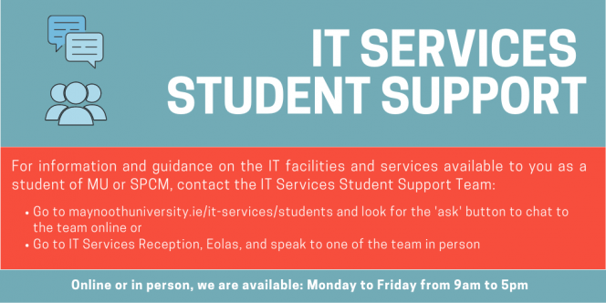
Getting Online – Your MU Account
YOU NEED:
MU STUDENT NUMBER
MU PASSWORD
Your unique MU student number (username), email (MUMail) and password were emailed to you by the Student Records & Registration Office.
Your student number and password will provide you with access to Email (Outlook), Microsoft 365, Moodle and Campus WIFI.
If you have any access/technical issues email servicedesk@mu.ie or visit the IT Services Reception.

Slide 11
Your Personal Details
Please always ensure that your details are accurate and up to date on your registration.
To update details log into ‘Student Web’ found on the For Current Students webpage.
Example of an Irish address:
ELM 9A, COURTYARD APARTMENTS, MAYNOOTH UNIVERSITY, MAYNOOTH, CO. KILDARE, W23 F3F1, Ireland.
7 STRAFFAN GREEN, STRAFFAN WOOD, MAYNOOTH, CO. KILDARE, W23 Y2W9, Ireland.
STUDY ADDRESS
HOME ADDRESS
EMERGENCY CONTACT

Slide 12
For Current Students section of MU website: https://www.maynoothuniversity.ie/current-students

Slide 13
Modules
MODULE = CLASS
As a visiting student you can take modules across all Departments at MU.
It is your responsibility to ensure you take the necessary or required modules and credits that will be approved by your home university.
We recommend that you take no more than 35 ECTS per semester.
CHANGING MODULES:
Identify Department International Coordinator
Email & Request Approval (Incl. student no. & transcript etc.)
Complete the CHANGE MODULE form on the Student Records Office webpage
Student Records will register you for new approved module
To remove a module from your registration, email: registration.docs@mu.ie

Slide 14
Changing Modules
Amendments can be made up to the 11th October 2024
https://www.maynoothuniversity.ie/records

Slide 15
Completing Registration with MU
Erasmus & Study Abroad students MUST attend in person registration during the scheduled Library tours this week.
Group 1 & 2 (Tuesday 17th) and Group 3 & 4 (Thursday 19th)
You MUST book a slot, sign up links have been emailed to you.
You will receive your MU Student card.
You will receive a library tour.
This is not connected to changing modules (you do that through the online form), this is to complete registration as a student at MU.
If you have any registration-specific questions, the Records Office will be giving a talk tomorrow!

Slide 16
Understanding the Timetable
How to access your personalized timetable? Go to the 'For Current Students' section of MU website.
Allow time for your registration and timetable to update if you are making changes to your modules.
Allow 2-3 days for changes to be reflected on your Moodle.
The Timetabling Office will speak to you later today to explain everything further.

Slide 17
Theology Modules
Students can register with St. Patrick's Pontifical University to take theology and philosophy modules. See available modules on our website.
Limited places are available and will be offered on a first come, first served basis.
To register you must complete this form: Registration Form
This form must be submitted by 5pm on Wednesday 18th September.
You are also required to attend in person on Wednesday 25th September between 2:30pm and 4:30pm for registration verification – further details outlined in the registration form.

Slide 18
Examinations
First semester ONLY students, do NOT sit the January exams.
You will be assigned an alternative assessment by each Department.
Ask the Lecturer/Professor/Department about the assessment if they do not mention it in the initial weeks/when talking about exams.
Full Year students: you will sit the university scheduled exams in January and May.
No exceptions to this policy.
The Exams Office will release the timetable in November and April.
If you require exam accommodations or learning support, register with the MU Access Office (access.office@mu.ie) as soon as possible.

Slide 19
Emergency / Need Assistance
Emergency Services: 999 or 112 – Police, Ambulance, Fire Services
Campus Security 24/7: 00353 1708 3929 or 00353 1708 3333 (Emergency)
Medical Contacts:
Doctor on campus: 003531708 3878
Off Campus Doctor: Dr. Denis Gaffney 00353 16291169
KDOC Appointments: 1890 599 362
Call ambulance 112 or 999
Nearest Hospital: Connolly Blanchardstown
Call campus security to notify them of ambulance arriving on campus. If you need to attend A&E - the wait times can be 8+ hours. Be prepared.
If you need help, please ASK FOR IT!

Slide 20
Maynooth Green Campus
Reuse Centre is a pop-up shop, OPEN for four days during Orientation Week.
Where: Phoenix Sports Hall
When: Monday, 16th – Thursday, 19th September from 10am - 12pm and 2 - 4 pm.
See further details on the MU Green Campus website: Reuse Centre, a pop-up shop for students

Slide 21
What Next?
TODAY
Immigration Information Session (Non-EU ONLY)
12:40pm: BREAK
4:00 – 5:00pm: Campus Tours (Meet outside TBC.)
TOMORROW (THURSDAY)
Equality, Diversity & Inclusion (EDI)
Healthy Campus/Consent Workshop
MSU
Access Office
Records Office
ESN
School of Celtic Studies – Certificate in Irish Cultural Heritage
US Embassy
Student Counselling

Slide 22
After You Arrive Webpage

Slide 23
Thank You for Listening!
We wish you the best of luck as you begin your studies at Maynooth University

