Slide 1
Welcome new international students!

Slide 2
Key points of information in this presentation:
Immigration
Opening a bank account
Appling for a PPS number
Culture Shock
Integrating into life in Ireland and Maynooth

Slide 3
Irish immigration
Registering for permission to remain in Ireland after arrival. If you are not a citizen of the European Economic Area (EEA), the United Kingdom or Switzerland, you must have permission to remain and register your presence in Ireland with Immigration Service Delivery (ISD). This applies even if you did not require a visa to enter Ireland. Once your permission to remain is complete you will receive an Irish Residence Permit (IRP) card. Please take care of this card and carry it with you while you are in Ireland. You will need to renew your permission to remain every year.
It is your responsibility to ensure that your immigration status is up-to-date.
You need to have completed registration with the University before you register with Irish Immigration.

Slide 4
Irish immigration
First time registration - there has been a change since last year
The first time registration of Irish Residence Permits for students living in counties Dublin, Meath, Kildare and Wicklow will be carried out by the Immigration Service Delivery (ISD) at the Registration Office, 13/14 Burgh Quay, Dublin 2, D02 XK70. PLEASE NOTE:
Appointments for first time registration can be booked using the Freephone number (1800 800 630)
This Freephone number is not accessible from outside of Ireland or via non-Irish telephone network providers (such as non-Irish mobile phone sim cards)
Operators are available between 9am and 5pm, Monday to Friday (excluding public holidays)
You must have your passport details and a valid email address to share with the customer service representative when you call
You will be required to provide certain documents on the day - next slide
Proof of registration letters (full-degree students only) can be downloaded from the MU Student web. Note: The StudentWeb letter facility is not available for visiting (one semester or one academic year) students - these students should request a proof of registration letter from the Records Office via this link Proof of tuition fees paid can be provided by Transfermate (if you have used this service to pay your account) or by requesting proof of payment from our Student Fees Office.

Slide 5
Irish immigration
Required documents to bring with you on the day - Please consult this page before you travel for your appointment: Required Documents - Immigration Service Delivery (irishimmigration.ie)
Proof of registration letters (full-degree students only) can be downloaded from the MU Student web. Note: The StudentWeb letter facility is not available for visiting (one semester or one academic year) students - these students should request a proof of registration letter from the Records Office via this link Proof of tuition fees paid can be provided by Transfermate (if you have used this service to pay your account) or by requesting proof of payment from our Student Fees Office.

Slide 6
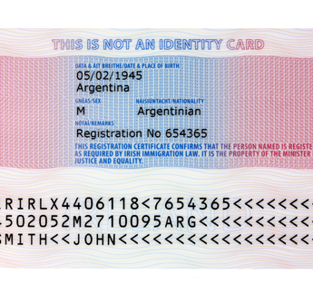
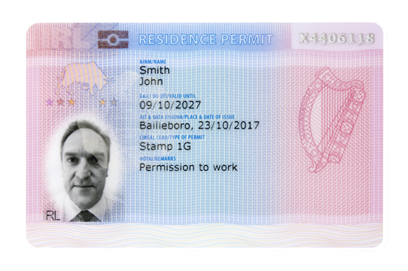
Irish immigration
After successful registration you will be issued with an IRP (Irish Residence Permit) card.
The IRP card is your proof of registration with the Irish Immigration services - it is an offence not to carry it on your person at all times.
If you lose your IRP card or if it is stolen, you should report the loss or theft to the nearest Garda (Police) station. You will be given an incident number. Please bring this incident number to the immigration officer and they will provide you with a free replacement IRP. If you are abroad, you should report it to the nearest police station and get a similar report. You should then go to your local immigration registration office with the lost/stolen report and your passport to get a replacement IRP card.

Slide 7
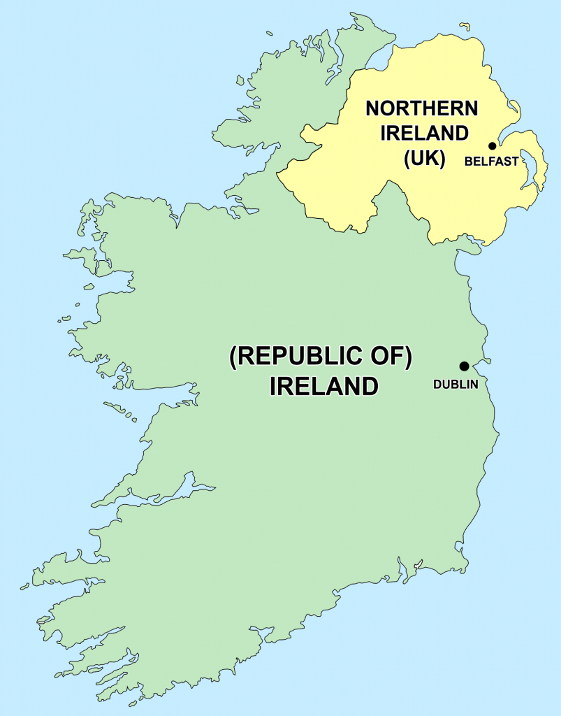
Irish immigration
Travelling to Northern Ireland
Check if you need a UK visa. How to apply for a visa to come to the UK: Choose a visa - GOV.UK (www.gov.uk)
Northern Ireland is a separate country. It is part of the United Kingdom of Great Britain and Northern Ireland. Your Republic of Ireland visa is not valid there.
The PSNI (Police Service of Northern Ireland) are conducting regular spot-checks.
From April 2025, all non-Irish and non-British citizens will need an ETA (Electronic Travel Authorisation) to enter the UK.

Slide 8
Opening a bank account
Opening a bank account in Ireland
You can only open an Irish bank account once you arrive in Ireland and complete your student registration with the university.
The quickest way to open a bank account is online with AIB - further details here: Quick sign up with AIB
The other Irish banks in Maynooth are Bank of Ireland and PTSB. These banks will require you to make an appointment to see them in person to open an account and you will also need to request a bank letter from the International Office. This process may take 2-3 weeks to complete.

Slide 9
Getting a PPS Number
Getting PPSN (Personal Public Service Number)
If you intend to work you should apply for a Personal Public Service Number - Further information on the Department of Social Protection here. Apply for it online via www.mywelfare.ie
To request an official letter from the University to prove your registration. You can get a proof of registration letter from Studentweb/Records Office please click here If you need a letter to prove your Irish term address please contact the Records Office on this form here (you will need to specify on the Records Office form that you need to have your study address included on their letter)
You can find full details of taxation and personal rates on the Irish Revenue website

Slide 10
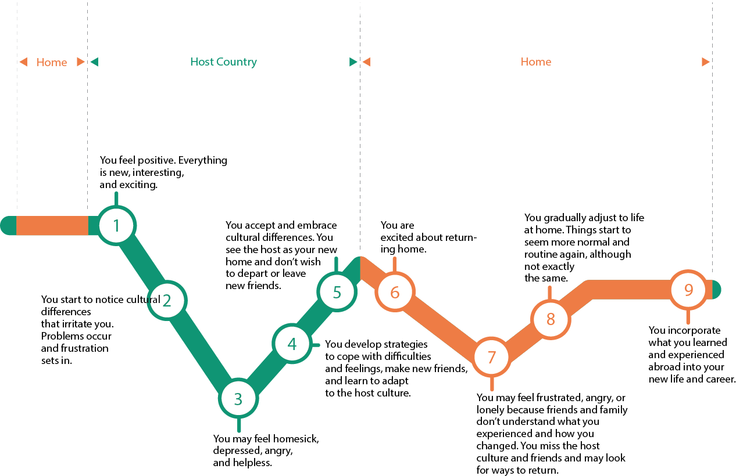
Culture shock

Slide 11
Culture shock
Culture "Shock": While the time of onset is variable, it usually occurs within a few months of entering a new culture and is a normal, healthy psychological reaction.
Symptoms may include:
Extreme homesickness
Depression, sadness, boredom
Irritability, including inappropriate anger and hostility
Excessive critical reactions to host culture/stereotyping
Feelings of helplessness/dependency
Sleep and eating disturbances (too little or too much)
While culture shock is common, relief is available. There are ways to minimise its effects -the first of which is to accept that it is a real phenomenon- and to learn to recognise its sometimes vague, if persistent, signs in yourself, as well as others.

Slide 12
Strategies to cope with culture shock
Be curious but non-judgmental
Be patient with yourself; be patient with others
Be flexible
Keep a regular schedule – sleep, rest, study, fun.
Eat well, exercise, get enough rest
Set attainable goals personally and academically
Talk about your concerns with a mentor/MU Counselling service
DON’T...
..fear the symptoms, it’s normal - It means you are learning.
..be afraid to make a mistake. - It is inevitable, engage humour.
..be overly critical of the host culture - accept the differences even if you can’t agree with them

Slide 13
Student supports
There are a range of student help services available on campus – from medical to academic advice to mental healthcare, etc.
www.maynoothuniversity.ie/studenthelp
The aim is to resolve any queries you might have, personal or academic.
studenthelp@mu.ie

Slide 14
Life in Ireland
Be cautious of storms – Met Eireann weather app for weather warnings (Yellow/Orange/Red) and rain radar map
Be cautious of ice/frost–slippery conditions, most of the two campuses will be iced/gritted but not all. Some footpaths, but not all.
Usually only very light snowfall for one or two days. Layer clothing in cold weather. Good shoes (rainproof) and a hat for cold days!
Daylight savings time – one hour forward in March (GMT+1), one hour back in October (GMT) (Spring forward, Fall back).

Slide 15
Introduction to ireland
Despite being a small country, there are a range of different accents, some are very strong! West Kerry sheep go missing Please be aware that it can take time to get used to the different accents in Ireland (both Irish and international)
Slang is used a lot! 117 Irish Slang Words (An Irishman's 2024 Guide) (theirishroadtrip.com)
Irish slang | Meaning
I will yeah | I will not
C’mere | Listen to me
Give me a ring/Ring me | Call (phone) me
The jacks | The toilet
Banjaxed | Broken

Slide 16
Introduction to ireland
Good quality meat and dairy produce – seafood near the coast
Four supermarkets in Maynooth – Tesco/Supervalu/Aldi/Lidl – Fresh vegetable/fruit shop near Tesco/Asia Market on the Main Street/Polish shops in Maynooth. Dublin City or online shopping for specialty food.
Cook at home to save money.
Traditional meals – Full Irish breakfast (pig products) and Irish stew (should be made with lamb). Also, the spice bag!

Slide 17
Introduction to ireland
Public holidays –often referred to as Bank holidays
2024 | 2025
1 January | 1 January
5 February | 3 February
17 March | 17 March
1 April | 21 April
6 May | 5 May
3 June | 2 June
5 August | 4 August
28 October | 27 October
25 December | 25 December
26 December | 26 December

Slide 18
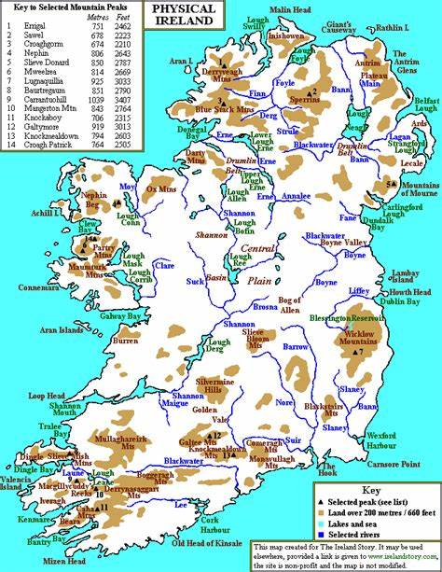
Introduction to Maynooth town
Irish name Maigh Nuadh meaning the Plain of Nuadhad
(Nuad, ancient Irish god).
In the county of Kildare
In the province of Leinster
Founded in 12th century, a significant medieval town.

Slide 19
Introduction to Maynooth university campus
Two universities on campus – Maynooth University and St. Patrick’s Pontifical University.
Maynooth University is a state university in the National University of Ireland federal system. Degrees are conferred by the National University of Ireland and Maynooth University. Parchments are in Latin – translations can be obtained from www.nui.ie
Original Royal College of St Patrick was founded in 1795. Maynooth University was created (as National University of Ireland Maynooth) in 1997, taking some departments from St Patrick’s College to form the new university. The name was changed to Maynooth University in 2016.

Slide 20
Introduction to Maynooth university campus

Slide 21
The academic year
3 February: Bank holiday (no lectures)
4-7 February: Lectures begin for 2nd Semester
17 March: St Patrick’s Day (no lectures)
18 April: Good Friday (no lectures)
21-25 April: Easter holiday for students
5 May: Bank holiday
6-9 May: Last week of Lectures for Second Semester
13-16 May: Study Period
16-31 May – Summer Examination Period
16- 20 September: Orientation week
23 – 27 September: Lectures begin
28 October – 1 November: Study week – bank holiday Monday 28th.
16-20 December: Last week of lectures
23 December – 3 January: Christmas Holiday
6-11 January: Study period
13-25 January – January Examination period

Slide 22
Campus security
Campus Security can be contacted 24 hours a day as follows: Tel: +353 (1) 7083929 (General/Emergency)
Campus Garda (Police Officer)
Security website – including gate opening times, etc – https://www.maynoothuniversity.ie/
Nationwide emergency number – 999/112 for all services

Slide 23
General tips and information
Make sure to keep your student record up-to-date via Student Web – especially study address, home address and emergency contact details.
Library – will be offering tours; keep an eye on their social media for details. Use the chat box on the website for queries. Keep an eye on LIST offerings.
International Office website – info for current international students
Join Clubs and Societies. Clubs = sports; Societies = activities www.mulife.ie
Volunteering is a great way to meet people – Maynooth Green Campus are always looking for student volunteers to help keep our beautiful campus clean and green.

Slide 24
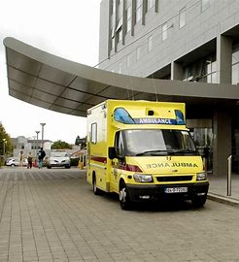
General tips and information
Emergency numbers – 999 or 112 Fire, Ambulance, Gardaí(Police) and Coastguard. The crime rate is low, however, please take precautions and look after your valuables. Hospitals and medical care are good quality and reliable. www.hse.ie
Tap water is generally safe to drink - www.water.ie
Power cuts – powercheck.esbnetworks.ie
Eircodes – unique code for every address in Ireland – www.eircode.ie
Good source of general information – www.citizensinformation.ie

Slide 25
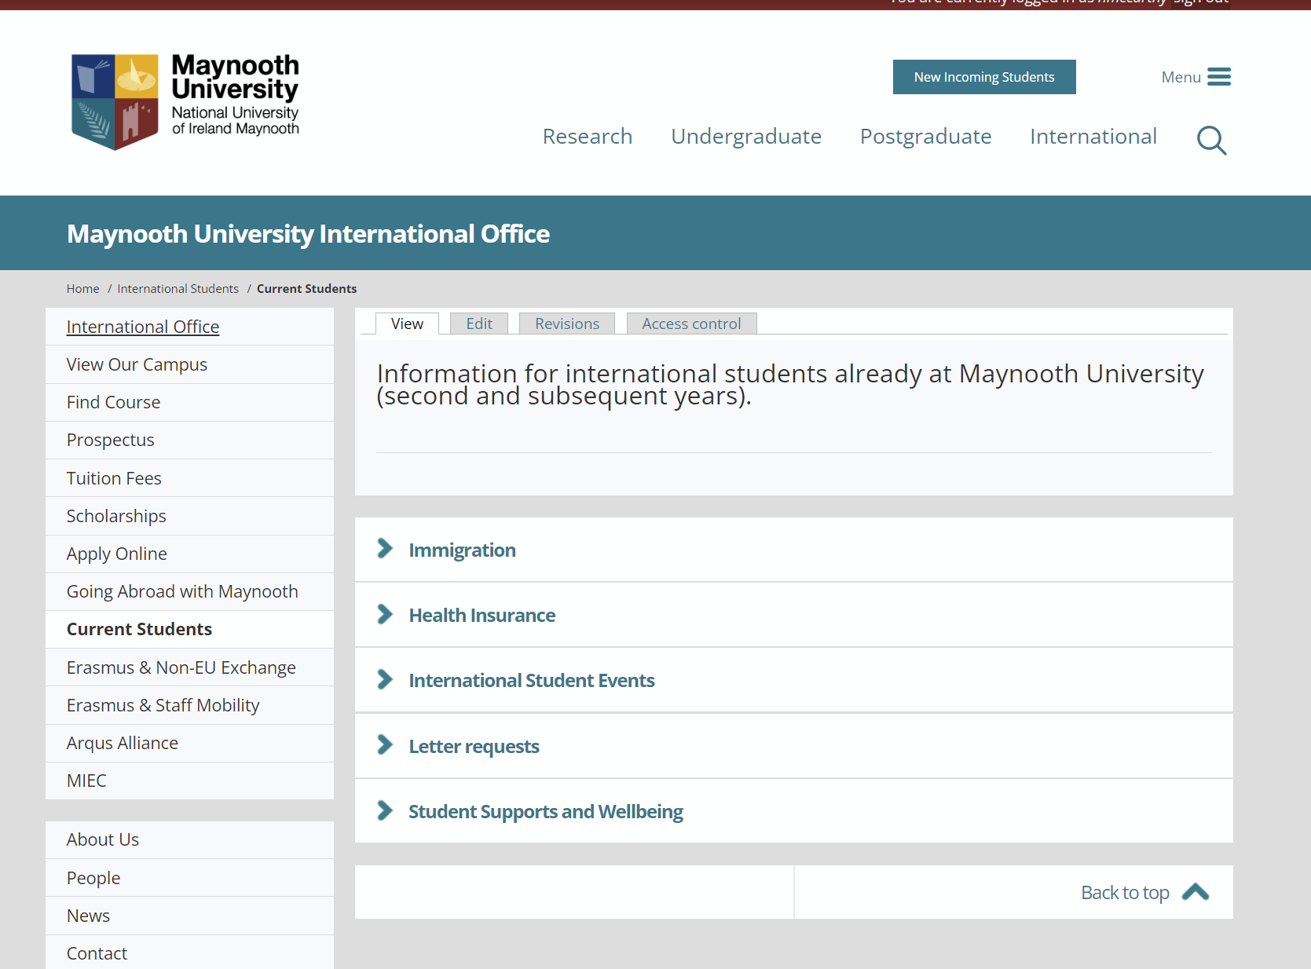
Events & Information for international students
There will be a series of events for international students held throughout the year– e.g. Céilí, Halloween, Christmas, Chinese New Year, Diwali, etc.
You will be invited by email and also keep an eye on information for current international students' section on International Office website

Slide 26
General tips and information

Slide 27
Best of luck!
Wishing you every success for the year ahead!
Study hard but don’t forget to have some FUN!
Helen.Kirrane@mu.ie

