Slide 1
Teacher CPD Workshop

Slide 2
Content of the following slides…
Two suggested ‘workshops warm up’ activities
A note on terminology
Six models of Team Teaching (see also poster with details and definitions)
Policy in the Irish context
Research: National and International
Activity to explore Benefits and Challenges of Team Teaching
Questions to consider … (see also Protocol document)

Slide 3
Warm up activity (suggestions)
1. Colour cards activity
2. Move if you… activity
In this activity the facilitators ask participating teachers to identify what ‘colour’ they are. Coloured cards could be distributed to each table to allow the teachers to pick a colour and hold up the card.
The activity allows a quick ‘show of hands’ in different categories and chance for teachers to air concerns before the workshop starts.
It also usually demonstrates that more people are either cautiously optimistic or enthusiastic than might you might think!
The options could be for example: red, yellow blue & green:
Alternatively, all participants could be asked to stand on one side of the room. They move if any of these statements apply to them. Start with some fun statements first: If you … have a dog’; …own a wetsuit (or whatever!!).
Move to the other side of the room if…
You have been team teaching in the past year. You came to the workshop because you had to! The thought of Team Teaching fills you with joy (fear, dread …?!) You think Team Teaching will be professionally rewarding You think TT is not a realistic option in your school You think Team Teaching would be a positive thing for pupils You have previously done CPD in Team Teaching ... You were ever a pupil in a class that was “team taught” …
The idea here is to start a conversation about team teaching if it is new or just being introduced in the school. It will identify which teachers have some experience of it and can speak about this experience. The activity is deliberately messy and chaotic to help create a relaxed atmosphere. If the room is small they can be asked to ”take a step if….”. Or if there is no room to move teachers can be asked to stand up or sit down. Facilitators can add or substitute any questions as suits the situation.
Dubious
Hesitant
Cautiously optimistic
Enthusiastic

Slide 4
Terminology
Co-operative teaching? Co-teaching? Team teaching?
‘The term “co-operative teaching” [denotes] any arrangement whereby two or more teachers work together in a collaborative manner with a class of students who have diverse learning needs.’ DES (2007). Inclusion of Students with Special Educational Needs: Post Primary Guidelines. (p. 53).
‘Team teaching is when two (or more) teachers share the instructional responsibility for a class, including planning and evaluation. They share the leadership of the class and responsibility for all students.’ County Cork VEC (2011). Team Teaching Guidelines for Schools/Colleges. Co Cork VEC
'Co-teaching may be defined as the partnering of a general education teacher and a special education teacher or another specialist for the purpose of jointly delivering instruction to a diverse group of students, including those with disabilities or other special needs, in a general education setting and in a way that flexibly and deliberately meets their learning needs' (Friend et al., 2010: 11).

Slide 6
Which model is ‘best’?
No single model is better than any other!
Teachers/schools are advised to adopt (and adapt) one model or use a combination of different models depending on their own circumstances and based on the identified learning needs of the pupils.
An over-reliance on any one model is best avoided.
It is also advised that teachers (with similar content knowledge) move between roles to avoid ‘typecasting’ one teacher to perform only certain roles with certain students.

Slide 7
Policy in the Irish context

Slide 8
Circular no. 0014/2017
Special Education Teaching Allocation
The range of teaching supports should include team-teaching, small group teaching and, where necessary, individualised teaching to address specific learning needs. …
Individualised learning needs can be addressed in a variety of ways and should not be solely equated with withdrawal from class for one-to-one or group tuition. Configurations of team-teaching have been shown to provide an appropriate model for engaging with individual needs in the collective setting of the classroom. As necessary, this can be combined with withdrawal for intensive teaching of specific skills, based on level of need. …
The provision of support for small groups of students, or use of in class support teaching for a number of students, as opposed to primarily one to one teaching, also means that qualifying students will often be able to receive more support than they otherwise would have done. (p. 18)

Slide 9
Research on Team Teaching: Irish Context
Team teaching a practice schools want to introduce but don’t know how to (Shevlin et al., 2009)
Team teaching under-researched in Irish context, especially in relation to process (Shevlin et al., 2009; Murphy, 2011)
Low levels of professional collaboration in Irish schools (Hogan et al., 2007; OECD [TALIS], 2009; Gleeson, 2012)
“...they [teachers] highlight the prevalence of professional insulation and isolation, as distinct from proactive professional co-operation, in the inherited cultures of post-primary education in Ireland.” (Hogan et al., 2007:34)

Slide 10
Research on Team Teaching: International
TALIS report (OECD 2009)
Collaboration a challenge in most countries but less collaboration the closer one gets to a classroom!
Low levels of Exchange & Co-ordination for Teaching (sharing resources, discussing individual students)
Still lower levels of Professional Collaboration associated with effective teaching (engaging in joint activities across classes, observing and giving feedback)

Slide 11
Research on Team Teaching: International
TALIS report (OECD 2009)
52% had never received feedback on their teaching from other teachers and/or school management
75% engaged in Team Teaching less than once a year (or never)
95% engaged in Teacher Observation less than once a year (or never)
18% had visited other teachers’ classrooms
7% had engaged in observation in other schools

Slide 12
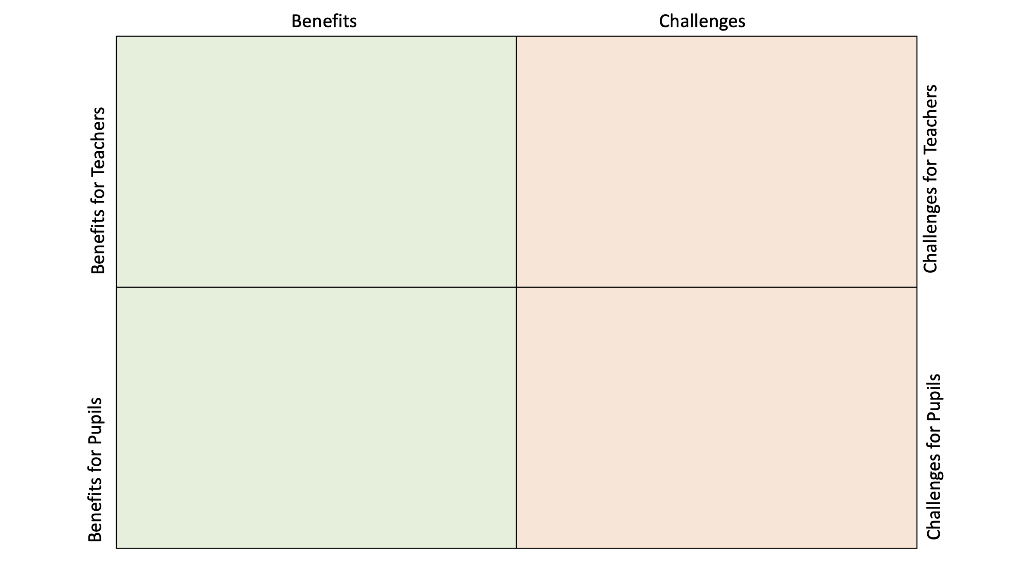
Activity: Explore the Benefits and Challenges…
Use a group activity to allow teachers to identify and discuss the benefits and challenges of team teaching
Create groups of four or five and allow time for discussion and feedback.
Depending on the number of groups give some the task of identifying the benefits while other groups tease out the challenges.
These could be divided further into:
Benefits for Teachers/Benefits for Pupils
Challenges for Teachers/Challenges for Pupils
Use a quadrant on the board or flipchart to gather the feedback…

Slide 13
Potential benefits of TT for teachers’ CPD
These ideas arise in the literature on Team Teaching but can also be elicited from staff through an activity asking teachers to identify the ‘benefits’ and ‘challenges’ they see in adopting Team Teaching…
Preparation
Planning and sharing of views and ideas for the betterment of students
Creation
Managing, teaching and learning in a more positive environment
Observation
Modelling and comparing styles and teaching strategies
Experimentation
Exploring different pedagogical ideas and approaches
Collaboration
Working together in a spirit of mutual support
Information
Teaching and learning
progress and outcomes
Induction
Sharing experience and resources e.g. electronic resources
Reflection
Opportunity to evaluate one’s own style/practice

Slide 14
Benefits for Pupils (Contrasting withdrawal & TT)
Withdrawal Offers…
Team-Teaching Offers…
Confidentiality
Quieter environment
More time and individualised attention
More appropriate pace
Easy use of ICT
Similar ability groups
Concentration level
Self-esteem
Continuity of learning
Social inclusion
Interactivity and engagement
Practical benefits
Peer support
Experience different teaching methods

Slide 15
Activity: thinking through the concerns
Questions intended to explore concerns teachers often have … and discuss how these may be overcome!
Where will we get time to plan?
How do we ensure that the workload will be shared equally?
Will team-teaching classes be stigmatised?
Will it cause a strain on staff relationships?
Will parents agree to this form of support?
Will all students benefit?
How will we assess/review/evaluate progress?
What if it doesn’t work out?

Slide 16
Considerations for teachers
Start on a small scale and slowly to avoid over-load
Initial stages can take hard work, collaboration, open mindedness and dedication
Team teaching should be part of a flexible menu of options to support teachers and students
Clarify roles and responsibilities
Establish a common framework for team teaching
Planning, delivery and review
Respect each other's skills and motivation
Both teachers should be seen as equals in team teaching
Set a review date – Reflect, re-design and celebrate!
See additional resources in the ‘Team Teaching Toolkit’ that accompany these slides.

