Slide 1
Irish immigration

Slide 2
Irish immigration
Registering for permission to remain in Ireland after arrival. If you are not a citizen of the European Economic Area (EEA), the United Kingdom or Switzerland, you must have permission to remain and register your presence in Ireland with Immigration Service Delivery (ISD). This applies even if you did not require a visa to enter Ireland. Once your permission to remain is complete you will receive an Irish Residence Permit (IRP) card. Please take care of this card and carry it with you while you are in Ireland. You will need to renew your permission to remain every year.
It is your responsibility to ensure that your immigration status is up-to-date.
You need to have completed registration with the University before you register with Irish Immigration.

Slide 3
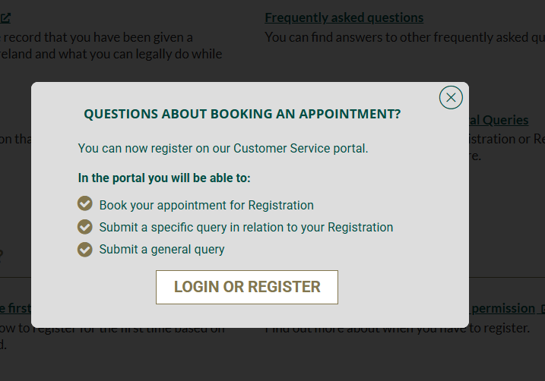
Irish immigration
First time registration - there have been recent changes
The first time registration of Irish Residence Permits for students will be carried out by the Immigration Service Delivery (ISD) at the Registration Office, 13/14 Burgh Quay, Dublin 2, D02 XK70. Located next to Tara Street Train Station.
Register for an appointment first
Must be completed within 90 days of arrival PLEASE NOTE:
Online portal for immigration registration appointments - Registering your immigration permission - Immigration Service Delivery

Slide 4
Irish immigration
Required documents to bring with you on the day - Please consult this page before you travel for your appointment: Required Documents - Immigration Service Delivery (irishimmigration.ie)
You are applying for Stamp 2 permission
Proof of registration letters (full-degree students only) require a proof of registration letter from the Records Office via this link - it is called a Certificate of Registration Proof of tuition fees paid can be provided by Transfermate (if you have used this service to pay your account) or by requesting proof of payment from our Student Fees Office.
Cost is 300 euro – no cash accepted
Print out the email confirming your appointment and bring it with you on the day.

Slide 5
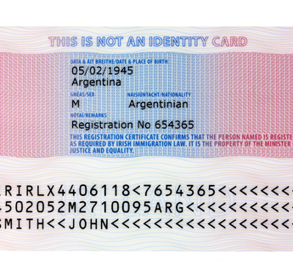
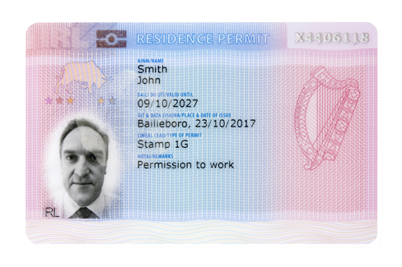
Irish immigration
After successful registration you will be issued with an IRP (Irish Residence Permit) card.
The IRP card is your proof of registration with the Irish Immigration services - it is an offence not to carry it on your person at all times.
If you lose your IRP card or if it is stolen, you should report the loss or theft to the nearest Garda (Police) station. You will be given an incident number. Please bring this incident number to the immigration officer and they will provide you with a free replacement IRP. If you are abroad, you should report it to the nearest police station and get a similar report. You should then go to your local immigration registration office with the lost/stolen report and your passport to get a replacement IRP card.

Slide 6
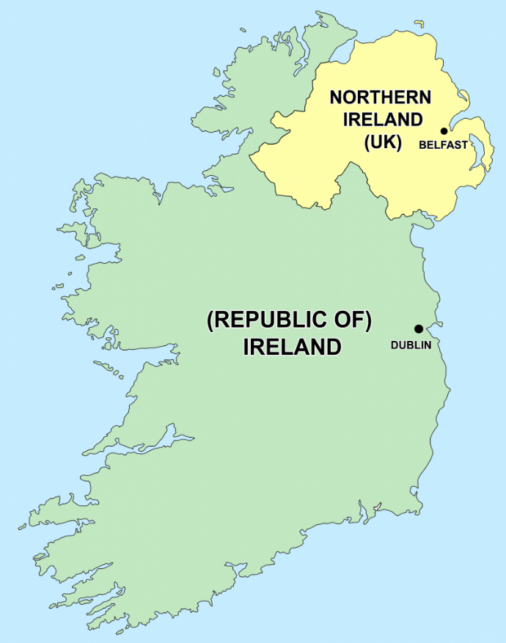
Irish immigration
Travelling to Northern Ireland
Check if you need a UK visa. How to apply for a visa to come to the UK: Choose a visa - GOV.UK (www.gov.uk)
Northern Ireland is a separate country. It is part of the United Kingdom of Great Britain and Northern Ireland. Your Republic of Ireland visa is not valid there.
The PSNI (Police Service of Northern Ireland) are conducting regular spot-checks.
Also check if you need to complete an EFTA -

Slide 7
Questions and answers time
Please ask us any questions you may have

