Slide 1
Timetable Questions & Answers
International Students

Slide 2
What’s in this presentation?
Link to Course finder and how to use (shows module details and class times*)
What are the timetabled hours in Maynooth University?
When and how is the timetable compiled?
A note about postgraduate modules
How can I see class times before I register my choices?
Online Timetable Viewer – links and how to use
When will I see my personal timetable?
Accessing your personal timetable
Understanding your personal timetable
Example of a clash on the timetable
Modules and classgroups
Need help?
Timetabling Office – Timetable@mu.ie
Notes:
*Class times for the academic year will show on the Timetable link and on Coursefinder from late August before the start of term in late September

Slide 3
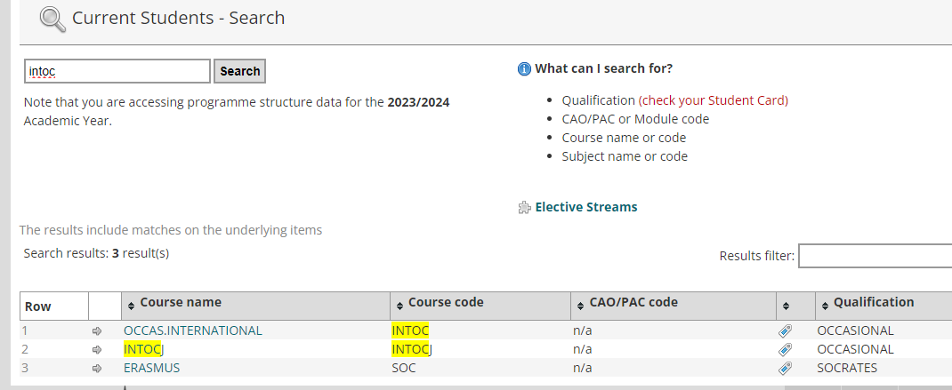
Link to Coursefinder and how to use it
Coursefinder is where you can see key information about the modules you will take when you come to MU
Use the search box to enter or INTOC (for Study Abroad) and a list of modules available to international students will show –select SOC for Erasmus students
Timetabling Office – Timetable@mu.ie

Slide 4
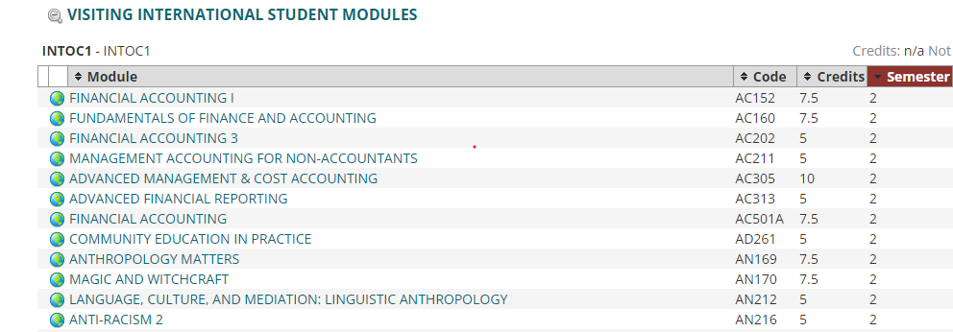
Using Coursefinder
Click on any of the modules on the list (here showing only semester 2), and further detail – including assessment, workload and timetable information will show
Timetabling Office – Timetable@mu.ie

Slide 5
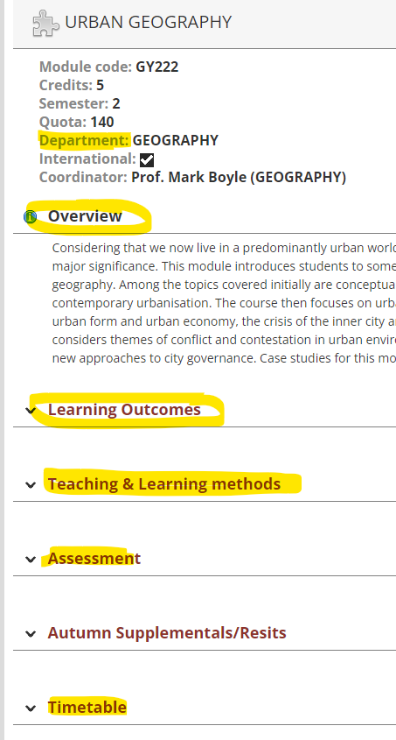
Using Coursefinder
E.g if you click on GY222, all the information relating to that module will show
Timetabling Office – Timetable@mu.ie

Slide 6
Timetabled hours in Maynooth
What are the timetabled hours in Maynooth University?
Monday-Thursday 9.00-18.00 and Friday 09.00-17.00
Classes can be scheduled at any time between these hours and days
It is common for students to have classes on different days and gaps between classes, as their timetable will depend on their module selection
Classes will appear on the timetable as running for one hour, but the norm is they start at 5 minutes past the hour to 5 minutes to the next hour (to give students time to move between classes)
Timetabling Office – Timetable@mu.ie
Notes:
Classes can be scheduled any time between these hours
It is possible that not all International Students’ module choices will be processed and recorded before the start of term and therefore you will not have a timetable until close to the start of term or some time into term

Slide 7
When and how is the timetable compiled?
When and how is the timetable created?
We schedule classes before students register, not after, and not all combinations of modules will be possible to take.
Subjects are grouped together so they are on at the same times in the University – please see this link for the subject groups
Students should be aware that modules from different years of study (e.g. 2nd year and 3rd year – i.e. coded with a 2 or 3 –e.g. PS255/PS355) are often scheduled at the same times and may clash.
Timetabling Office – Timetable@mu.ie
Notes:
Classes can be scheduled any time between these hours
It is possible that not all International Students’ module choices will be processed and recorded before the start of term and therefore you will not have a timetable until close to the start of term or some time into term

Slide 8
A note about postgraduate modules
Many modules coded ‘6’ (or higher) are postgraduate modules – they are primarily aimed at students who have already completed an undergraduate degree
These modules may be more difficult than undergraduate modules
Postgraduate modules are not all centrally timetabled, so it is difficult to know in advance if they will clash
If you do not see times displayed on the Timetable Viewer or Coursefinder, you will need to contact the relevant academic department for class times
If you have a clash, it may be possible to switch to a similar module with a different code – e.g. GY333 – Global Foodscapes covers similar themes to GY699HI- Global Foodscapes
Timetabling Office – Timetable@mu.ie

Slide 9
How can I see class times before I register my choices?
Course finder brings you to detailed information in relation to your course – including information on modules such as what it’s about, how the module will be assessed (% assigned to continuous assessment or exam); and when and where it is scheduled.
Search INTOC (International Occasional) or SOC (Erasmus) for modules available to international students
Use the search function (CTRL+F) to search for key subject areas that interest you or are part of your programme of study at your home University
Do your research before you make your selection on IMAS - it is better to check if modules clash before signing up to them
Timetabling Office – Timetable@mu.ie

Slide 10
How can I see class times before I register my choices?
Note: if a module is timetabled centrally – the timetable will show on the module descriptor.
If it is not timetabled centrally, students should contact the relevant academic department – links here
It is also possible to view a number of modules at the same time – go to the Departments link on the Timetable Viewer
Click on the relevant department or School (this is listed against all modules in each module descriptor)
Do not select a Course, press the Continue button
Do not select a Programme, press the Continue button
If you are here for one semester, choose either semester one or two, then press Continue
Then choose the modules you are interested in from the list you have looked at on Coursefinder
Timetabling Office – Timetable@mu.ie

Slide 11
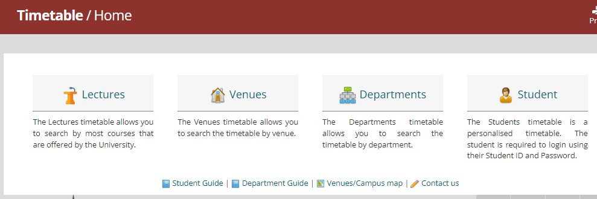
Timetable – links and how to use
The timetable link will bring you to the academic timetable
Https://apps.maynoothuniversity.ie/timetable/
Timetabling Office – Timetable@mu.ie

Slide 12
When will I see my personal timetable?
When will I see my personal timetable?
Students will begin to see modules on their timetable once their registration is processed by the Student Records & Registration Office*.
In the meantime, if the semester has started and you don’t have a personal timetable, you should use the steps outlined in the previous slide
Changes to registration will result in changes to your timetable
Not all class contact hours will appear on your personal timetable
Conversation classes, tutorials and practicals are managed by academic departments, and they will tell you when and how you need to sign up and attend
Often sign-up is done through Moodle, so make sure you log in and check
Timetabling Office – Timetable@mu.ie
Notes:
It is possible that not all International Students’ module choices will be processed and recorded before the start of term and therefore you will not have a timetable until close to the start of term or some time into term

Slide 13
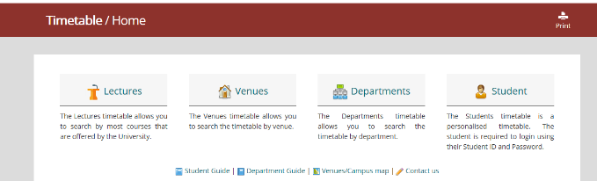
Accessing your personal timetable - Timetable :: Home - Home (maynoothuniversity.ie)
Timetabling Office – Timetable@mu.ie
Notes:
Timetable :: Home - Home (maynoothuniversity.ie)
Student – personal timetable
Departments – e.g. English, History, School of Law and Criminology, etc
) Lectures - allows you to search by course e.g. BACHELOR OF ARTS 1 (MH101)
2) Venues – allows you to search to see what’s in a room at a given time (more relevant for academic departments than students)
3) Departments – allows you to see every activity i.e. both Lectures and Tutorials for the Department
4) Students – this is a personalised timetable that you need to log in to view. There is work involved in allocating students to classes to make the personalised timetable work and this takes some timeThere are guides and useful information available at the bottom of the page.

Slide 14
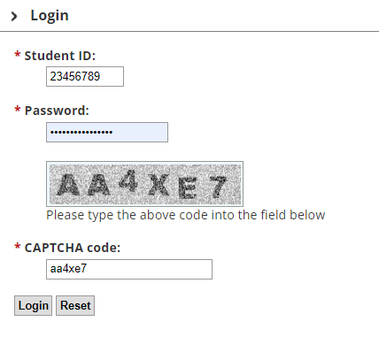
Accessing your personal timetable
Login is your student ID
Password is your MU password
Password must not have a space in it!
Enter CAPTCHA code – will be different every time you log in
Note: most postgrad and Froebel students will not have a personal timetable!
Timetabling Office – Timetable@mu.ie
Notes:
Timetable :: Home - Home (maynoothuniversity.ie)
Student – personal timetable
Departments – e.g. English, History, School of Law and Criminology, etc
) Lectures - allows you to search by course e.g. BACHELOR OF ARTS 1 (MH101)
2) Venues – allows you to search to see what’s in a room at a given time (more relevant for academic departments than students)
3) Departments – allows you to see every activity i.e. both Lectures and Tutorials for the Department
4) Students – this is a personalised timetable that you need to log in to view. There is work involved in allocating students to classes to make the personalised timetable work and this takes some timeThere are guides and useful information available at the bottom of the page.

Slide 15
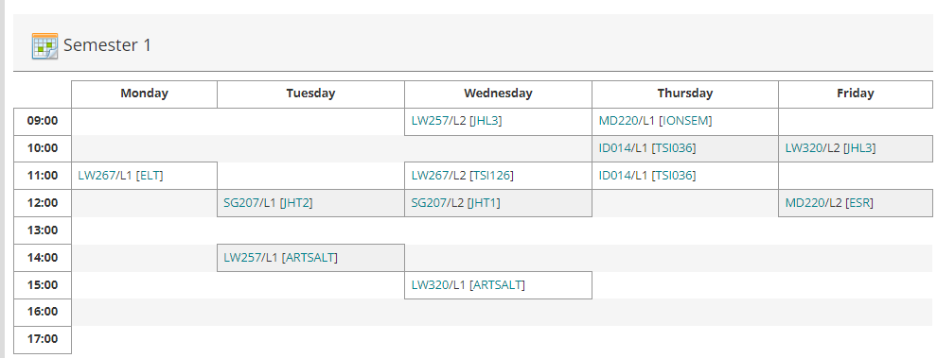
Understanding your personalised timetable – sample below
Timetabling Office – Timetable@mu.ie
Notes:
Module code appears first – L1 means lecture one (of 2 or 3)
Venue appears in square brackets [ELT – Education Lecture Theatre], JHL3 is John Hume Lecture Theatre 3, TSI036 is in the TSI Building

Slide 16
‘Reading’ the timetable- key points
L1/L2/L3, etc. refer to Lecture 1, Lecture 2, Lecture 3. Most modules have 2 lectures per week and students need to attend all of these.
Classes are generally 1 hour long with the lectures as two separate hours in the week. However, sometimes the lecture will be 2 hours long occurring only once a week.
T1/T2 or TUT1, TUT 2 refers to tutorials. (In general students do not need to attend all of these, but will have a choice about which to attend – see your academic department for further information)
E.g. EN243 has 3 of tutorials – EN243/T1 – that show on the timetable, but students will choose one of these 3 tutorial
P1, P2, P3 refers to practicals. These are managed by the relevant academic department.
The registration system will allow students register to modules that may have a timetable clash. The student must check the times of modules before they register to ensure there is no clash.
Timetabling Office – Timetable@mu.ie

Slide 17
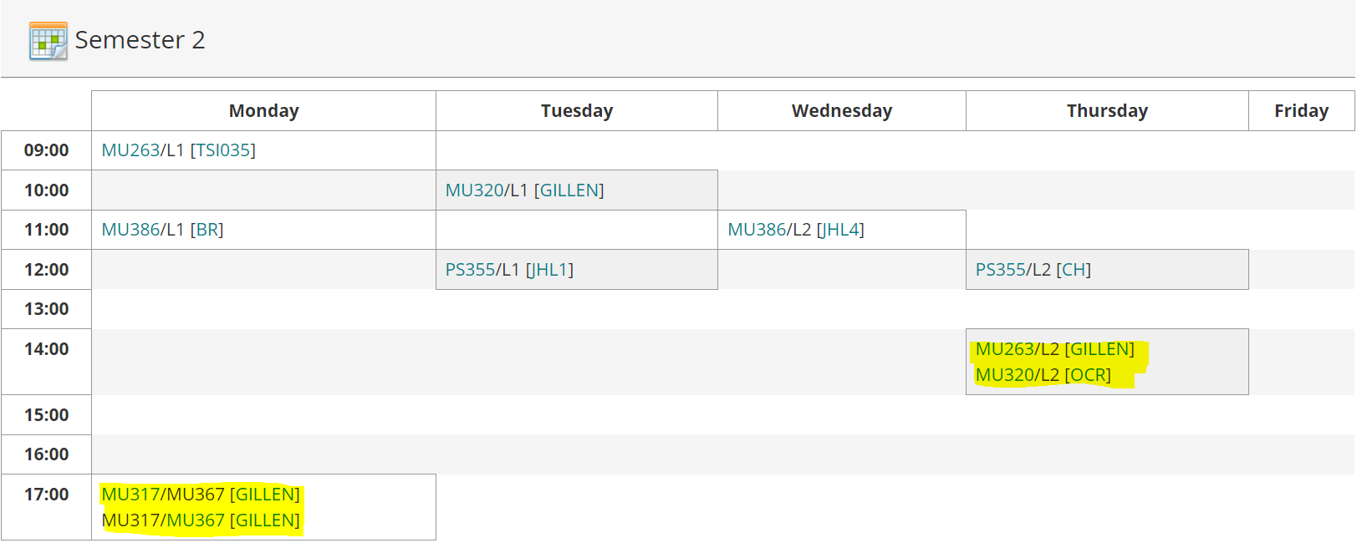
Example of Clash on Timetable
Timetabling Office – Timetable@mu.ie
Notes:
We see a lot of clashes for students who’ve chosen Psychology modules. Modules for different years are on at the same times, and we cannot avoid clashes in these cases. We recommend that students change modules – we know that this can be difficult because of learning agreements, but in general, this is our recommendation. Lectures are not delivered online, and usually attendance is required. We cannot insist you change modules, but the times for these modules will not change.

Slide 18
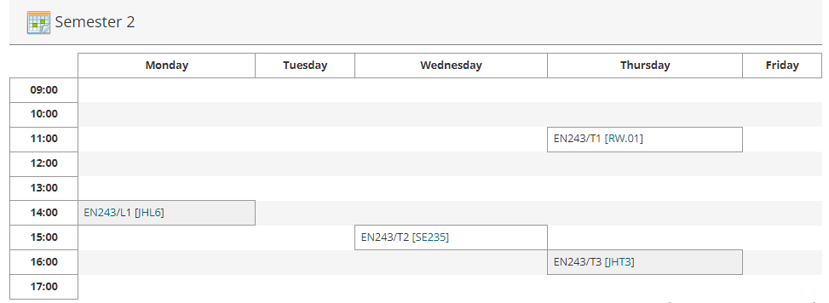
Example of Tutorials
Timetabling Office – Timetable@mu.ie
Notes:
L1 is

Slide 19
Modules and classgroups
Some Business, Maths, Economics and Law modules are taught more than once; on the general timetable, they will appear with /A or /B or /C after the module code
If you click on any module on your timetable, it will bring you to coursefinder where you will see the module description. If there are /A or /B or /C after the module code, that means there is more than one classgroup and it may be possible for you to attend without clashes.
Your personalised timetable will only show the group you are registered to and these are the lectures you should attend!
If you need to be in a different classgroup, please email the Timetable Department and we will move you where possible.
Timetabling Office – Timetable@mu.ie

Slide 20
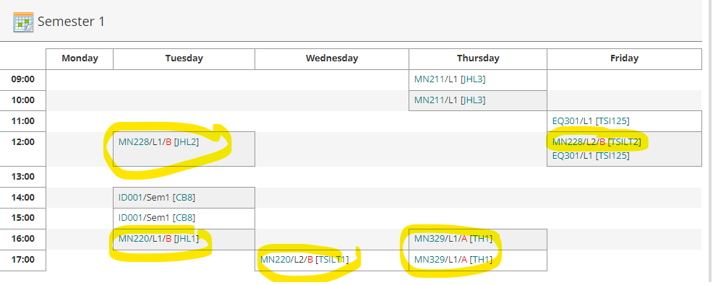
Modules and classgroups
Timetabling Office – Timetable@mu.ie
Notes:
In this example, all the modules that are circled have classgroups, so there is another time when this class is on. Although we have to put students into one classgroup per module – e.g. MN228/A, if the student can attend the 2nd lecture of B and the first lecture of A, this will help avoid having to change modules. In all of these cases, if you click on the module in the timetable, it will bring you to the module descriptor, and this will show when the other classtimes are on.

Slide 21
Critical Skills
If you are doing Critical Skills you will have registered to a particular group through the registration system (a different core hour group) . SK1051, SK1052, SK1053, SK1054, SK1055, or SK1056.
All classes in each group are on at the same time. You will be further allocated into classgroups, (such as SK1051/A or SK1051/B). See your personalised timetable to see which class you have been allocated to.
As all classes in your group are on at the same time we will not be able to facilitate moves between classes.
If, for any reason, you need to move to a different group (e.g. from SK1051 to SK1052) you will need to deregister from SK1051 and reregister for SK1052.
Timetabling Office – Timetable@mu.ie

Slide 22
Other points
The timetable is subject to change – especially venues
Not all contact hours are scheduled centrally and so will not appear on your personalised timetable – e.g. practicals, language labs, and tutorials.
Students must familiarise themselves with their own tutorial and practical timetable. Students are responsible for checking their own timetable prior to going to class.
Some modules – e.g. Business, some languages, are delivered more than once; students must attend their assigned times.
When emailing any office in the University (Timetabling, Student Records, etc.) always include your student number!
Note that the personal timetable is not always available*; there will be an advisory message indicating if it is down for maintenance, etc.
Lots of change – especially to venues – in the first couple of weeks of term.
Timetabling Office – Timetable@mu.ie
Notes:
It will not be available for many postgraduate modules and for Froebel and Education modules.

Slide 23
Need help with your timetable?
Email: timetable@mu.ie
Phone : 01 7083626
(Monday-Friday 09.00-13.00 and 14.00-17.00)
Please include your student number in all correspondence with the University
https://www.maynoothuniversity.ie/timetabling
Thank you
Timetabling Office – Timetable@mu.ie

