Slide 1
U.S. Embassy Dublin
Information for U.S. Students in Ireland

Slide 2
Where to find us
The U.S. Embassy is in South Dublin at 42 Elgin Road, Ballsbridge, Dublin 4.
Bus routes that stop at the Embassy are bus numbers 4, 7, 7A and S2.
Notes:
The U.S. Embassy is located in south Dublin
As you can see it is a unique building, if getting a taxi any taxi driver will be able to bring you to it.

Slide 3
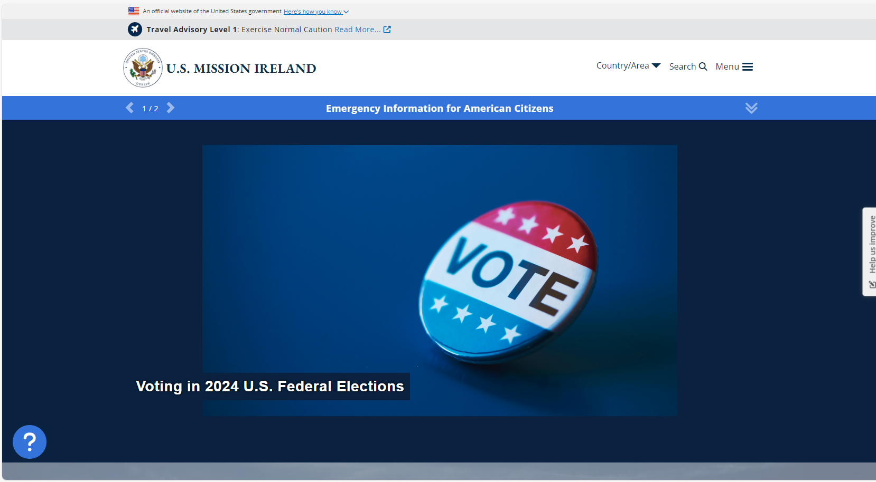
Our Website: https://ie.usembassy.gov/
Notes:
Our website is ie.usembassy.gov, here you will find all of the information on the services we provide for U.S. citizens in Ireland.
When accessing the menu you will find pages for passport applications, U.S. citizen services and notarials.

Slide 4
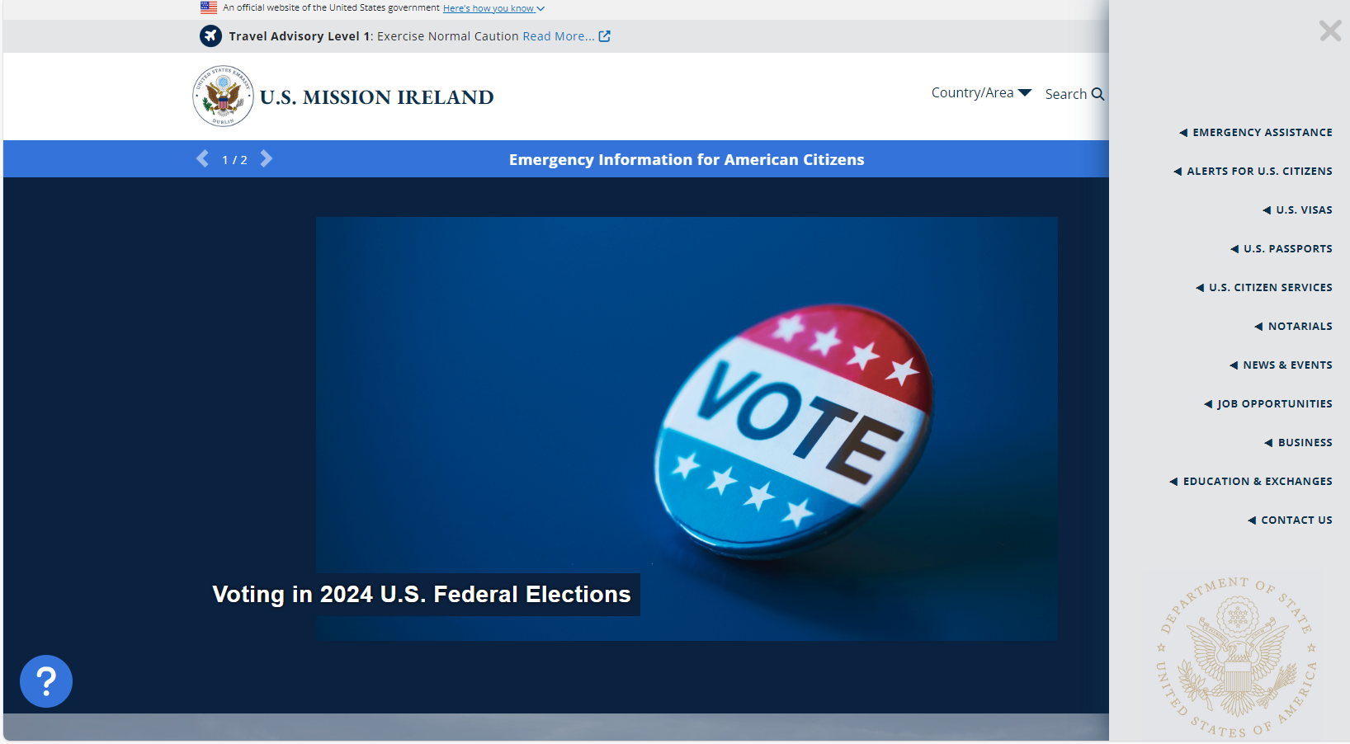
Our Website: https://ie.usembassy.gov/
Notes:
When accessing the menu you will find pages for passport applications, U.S. citizen services and notarials.

Slide 5
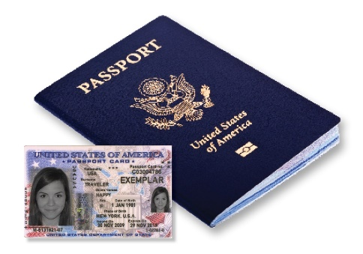
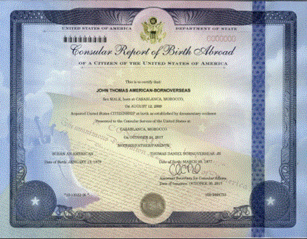
What We Do – Overview
Routine Services
Passport renewals
Emergency passports applications
Check travel requirements at https://travel.state.gov/content/travel/en/international-travel.html
Consular Report of Birth Abroad
Notary Services
Special Consular Services
Privacy Act
Arrested overseas
Victim of Crime
Absentee Voting – www.fvap.gov
Irish Immigration
We cannot assist you with Irish Immigration queries
https://www.irishimmigration.ie/
Notes:
Passport services. Passports are your ticket to seeing the world. It is important to note that different countries have different requirements for U.S. Citizens to enter them.
Many countries require either 3 or 6 months validity from the date of departure on your U.S. passport. If you are planning to do some traveling while in Ireland, we strongly recommend you check the requirements of the country you are travelling to.
All the instruction to renew a U.S. passport can be found on our website. You will need to complete the online application and pay your fees.
Emergency Passport: If you lose your passport, and need to travel within a few weeks, you can apply for an emergency passport at the U.S. Embassy.
These passports are only good for a year. It is important to note that an emergency passport is primarily for return to the U.S., although many countries do accept this passport there are a number that do not.
To apply for an emergency passport, you will need to visit our website, ie.usembassy.gov and schedule a passport appointment. There are clear instructions on our website on the passport page explaining what to bring to your appointment. You will need to complete the online application and pay your fees.
Notary Services: Should you need a notary service while you are abroad, perhaps to give power of attorney to someone or if you are buying a house! this can be completed at the U.S. Embassy.
As with passport applications you do need an appointment for this service and there is a page on our website dedicated to Notaries where you can schedule an appointment.
Privacy Act: The Privacy Act prohibits us from speaking with anyone about you or your situation without written consent from you. For example, should a parent or guardian contact us as they have not heard from you for a while we cannot give them any information about you without your permission.
Arrested Overseas: If arrested while in Ireland, you should notify the U.S. Embassy.
We can visit you in jail to ensure you are receiving appropriate treatment under the Geneva Convention. We can supply you with a list of lawyers in Ireland. If you wish for us to contact your family, we can do so after receiving your written consent.
We cannot work with law enforcement on your behalf to have you released or provide you with legal advice.
Victim of Crime: You should file a report with the police service in Ireland, An Garda. If you need assistance from the Embassy, you can reach out to us through our website. As we have covered if you would like us to contact family or friends, we just need written consent.
There are local resources also available for you:
School resources
Tourist Assistance Services (Tourist SOS) www.touristsos.ie
Dublin Rape Crisis Centre www.drcc.ie
Absentee Voting: U.S. citizens who are 18 or older are eligible to vote in Federal elections while abroad.
You need to register to vote and request your ballot on www.fvap.gov, you will have to register annually.
Your ballot will be received at least 45 days before an election and will include a preaddressed envelope to return your ballot.
Although you can bring this ballot to the U.S. Embassy to be returned through the Diplomatic ouch the quicker way to return your ballot is to send it through the Irish Postal system and pay for the international postage.
Irish Immigration: The U.S. Embassy cannot advise you on or help you with the process for Irish Immigration. For any questions on this process, you must visit www.irishimmigration.ie.

Slide 6
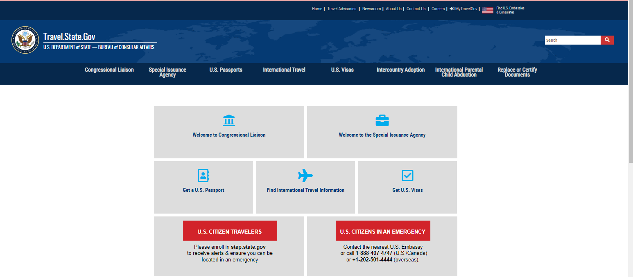
State Department Website: Travel.State.gov
Notes:
Here you will find information on:
Under “Before you go” you will find:
Smart Traveler Enrollment Program (STEP): it is recommended you register in this program to ensure the Embassy knows that you are in the country and allows us to send you routine messages and alerts about the country you are in
Traveler Information; There is a dedicated section to U.S. Students abroad
International Travel – You can search by the country you wish to travel to. This area will give you the requirements to travel to the country and any pertinent information about the country.
Insert random travel advisory to random European country.
Apart from what is noted above there is a wealth of information on this website that you may find useful.

Slide 7
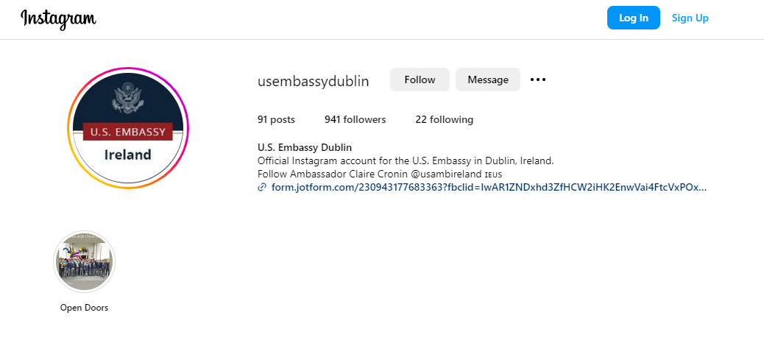
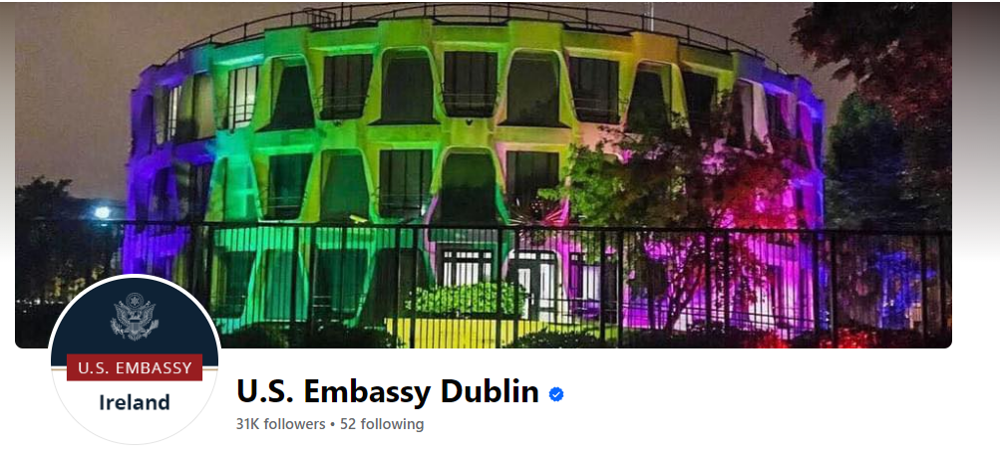
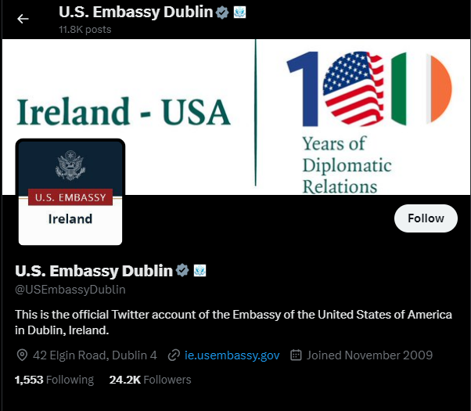
Let's Get Social!
Follow us @usembassydublin
Notes:
Stay connected with us through our social media handle @usembassydublin and follow us for the most up-to-date information!

Slide 8
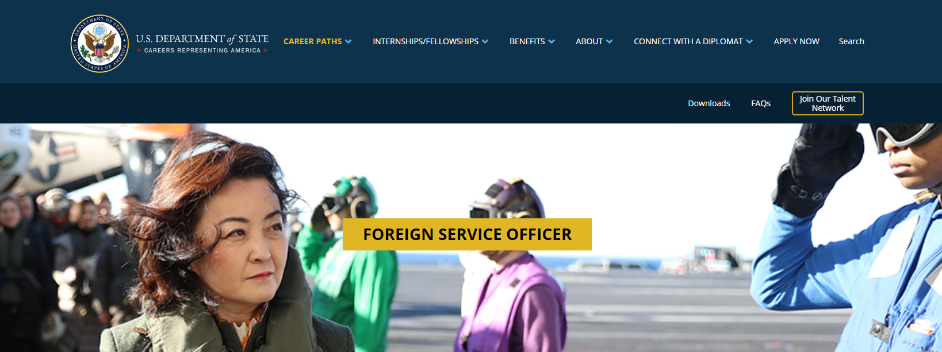
Working for the Foreign Service
https://careers.state.gov/career-paths/foreign-service/officer/
Notes:
As you are all in Ireland to study abroad you may be interested in a career in the Foreign Service. A job which allows you to travel, experience other cultures and help U.S. Citizens!
The mission of a U.S. diplomat in the Foreign Service is to promote peace, support prosperity, and protect American citizens while advancing the interests of the U.S. abroad.
There is a place for everyone in the foreign service, regardless of your interests
Online application: Foreign service officer assessment (FSOA)

Slide 9
Embassy Top Tips
Call your family
Don’t bring your passport out as a form of ID
Check your passport validity- renew now if you have less than six months
Make sure a relative or friend has a copy of your passport
Register for STEP www.step.state.gov
Register to vote (if you want to) www.fvap.gov
Make the most out of your time in Ireland!

Slide 10
Thank you.
Questions?

